Slide 1

Murat Güray Kirdar
Professor, Boğaziçi University
Ph.D. in Economics, University of Pennsylvania
Development Economics, Labor Economics

Slide 2
Estimating Returns to Schooling when Average and Local Average Treatment Effects are almost Equal
Ragui Assaad, University of Minnesota
Abdurrahman Aydemir, Sabancı University
Meltem Dayioglu-Tayfur, Middle East Technical University
Murat Güray Kırdar, Boğaziçi University

Slide 3
This study estimates the causal effect of the education on earnings in Egypt.
For this purpose, we use the education reform of 1988—which reduced the duration of compulsory primary school from 6 to 5 years.
The policy led to a sharp decrease in schooling levels across birth cohorts—which is the source of identification in this study.

Slide 4
Distinguishing Features of Our Study
The key distinguishing feature of this is that since the policy affected all who earn a primary school degree or above, the local average treatment effect is estimated for all the population but those earning no degree at all. Hence, our LATE estimate comes very close to the average treatment effect.
Few studies deal with the endogeneity of education in the estimation of returns to schooling in developing country contexts (Duflo [2001] for Indoneisa; Spohr [2003]; Fang et al. [ 2012] for China; Aydemir and Kirdar [2015] for Turkey).
Strong instrument – The original work in this literature was criticized due to weak first stages (Bound et al., 1995; Staiger and Stock, 1997).

Slide 5
The Education System in Egypt and the New Policy
6+3+3 system, which means six years of primary schooling, three years of lower secondary schooling and three years of upper secondary schooling.
The education reform was implemented in the 1988-89 school year.
It covered students who finished grade 4 or lower grades at the end of the 1987-88 school year. Children who started school in the 1984-85 school year or later are affected by the policy.
This means that children who are born after January 1978 are affected by the policy (assuming a school start-age of six).
This decision was reversed in 1999 increasing the duration of primary schooling back to six years. This policy affected children who started school in 1999 or later (who are born in 1993 or later).

Slide 6
DATA
2012 round of the Egypt Labor Market Panel Survey (ELMPS)
2012 cross-section is representative of the country.
Detailed schooling and labor market information on individuals
We restrict the sample to men between the ages of 20 and 45. Persons older than 45 years were not asked of detailed schooling information. The lower age limit is set to make sure that we do not include individuals who might still be in school.
In estimating the returns to schooling we focus only on men because of the low participation rate of women in the labor market.
There are 9,481 men with employment information, 6,286 men with wage information.

Slide 7
No years of education variable in the data. We construct the year of schooling variable using the information on schooling attainment level, age at school entry, and grade repetitions in the dataset.
A critical step in this construction is calculating the duration of primary school. Whether a student faced 5 or 6 years of primary schooling is not directly available in the dataset.
We use the information on age at school entry and grade repetitions to calculate whether an individual completes 5 or 6 years of primary schooling (which depends on whether or not he/she reaches grade 6 before the 1988/89 school year).
Assuming that children start school after turning age 6 and do not repeat any grade, children who are born after January 1978 would be affected by the new policy.

Slide 8
Probability of Receiving Treatment over the Running Variable

Slide 9
Distribution of Years of Schooling for the Non-treated Birth Cohorts in the Sample (1968-1977)

Slide 10
Distribution of Years of Schooling for the Treated Birth Cohorts in the Sample (1978-1987)

Slide 11
Mean Years of Schooling for Females and Males

Slide 12
Fraction Completing Primary School for Females and Males

Slide 13
Fraction Completing Middle School for Females and Males

Slide 14
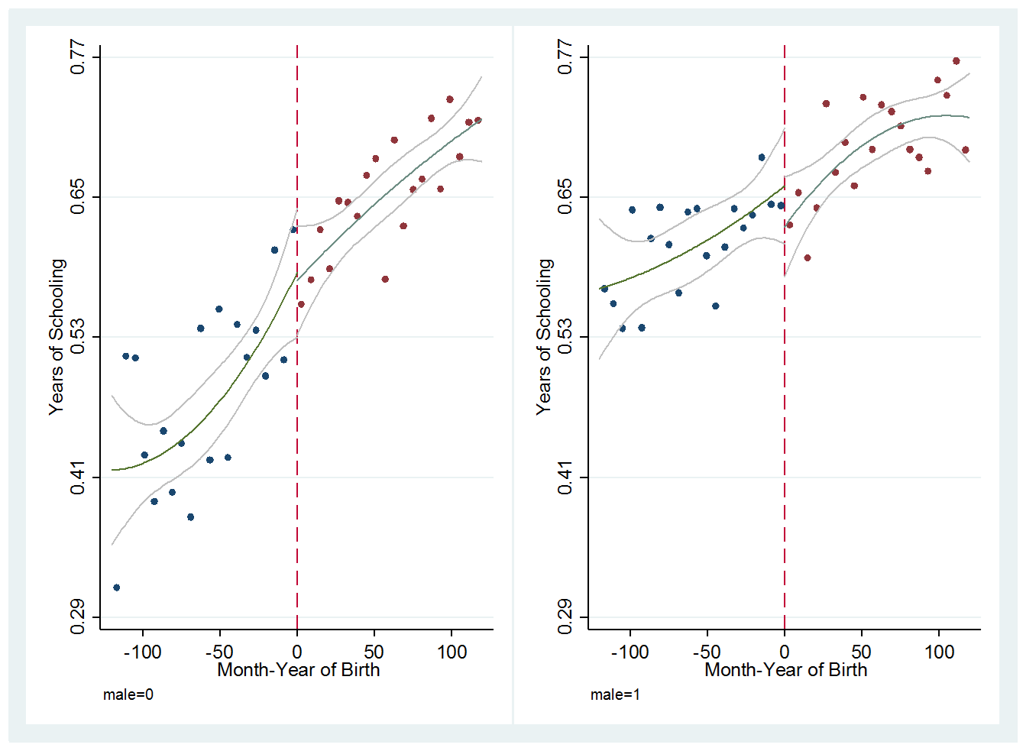
Fraction Completing High School for Females and Males

Slide 15
Identification and Estimation
Schooling is endogenous due to omitted variables like ability, motivation, parental connections, and so forth.
We use the reduction in compulsory schooling in Egypt as a source of exogenous variation in schooling.
We define a policy dummy, which is equal to one for those born in 1978 or later and zero for earlier birth cohorts. This policy dummy is used as an instrument for schooling.
The structure of our data fits a regression discontinuity design as the schooling variable is roughly continuous over month-year of birth and there is a jump in 1978.
Since there is imperfect compliance with the policy (early/late school start and grade repetition), we use a fuzzy regression discontinuity design.

Slide 16
Fuzzy regression discontinuity design is in fact IV estimation.
s denotes the years of schooling
D is a dummy variable for the policy
w denotes the wage rate
x is month-year of birth — which is the running variable
Covariates are shown by X, which include dummies for birth month, dummies for birth of governorate, a dummy for urban/rural status of birth place, and dummies for father’s educational attainment.

Slide 17
Critical Issue: Disentangling the jump from the time trends in the running variable
We use (1) global (parametric) and (2) the state-of-art local (nonparametric) methods developed by Calonico, Cattaneo and Titiunik (CCT).
Global (parametric) method:
Use all or a wide time window but allow for high-order polynomials in the running variable (up to 4th order)
Go from global to local by restricting the time windows around the cutoff and assess the robustness of our findings

Slide 18
(2) Local (non-parametric) methods by CCT
CCT allows for data-driven bandwidths
The key feature of CCT is robust bias-corrected inference.
CCT conducts covariate-adjusted bandwidth selection, covariate-adjusted point estimation, and covariate-adjusted robust bias-corrected inference.
CCT allows for different bandwidths for control and treatment groups and coverage error rate optimal bandwidths.

Slide 19
RESULTS
Policy Effect on Years of Schooling of Men – Global Polynomials

Slide 20
Policy Effect on Years of Schooling of Men
Global to Local Polynomials

Slide 21
Policy Effect on Years of Schooling of Men
Local Polynomials (CCT)

Slide 22
Policy Effect on Years of Schooling of Men Global Polynomials with Donut Holes

Slide 23
Policy Effect on Years of Schooling of Men
Global to Local Polynomials with a Donut Hole excluding the 1978 Birth Cohort

Slide 24
Policy Effect on Years of Schooling of Men
Global to Local Polynomials with a Donut Hole excluding the 1977 and 1978 Birth Cohorts

Slide 25
Log Hourly Wage Rate over the Running Variable

Slide 26
Returns to Schooling for Men – Global Polynomials

Slide 27
Returns to Schooling – Global to Local Polynomials

Slide 28
Returns to Schooling for Men – Data-Driven Bandwidths via CCT Method

Slide 29
Estimates of Returns to Schooling with Donut-Holes

Slide 30
Conclusion
We estimate the returns to schooling for men in Egypt. We find that the 2SLS estimate is either about or slightly higher than the OLS estimate.
The return from an extra year of schooling is imprecisely estimated to be 2-3 percent.
This estimate is smaller than the estimates reported by the previous studies in developing country settings (except for Aydemir and Kirdar [2017] for Turkey).
Unlike the previous studies, due to the peculiar nature of the natural experiment we use, our LATE estimate comes very close to the ATE.

