Slide 1

Hassan Taee
Minister-Counselor for Economic Affairs
Ph.D. in Economics, Tehran University
Human Resource Planning And Labor Market Analysis
Head of Economic Faculty in
Allame Tabatabaei University

Slide 2
Gender wage gap, glass ceiling and sticky floor in Iran's labor market
Hassan Taee
Mahla Shourian
Introduction
Key words definition
Questions and assumptions
literature review
Data Description
Methodology
Results Without sample selection correction
Results With sample selection correction

Slide 3
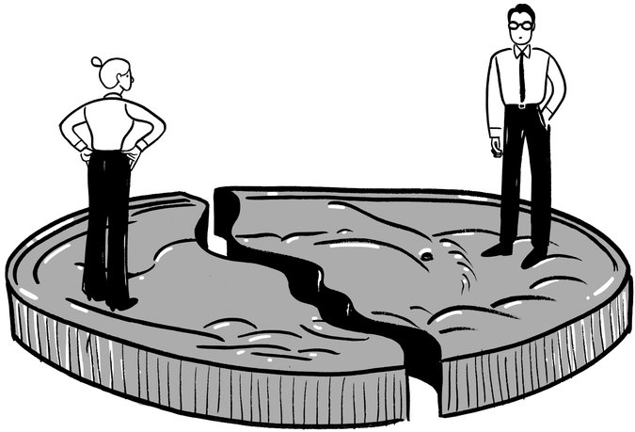
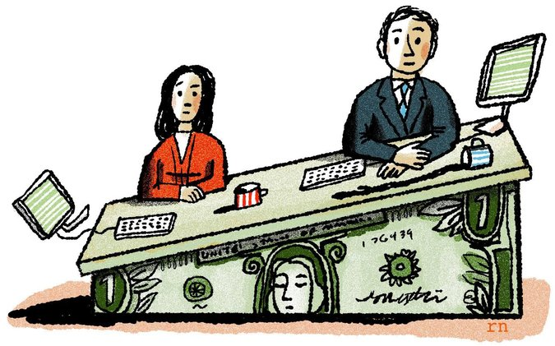




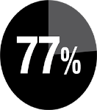
introduction
(2006)
(2015)
(2015)
$11,000
$11,000
$21,000
World Economic Forum
(2015)
International Labour Organization
(2016)
World Economic Forum
(2015)
H. Taee, M. Shourian
Notes:
1. There is no country in the world in which women and men receive equal pay for equal work (World Economic Forum, 2015).
2. According to the latest ILO estimates (2016), women worldwide earn on average 77% of the male wage.
3. in 2006 men earned on average $11,000 per year, In 2015, the average annual salary of a woman was $11,000, compared to $21,000 for a man. This means that women were 10 years behind men in terms of earnings, (World Economic Forum, 2015)

Slide 4


Literacy rate(2016)
% 84.1
% 91
Economic participation rate (2014)
% 13.1
% 68.6
Unemployment rate (2014)
% 19.7
% 8.8
rates of literacy, economic participation and unemployment by gender in Iran
H. Taee, M. Shourian
Notes:
Labor market condition in Iran shows that in spite of Insignificant difference between literacy rate among men and women, women’s economic participation rate is very low.
As you can see in 2014 , 68.6 percent of men in work age were Economically active, while the economic participation rate among women was only 13.1 percent.

Slide 5
Key words definition
Gender wage gap
The term "sticky floor" is used to describe a discriminatory employment pattern that keeps a certain group of people at the bottom of the job scale.
It also be used when the gender wage gap is wider in low levels of wage distribution.
The glass ceiling metaphor has often been used to describe “the lack of success in women to reach the superior levels of management”.
This term can also be used to indicate the significant gender gap in wages in high levels of wage distribution.
The OECD (2016) defines the gender wage gap as “the difference between male and female median wages divided by the male median wages”.
For the European Union (2014), “the gender pay gap is the difference between men’s and women’s pay, based on the average difference in gross hourly earnings of all employees”.
Glass ceiling effect
Sticky floor effect
H. Taee, M. Shourian

Slide 6
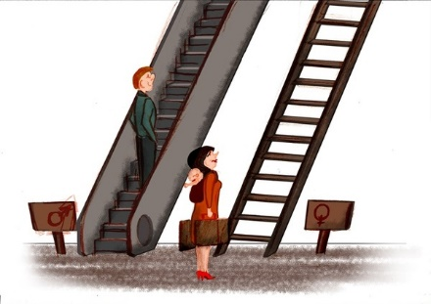
Questions
Questions
Is there a gender wage gap in Iran’s labor market?
is there a glass ceiling or a sticky floor in Iran’s labor market?
Hypothesis
There is wage discrimination against women in Iran.
We are facing the glass ceiling effect in Iran’s labor market.
Women, in Iran’s labor market, are facing a sticky floor effect.
H. Taee, M. Shourian

Slide 7

literature review
2008
Albrecht et al
2012
Alavian, A &
Keshavarz, gh
1996
Buchinsky, M.
1978
Koenker and Bassett
Quantile regression
2010
Badel, A &
Peña, X
2005
Machado, J. A. F.
and J. Mata
1975
Gary Becker
Economic of Discrimination
1973
oaxaca
Gender gap
decomposition in
mean wage
1994
Oaxaca, R &
Ransom, M.
2001
Garcia et al
...........................................................
1973
Blinder
Gender gap
decomposition in
mean wage
1988
Cotton, J.
1994
Buchinsky, M.
2004
Dolado, J.J.
and Llorens, V.
2010
Christofides et al
1979
James Heckman
sample selection correction
1998
Buchinsky, M.
2015
Khanna et al
India
2005
Hiau Joo Kee
H. Taee, M. Shourian
Notes:
Economic of discrimination literature starts with Gary Becker study in 1975.
Most important studies in the literature which we used in our methodology were:
Oaxaca and blinder (1973) which decompose the gender gap in mean wage.
Buchinsky (1994, 1996, 1998) used quantile regression Technique to decompose gender gap all over wage distribution.
Machado and mata (2005), using quantile regression, introduced a new decomposition method.
There are a few studies in Iran, one of the best is Alavian & Keshavarz (2012) which estimated the gender wage gap in urban area in Iran. It finds that the gender wage discrimination exists in the labor market but its magnitude in professional job groups is less than low skilled one. Furthermore, the wage differentials in the private sector are much higher than the public sector

Slide 8


Data Description
44770 individuals aged 18-65
the Household Expenditure and Income Survey data for the year 2014.
22068
22702
% 6
% 43
1388
9943
H. Taee, M. Shourian
Notes:
In this paper we used the Household Expenditure and Income Survey data for year 2014. This research focuses on the gender pay gap in urban areas.
The total data includes 44770 townspeople aged 18-65 . Which includes of 22068 women and 22702 men. Out of these, only 6 percent of women and 43 percent of men are employing in earning jobs and have an income.

Slide 9









Methodology
$$μ eduyear$$
$$+β exp$$
$$+β age+γagesq$$
$$lnw=α+$$
$$+μ_{1}{dmadrak}_{1}+μ_{2}{dmadrak}_{2}+$$
$$μ_{3}{dmadrak}_{3}+μ_{4}{dmadrak}_{4}$$
$$+τ_{1}{job}_{1}+τ_{2}{job}_{2}+τ_{3}{job}_{3}+$$
$$τ_{4}{job}_{4}+τ_{5}{job}_{6}$$
$$+φ_{1}{sanat}_{2}+φ_{2}{sanat}_{3}+φ_{3}{sanat}_{4}+$$
$$+φ_{4}{sanat}_{5}+φ_{5}{sanat}_{6}+φ_{6}{sanat}_{7}$$
$$+δ private$$
The Mincer earnings function
1974
Quantile regression
0.1, 0.25, 0.5, 0.75, 0.9
OLS
H. Taee, M. Shourian
Notes:
The experimental model used in this study is an earnings function of Mincer (1974). The mincer earnings function is a single-equation model that explains wage income as a function of schooling and experience. A fundamental explanatory variable in the mincer’s wage equation is experience. Yet, most data used in the empirical literature of labor market doesn’t include direct amount of experience.
Therefore we will eliminate the variable of experience and will add the variable of age to the equation as a representative of experience. Furthermore, we used the logarithm of annual wage in place of hourly wage and 4 educational dummies in substitution of the schooling years. In addition, we will fit 5 dummies for professions and 6 dummies of activity in to the equation.
private dummy is also added to the equation in order to compare wage gap between private and public sectors. Finally we estimate this equation using both quantile regression and OLS Techniques.

Slide 10
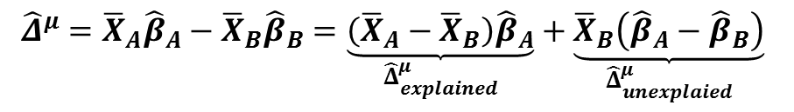
Methodology
Suppose two groups assigned to A and B, And a result variable 𝒚, And a set of regressors 𝑿:
Oaxaca – Blinder
decomposition
$${\hat{Δ}}^{μ}={\overline{X}}_{A}{\hat{β}}_{A}−{\overline{X}}_{B}{\hat{β}}_{B}=\underset{{\hat{Δ}}_{explained}^{μ}}{\underbrace{\left({\overline{X}}_{A}−{\overline{X}}_{B}\right){\hat{β}}_{A}}}+\underset{{\hat{Δ}}_{unexplaied}^{μ}}{\underbrace{{\overline{X}}_{B}\left({\hat{β}}_{A}−{\hat{β}}_{B}\right)}}$$
Characteristics effect
(Endowments)
Coefficient effect
(discrimination)
H. Taee, M. Shourian
Notes:
Suppose two groups assigned to A and B, And a result variable 𝒚, And a set of regressors 𝑿:
the Oaxaca- blinder decomposition, decomposes the gender wage gap into 2 part:
A part related to the gender characteristics and a part which can be attributed to the discrimination.

Slide 11









Methodology
$β^{f}$: women’s returns
$x^{f}$: women’s characteristics
idea
counterfactual density:
the female log wage density that would arise if women were given men’s labour market characteristics but continued to be ‘paid like women’.
$β^{m}$: men’s returns
$x^{m}$: men’s characteristics
Counterfactual
decomposition
if
$$w^{f}$$
$$=$$
$β^{f}$= $β^{m}$
$$≠$$
$$w^{m}$$
observed wage differences can be attributed to unequal treatment by gender, or other unobserved heterogeneity that the model fails to capture.
Notes:
Denote women’s and men’s returns by $β^{f}$ and $β^{m}$ , and their characteristics by $x^{f}$ and $x^{m}$ respectively. The idea is to generate a counterfactual density, in particular, the female log wage density that would arise if women were given men’s labour market characteristics but continued to be ‘paid like women’.
Hence in the situation where identical men and women possess same productive characteristics ($β^{f}$=$β^{m}$), men’s wages would be equal to the women’s wages, and no pay gap will be observed. Therefore, observed wage differences can be attributed to unequal treatment by gender, or other unobserved heterogeneity that the model fails to capture.

Slide 12
Methodology
$$Q^{\left(p\right)}\left(w_{i} | x_{i}\right)=μ_{p}+x_{i}^{f}β_{p}^{f}+P_{p}\left(z_{i}^{f}γ\right)+ε_{pi} p∈\left(0,1\right)$$
The components derived from the probit equation for each quantile; and in fact, it is the corrective of sample selection problem.
Sample selection
correction
$x^{f }$: The vector of human capital characteristics of women
$z^{f}$: a vector of variables which affect on women’s decision to participate in labor market
$p$ : the probability of women's participation in the labor market
H. Taee, M. Shourian
Notes:
The equation for correcting the sample selection problem in each quantile, based on Buchansky (1998) is this.
In this equation $x^{f}$ is the vector of human capital characteristics of women, $z^{f}$ is a vector of variables which affect on women’s decision to participate in labor market; and vector p is the probability of women's participation in the labor market.

Slide 13
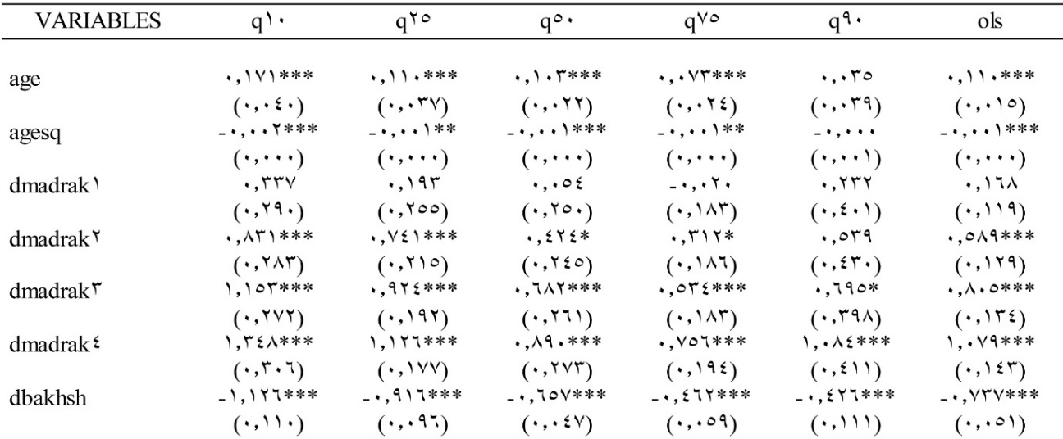

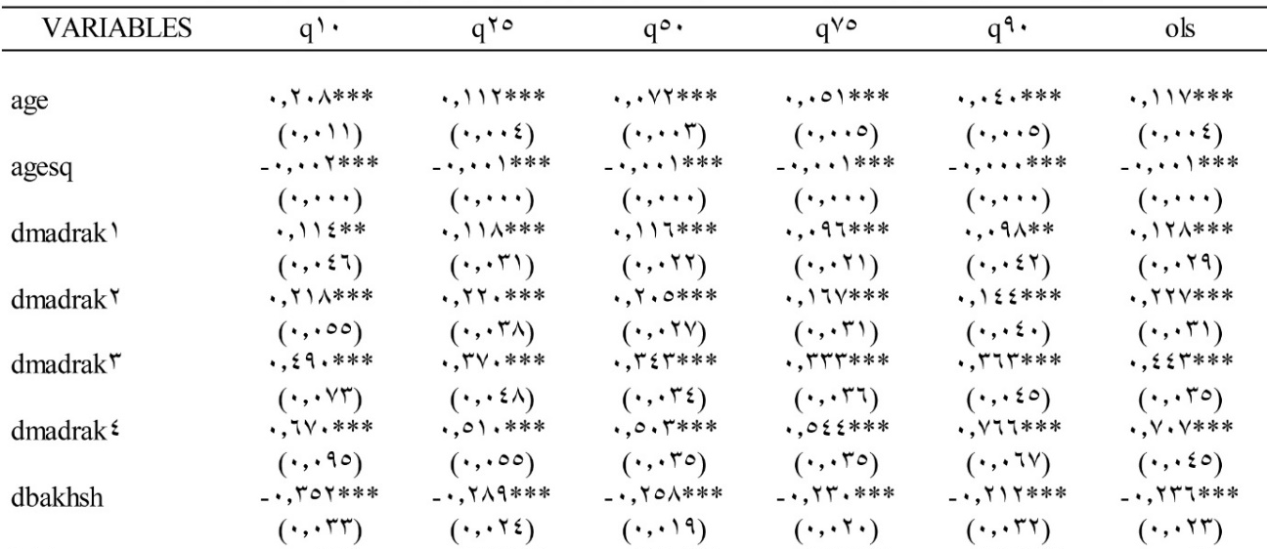

Quantile Regression by Gender
Without sample selection correction
The age variable for both men and women is positive and significant and is approximately equal.
As expected, an increase in education, for both men and women, and in all quantiles will increase wages.
Comparing the coefficients of the four educational dummies between men and women shows that having a degree increases women's wages significantly more than men.
The sector dummy is significant and negative for both groups of women and men, indicating that working in private sector reduces wages, and this reduction is much more for women than men.
As expected, activities in more professional groups, including managers and specialists or technicians and assistants, increase wages in both men and women.
H. Taee, M. Shourian

Slide 14
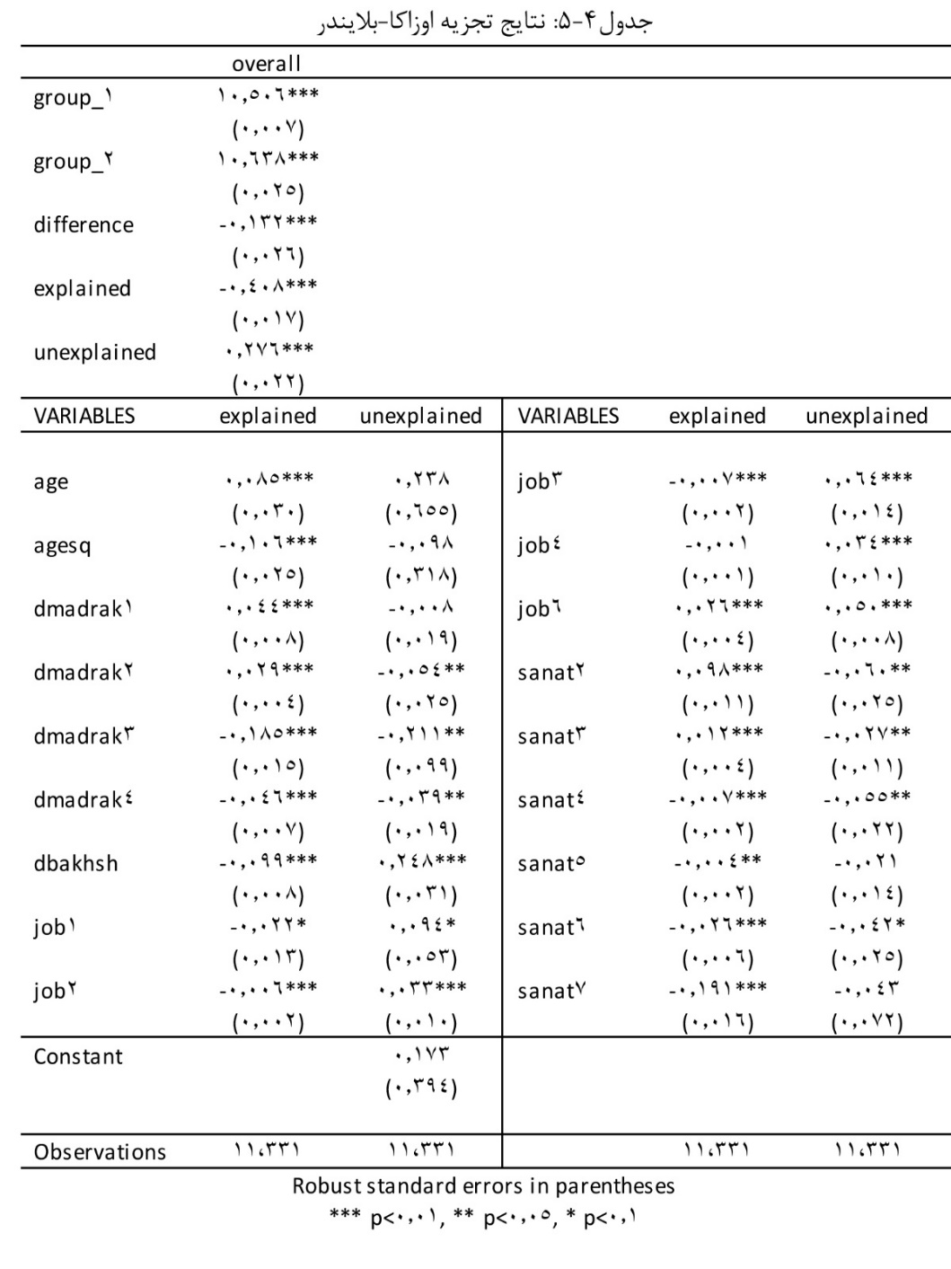
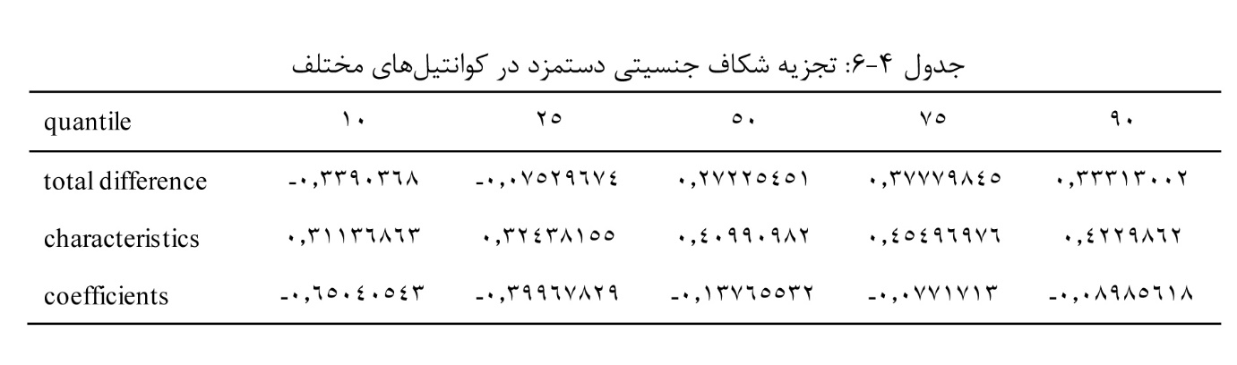
Decomposition results
Without sample selection correction
Counterfactual
decomposition
Oaxaca – Blinder
decomposition
H. Taee, M. Shourian
Notes:
The Oaxaca-blinder decomposition results shows that the differences between men and women in mean wage is equal to -0.13.
Negative sign indicates that the average hourly wage of women is higher than that of men.
The discrimination or the unexplained part of the gap is equal to 0.27, which means that when women are given as equal returns as men, their wages will increase by 27 percent.
The finding of counterfactual decomposition indicates that gender wage gap is negative in 10th and 25th quantiles, but as we move toward the upper tail of the wage distribution, it becomes positive. Negative sign of the unexplained part also shows that there is discrimination against women in all over the wage distribution.
Another significant finding is that the unexplained gap decreases as we move towards the upper levels of wage distribution; which means that women in Iran’s labor market face a sticky floor.

Slide 15

Quantile Regression by Gender
With sample selection correction
Estimating wage equation, using OLS technique, shows that inverse mills ratio is absolutely significant for both men and women.
Estimating wage equation, using quantile regression technique, shows that inverse mills ratio is significant for men; but for women it is only significant in 25th and 50th quantiles. .
H. Taee, M. Shourian

Slide 16

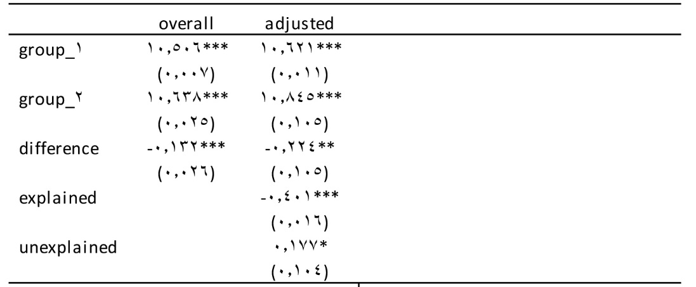
Decomposition results
With sample selection correction
Oaxaca- Blinder decomposition without sample selection correction
Oaxaca- Blinder decomposition with
sample selection correction
H. Taee, M. Shourian
Notes:
Comparing the results of the oaxaca-blinder decomposition with and without sample selection correction shows that, correction will increase the amount of the gender wage gap to 22 percent.
but the unexplained part of the gap will decrease from 27 percent to 17 percent after correction.

Slide 17
conclusion
In Iran’s labor market:
In the wage mean, there is a gender wage gap in favor of women and equal to 13 percent.
There is a discrimination, equal to 27 percent, against women.
The gender wage discrimination is significantly high at the lower tail of the distribution, and decreases as moving to the upper tail. This statement proves that women face a sticky floor.
Comparing the results of the estimation with and without sample selection correction shows that selection effect is Very important and noteworthy and it makes the results less than real.
H. Taee, M. Shourian

