Slide 1

Hosein Joshaghani
PhD in economics at the University of Chicago
Empirical Macroeconomics, Labor Economics, Behavioral Economics
Visiting Assistant Professor at
Graduate School of Management and Economics,
Sharif University of Technology

Slide 2
Responses of Job and Worker Flows to
Oil and Exchange Rate Shocks
Hosein Joshaghani
Kiarash Hoseiny

Slide 3
Introduction
What can we learn from sectoral job and worker flows?
How large is the job reallocation in Iran relative to developed countries?
How do oil (and real exchange rate) shocks affect job creation and job destruction (as well as hire and separation rates) across sectors?
Are they reallocative or aggregate shocks?
H. Joshaghani, K. Hoseiny

Slide 4
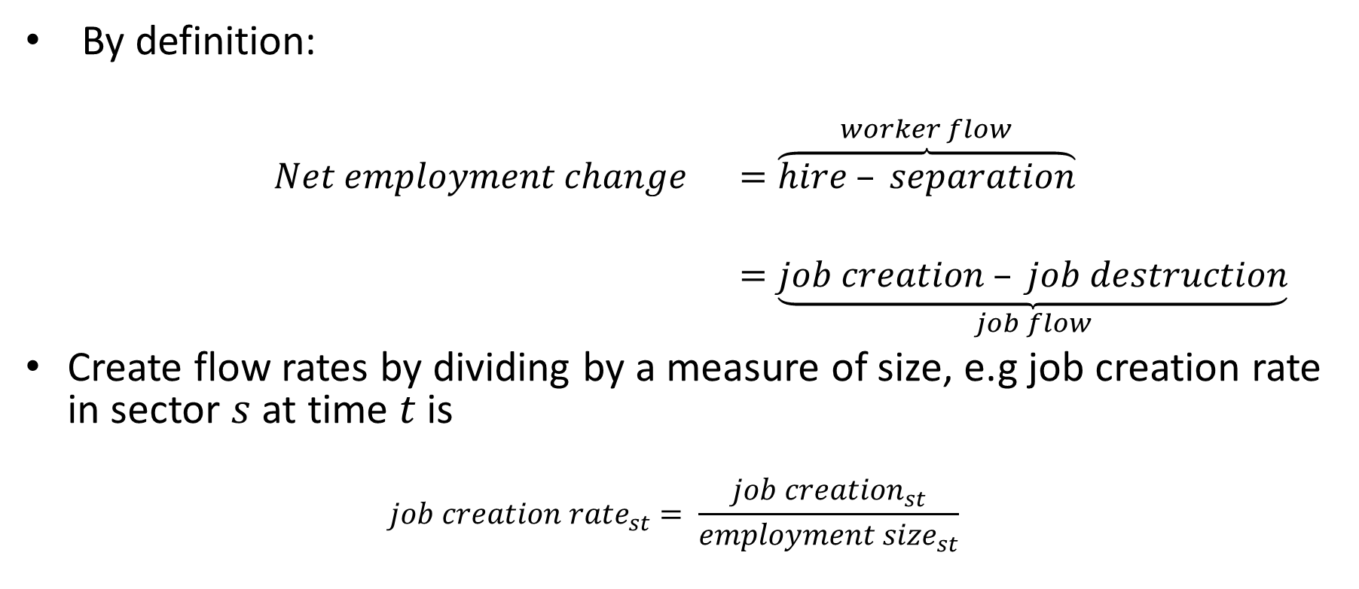
Job Flows versus Worker Flows
By definition:
$$Net employment change =\overset{worker flow}{\overbrace{hire – separation}}$$
$=\underset{job flow}{\underbrace{job creation – job destruction}}$
Create flow rates by dividing by a measure of size, e.g job creation rate in sector $s$ at time $t$ is
$${job creation rate}_{st}= \frac{{job creation}_{st}}{{employment size}_{st}}$$
H. Joshaghani, K. Hoseiny

Slide 5
Job Flows versus Worker Flows
Job Flows | Worker Flows
Job Creation and Destruction | Hire and Separation
Demand Side | Supply Side
Survey of Manufacturing Plants | Labor Force Survey
1382 - 1392 | 1385-1393
Yearly | Quarterly
Only manufacturing | Covers all sectors
Only plants with more than 10 workers | Covers all plant sizes
Some years, some regions survey of plants with 10-50 workers
But universe of plants with more than 50 employees | Always a survey
H. Joshaghani, K. Hoseiny

Slide 6
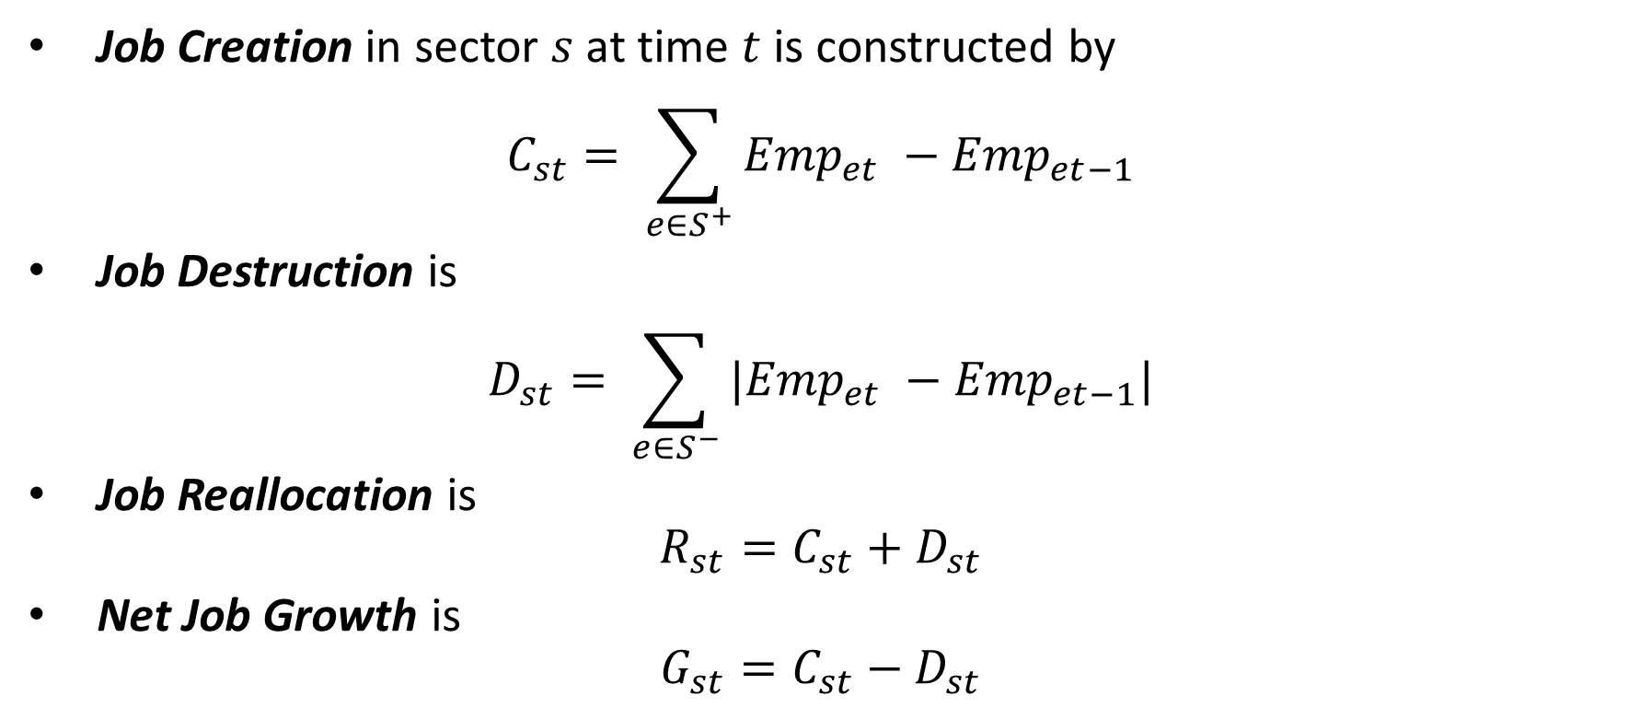
Job Flows: Creation and Destruction
Job Creation in sector $s$ at time $t$ is constructed by
$$C_{st}= \sum_{e∈S^{+}}{{Emp}_{et} −{Emp}_{et−1}}$$
Job Destruction is
$$D_{st}= \sum_{e∈S^{−}}{{|Emp}_{et} −{Emp}_{et−1}|}$$
Job Reallocation is
$$R_{st}=C_{st}+D_{st}$$
Net Job Growth is
$$G_{st}=C_{st}−D_{st}$$
H. Joshaghani, K. Hoseiny

Slide 7
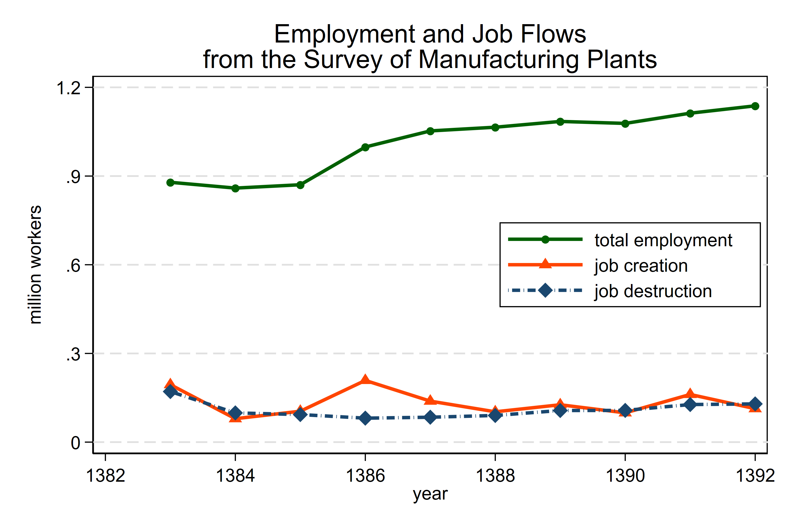
H. Joshaghani, K. Hoseiny

Slide 8
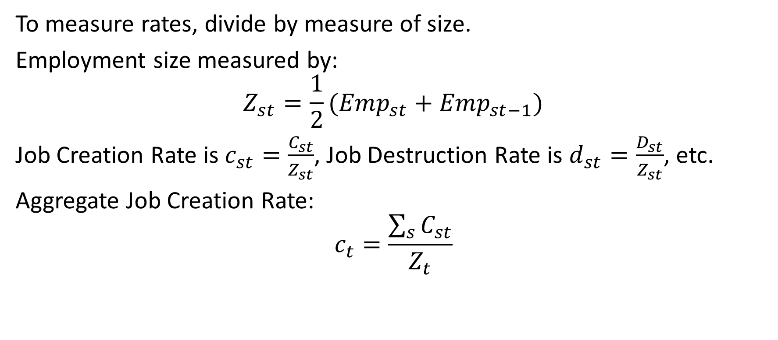
Job Flow Rates
To measure rates, divide by measure of size.
Employment size measured by:
$$Z_{st}=\frac{1}{2}({Emp}_{st}+{Emp}_{st−1})$$
Job Creation Rate is $c_{st}=\frac{C_{st}}{Z_{st}}$, Job Destruction Rate is $d_{st}=\frac{D_{st}}{Z_{st}}$, etc.
Aggregate Job Creation Rate:
$$c_{t}=\frac{\sum_{s}{C_{st}}}{Z_{t}}$$
H. Joshaghani, K. Hoseiny

Slide 9
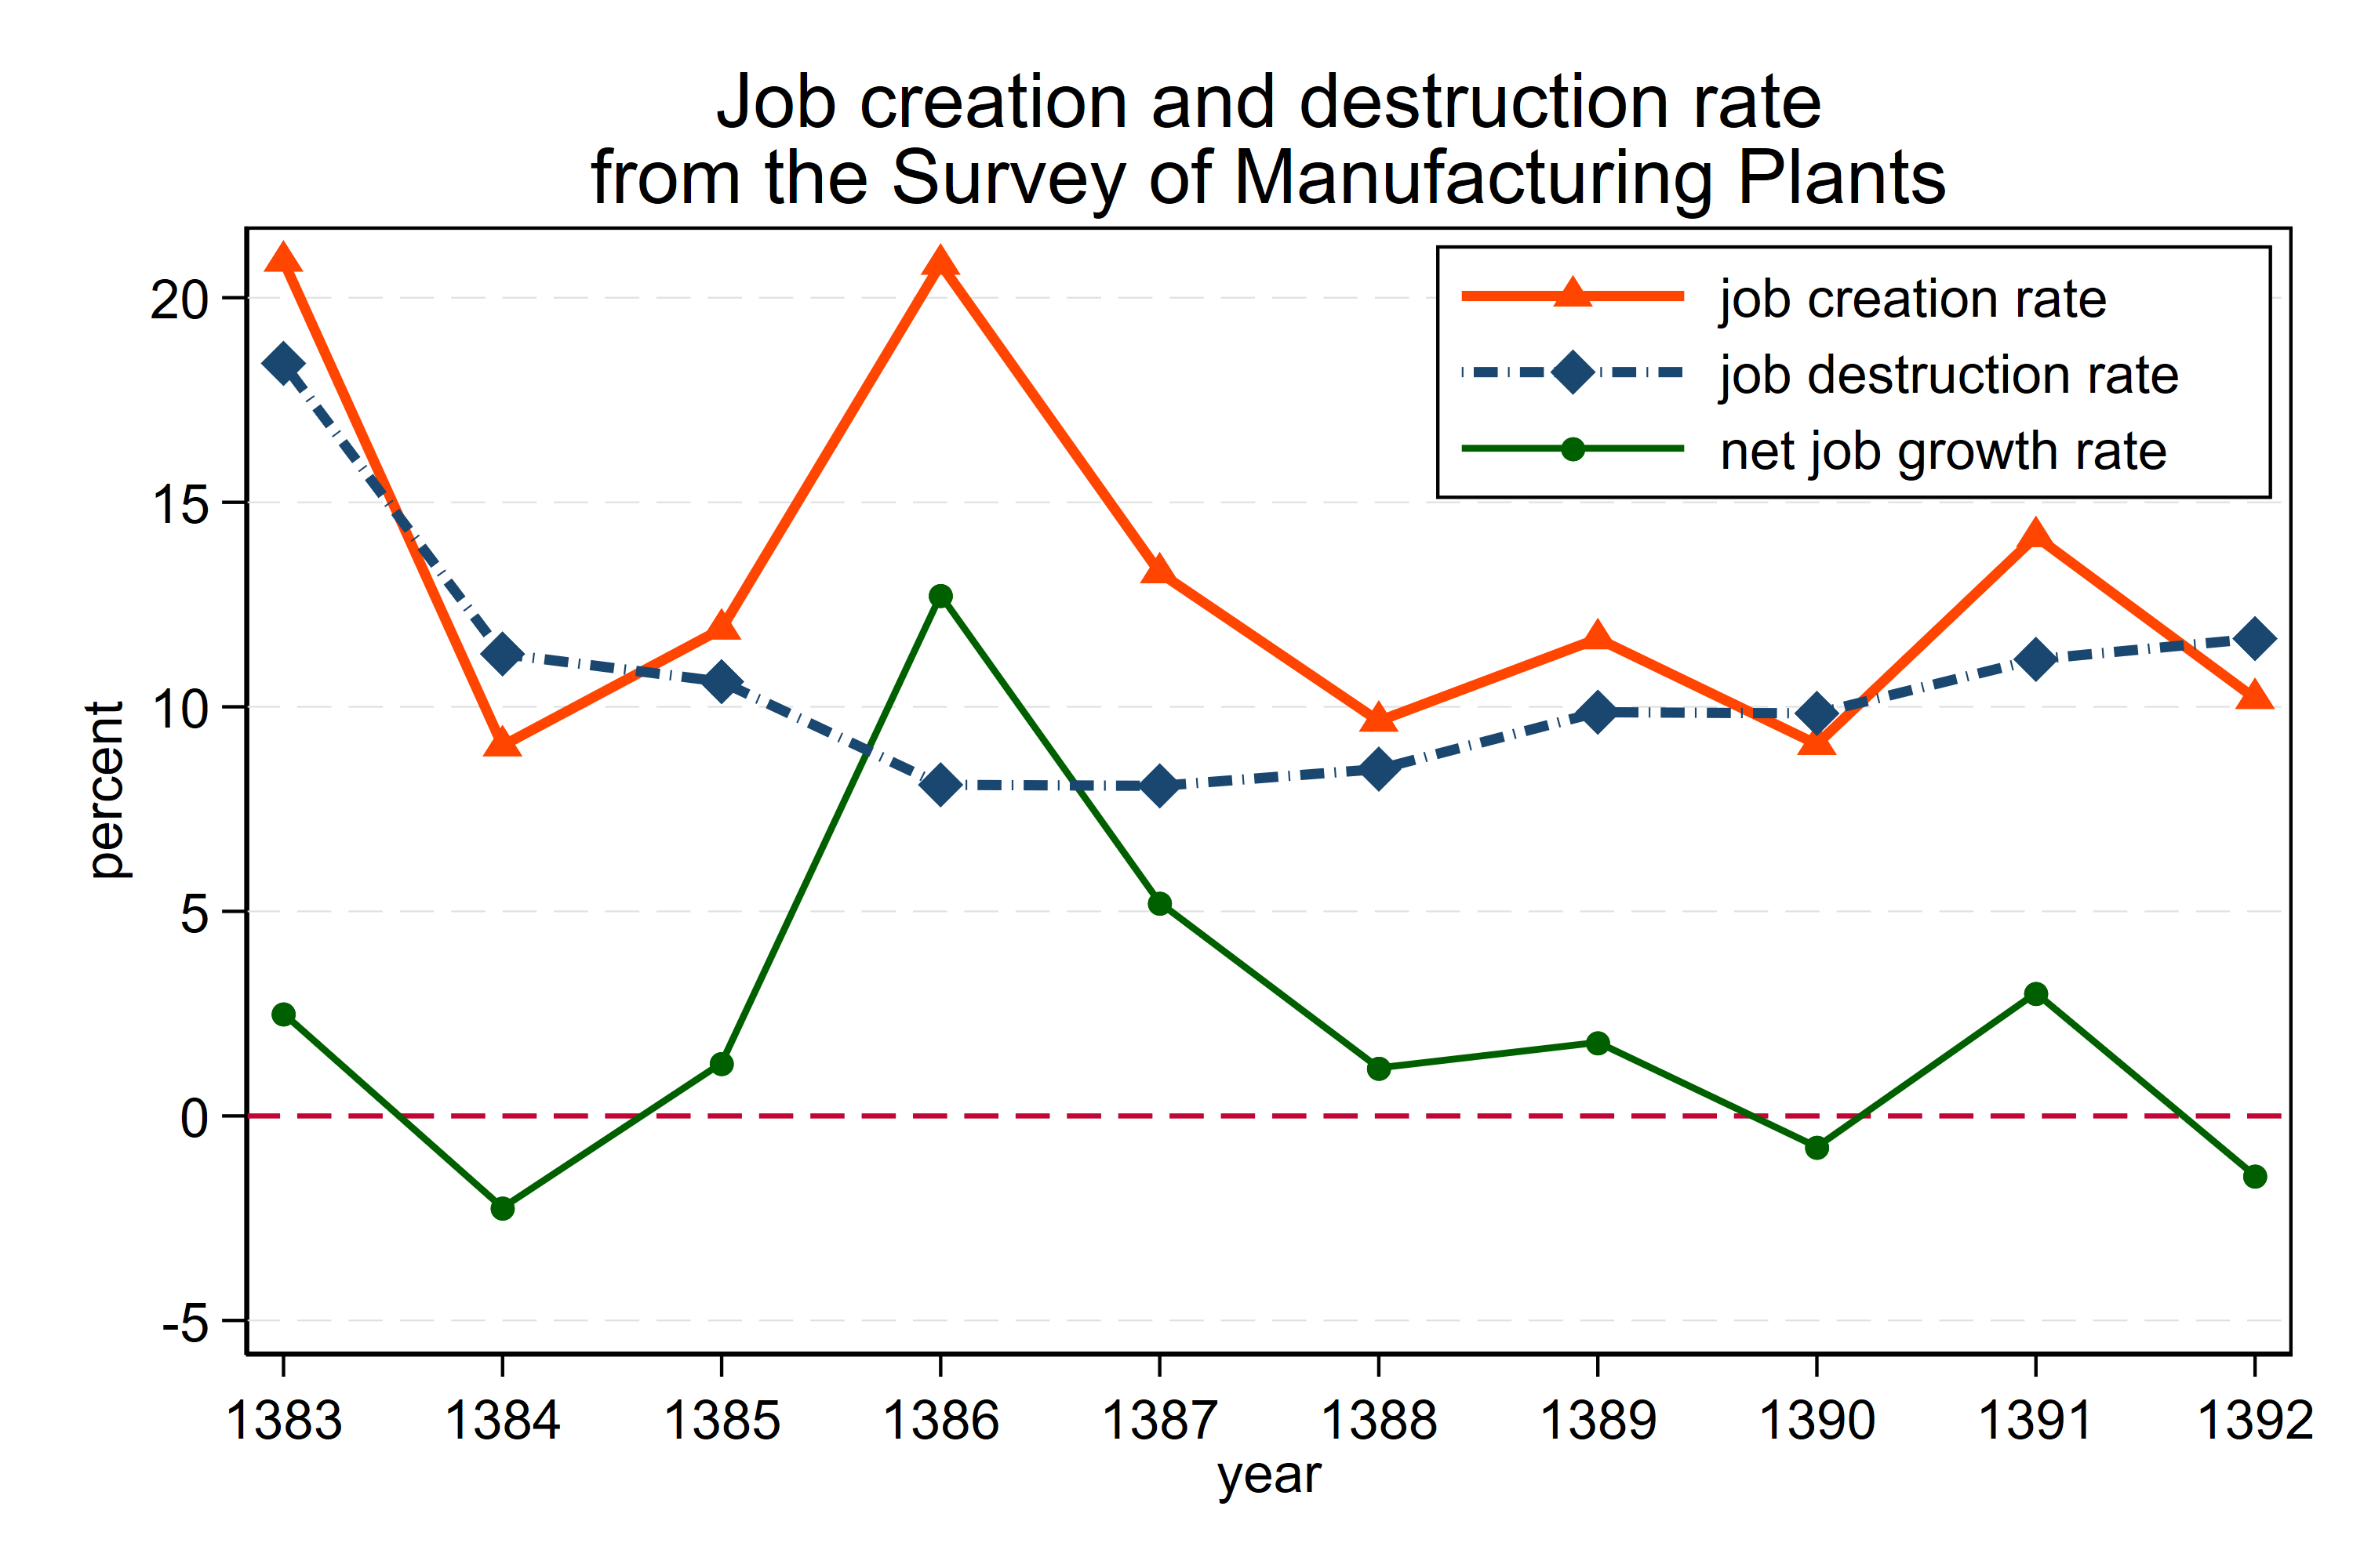
H. Joshaghani, K. Hoseiny

Slide 10
Industry (ISIC 2-digit) | Employment share | Mean job creation rate | Mean job destruction rate | St. Dev. Of creation rate | St. Dev. Of destruction rate | St. Dev. Of growth rate
food products and beverages - tobacco products | 15.6 | 14.6 | 10.4 | 4.5 | 1.2 | 5.1
textile | 8.0 | 11.2 | 11.6 | 4.8 | 2.4 | 5.9
wearing apparel; dressing and dyeing of fur - tanning and dressing of leather; manufacture of luggage, handbags, saddlery, harness and footwear - wood and products of wood and cork, except furniture; | 1.6 | 15.1 | 11.8 | 5.6 | 3.9 | 6.0
publishing, printing and reproduction of recorded media - paper and paper products | 2.4 | 12.4 | 8.9 | 6.8 | 2.3 | 7.5
coke, refined petroleum products and nuclear fuel | 2.0 | 15.0 | 7.7 | 11.2 | 5.7 | 15.2
chemicals and chemical products | 8.7 | 14.6 | 6.5 | 5.5 | 1.8 | 5.1
rubber and plastics products | 4.1 | 13.1 | 8.4 | 5.8 | 2.4 | 7.1
other non-metallic mineral products | 11.6 | 14.1 | 9.8 | 5.2 | 2.1 | 6.5
basic metals | 9.3 | 14.2 | 6.7 | 4.9 | 1.7 | 5.3
fabricated metal products,except machinery and equipment - machinery and equipment n.e.c. | 13.0 | 12.7 | 10.2 | 6.1 | 1.7 | 6.8
office, accounting and computing machinery - electrical machinery and apparatus n.e.c. - radio, television and communication equipment and apparatus | 5.9 | 12.7 | 9.7 | 6.9 | 1.4 | 7.2
medical, precision and optical instruments, watches and clocks | 1.1 | 13.0 | 8.1 | 6.8 | 5.0 | 9.7
motor vehicles, trailers and semi-trailers - other transport equipment | 14.3 | 10.7 | 7.3 | 5.5 | 2.8 | 7.1
furniture; manufacturing n.e.c. - recycling | 1.2 | 13.6 | 9.8 | 5.8 | 2.3 | 6.5
H. Joshaghani, K. Hoseiny

Slide 11
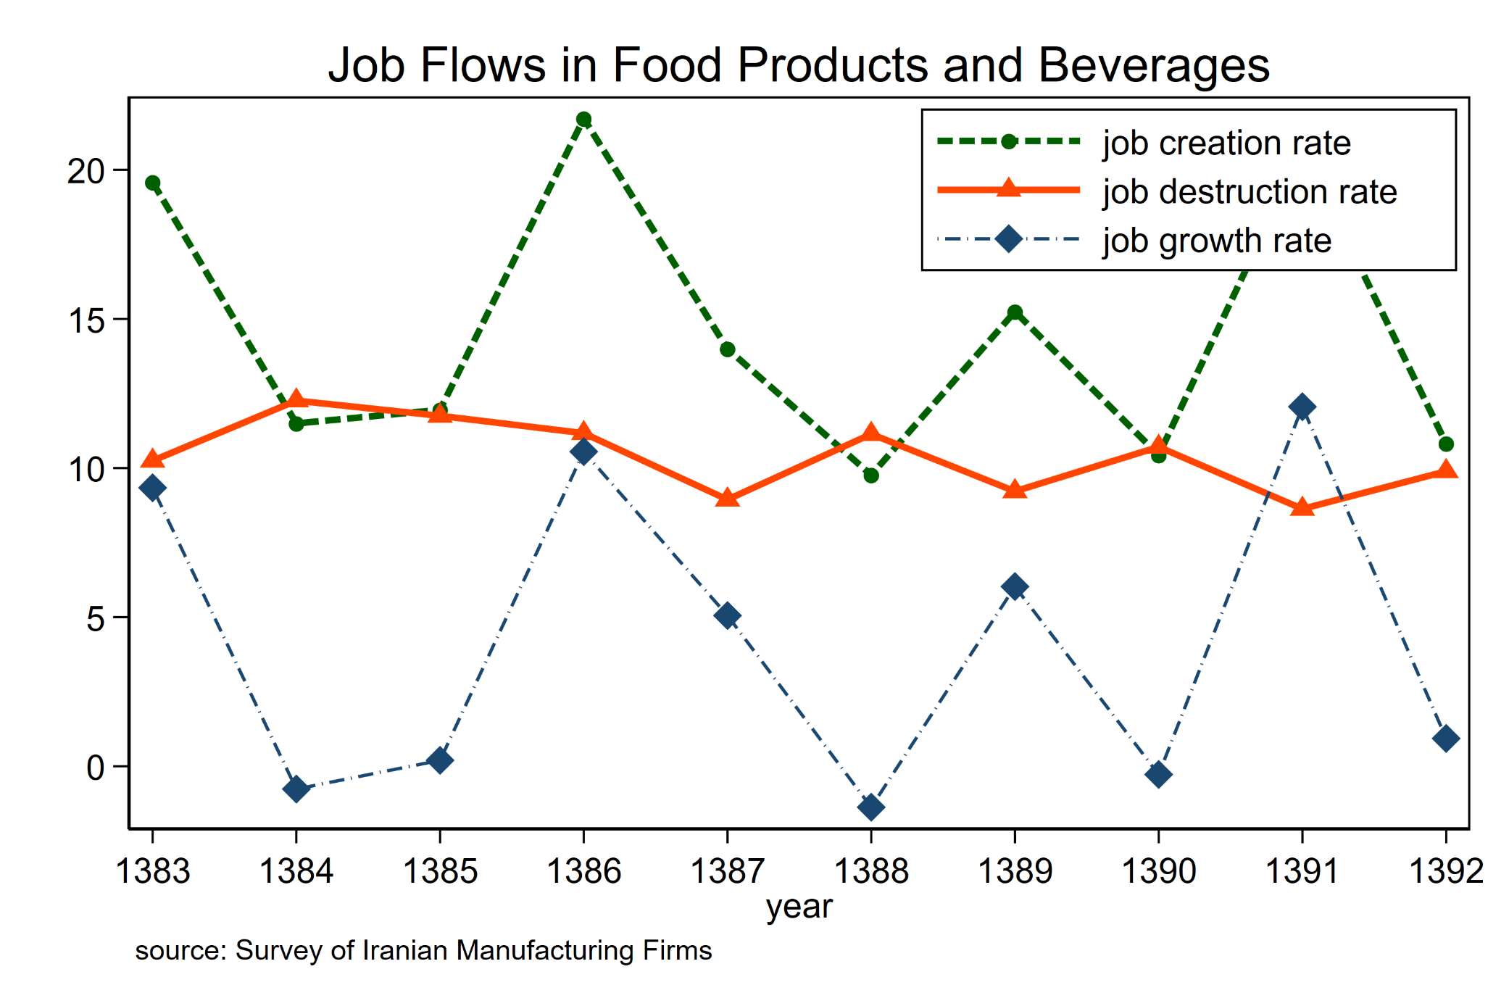
Food Products:
8.0%
Employment
Share
H. Joshaghani, K. Hoseiny

Slide 12
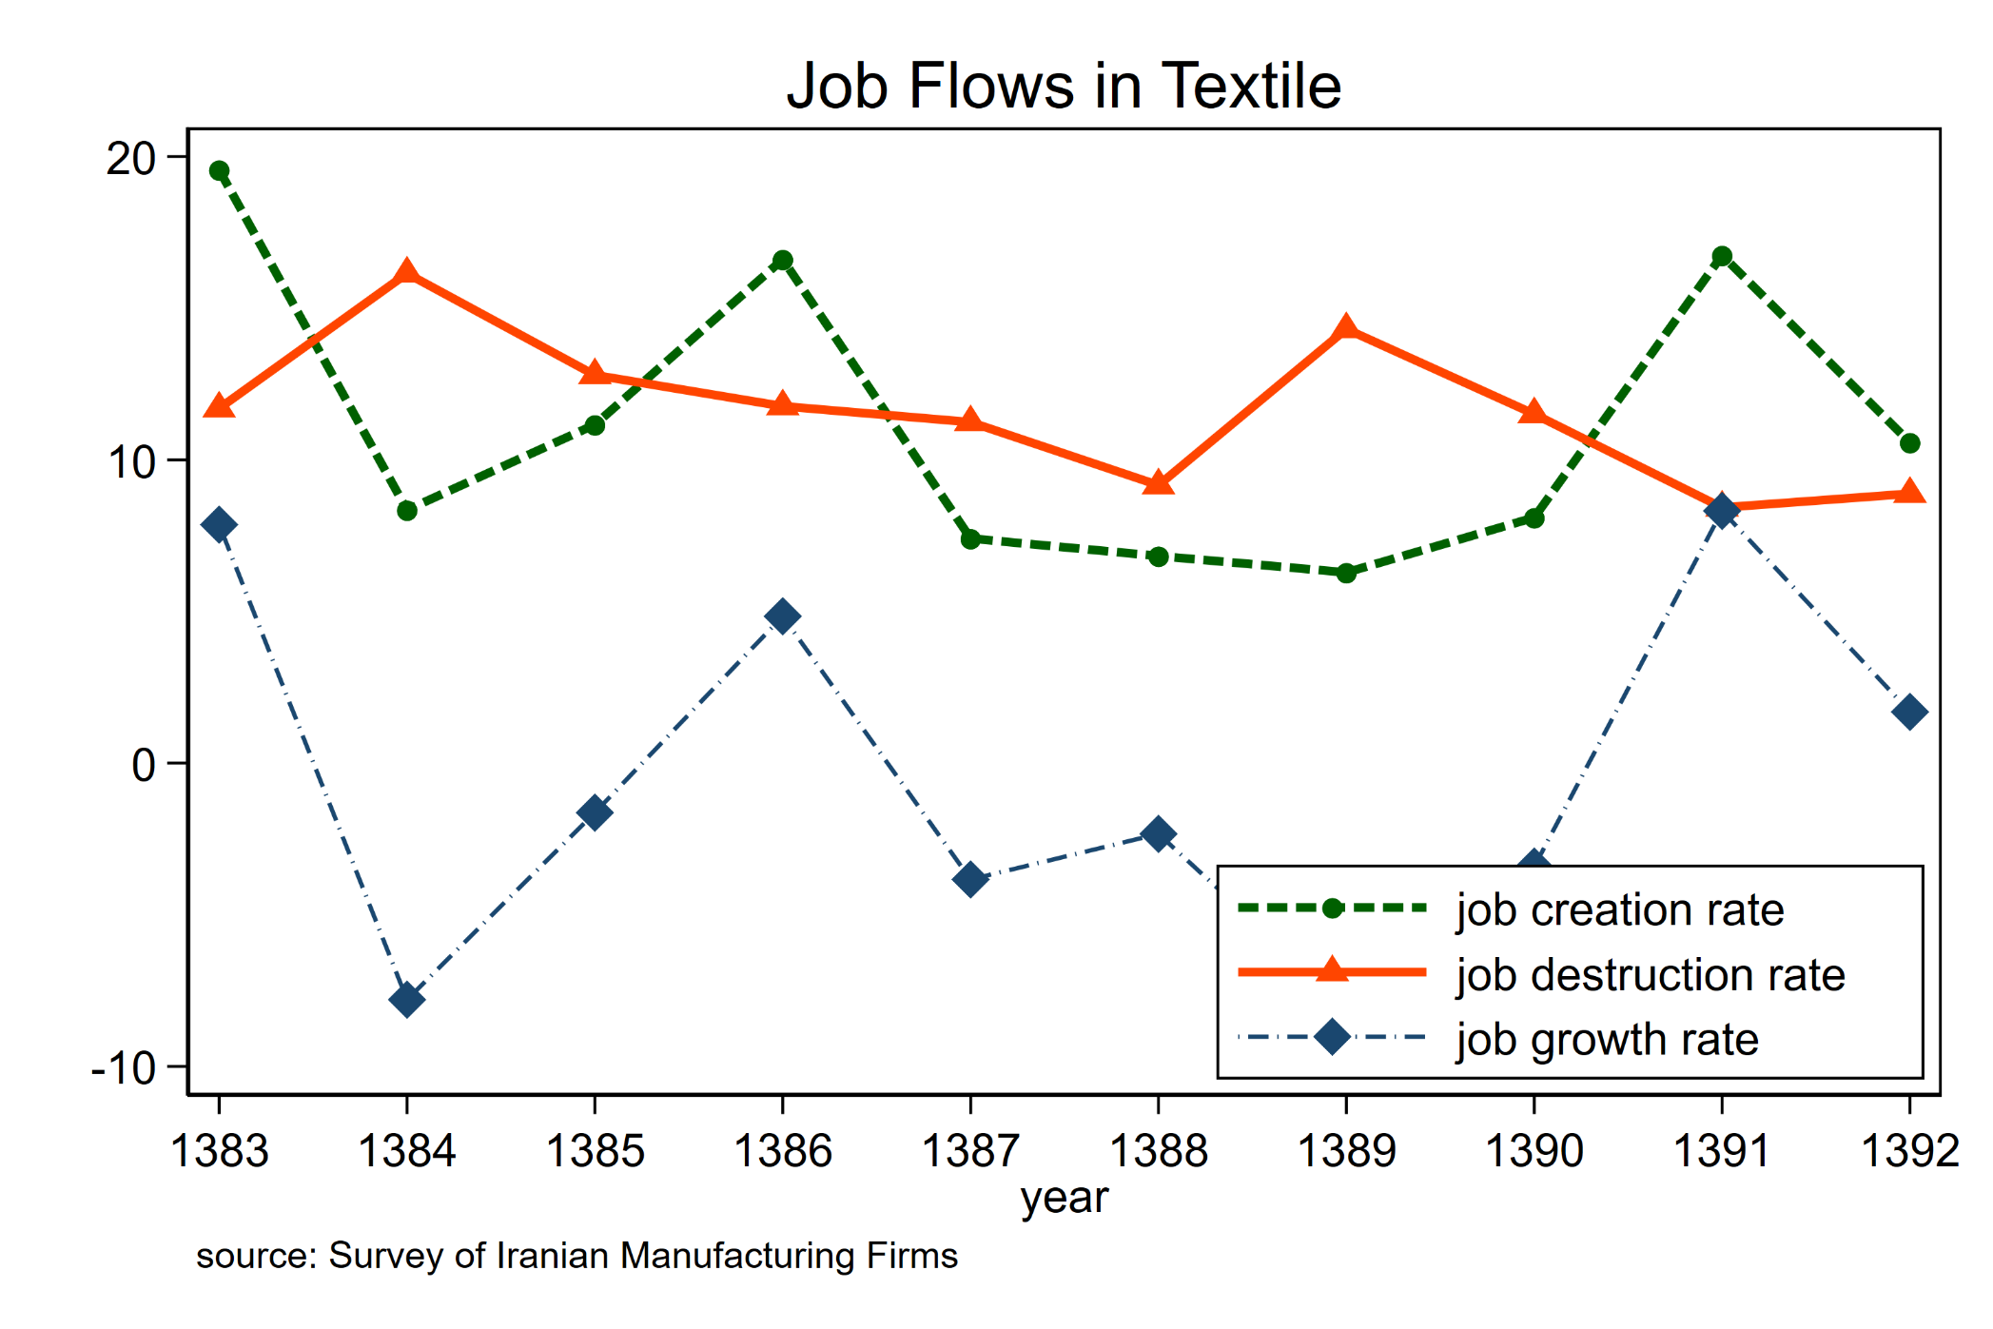
Textile:
15.6%
Employment
Share
H. Joshaghani, K. Hoseiny

Slide 13
Job Creation and Destruction and Plant size
Establishment size | Employment share | Mean job creation rate | Mean job destruction rate | St. Dev. Of creation rate | St. Dev. Of destruction rate | St. Dev. Of growth rate
50-100 | 24.6 | 16.6 | 16.0 | 6.1 | 4.6 | 5.3
100-250 | 22.8 | 14.1 | 11.7 | 6.3 | 3.7 | 6.2
250-500 | 18.0 | 12.8 | 10.4 | 5.6 | 3.1 | 5.9
500-2000 | 22.6 | 10.9 | 7.9 | 4.1 | 2.4 | 4.6
2000+ | 11.9 | 7.7 | 3.4 | 5.0 | 2.1 | 5.9
H. Joshaghani, K. Hoseiny

Slide 14

Labor Intensity and Job Flows
We measure labor intensity of plants by $L/Y$ ratio.
Divide plants into 4 quartiles with the same employment share.
Compute worker flows:
H. Joshaghani, K. Hoseiny

Slide 15
Job Creation and Destruction and Labor Intensity
Labor intensity quartile | Employment share | Mean job creation rate | Mean job destruction rate | St. Dev. Of creation rate | St. Dev. Of destruction rate | St. Dev. Of growth rate
1 | 25.0 | 11.9 | 6.9 | 3.9 | 2.1 | 4.9
2 | 25.0 | 13.0 | 7.4 | 4.2 | 1.0 | 3.8
3 | 25.0 | 13.1 | 8.7 | 6.4 | 1.0 | 6.6
4 | 25.0 | 14.7 | 10.9 | 5.0 | 1.9 | 5.7
H. Joshaghani, K. Hoseiny

Slide 16
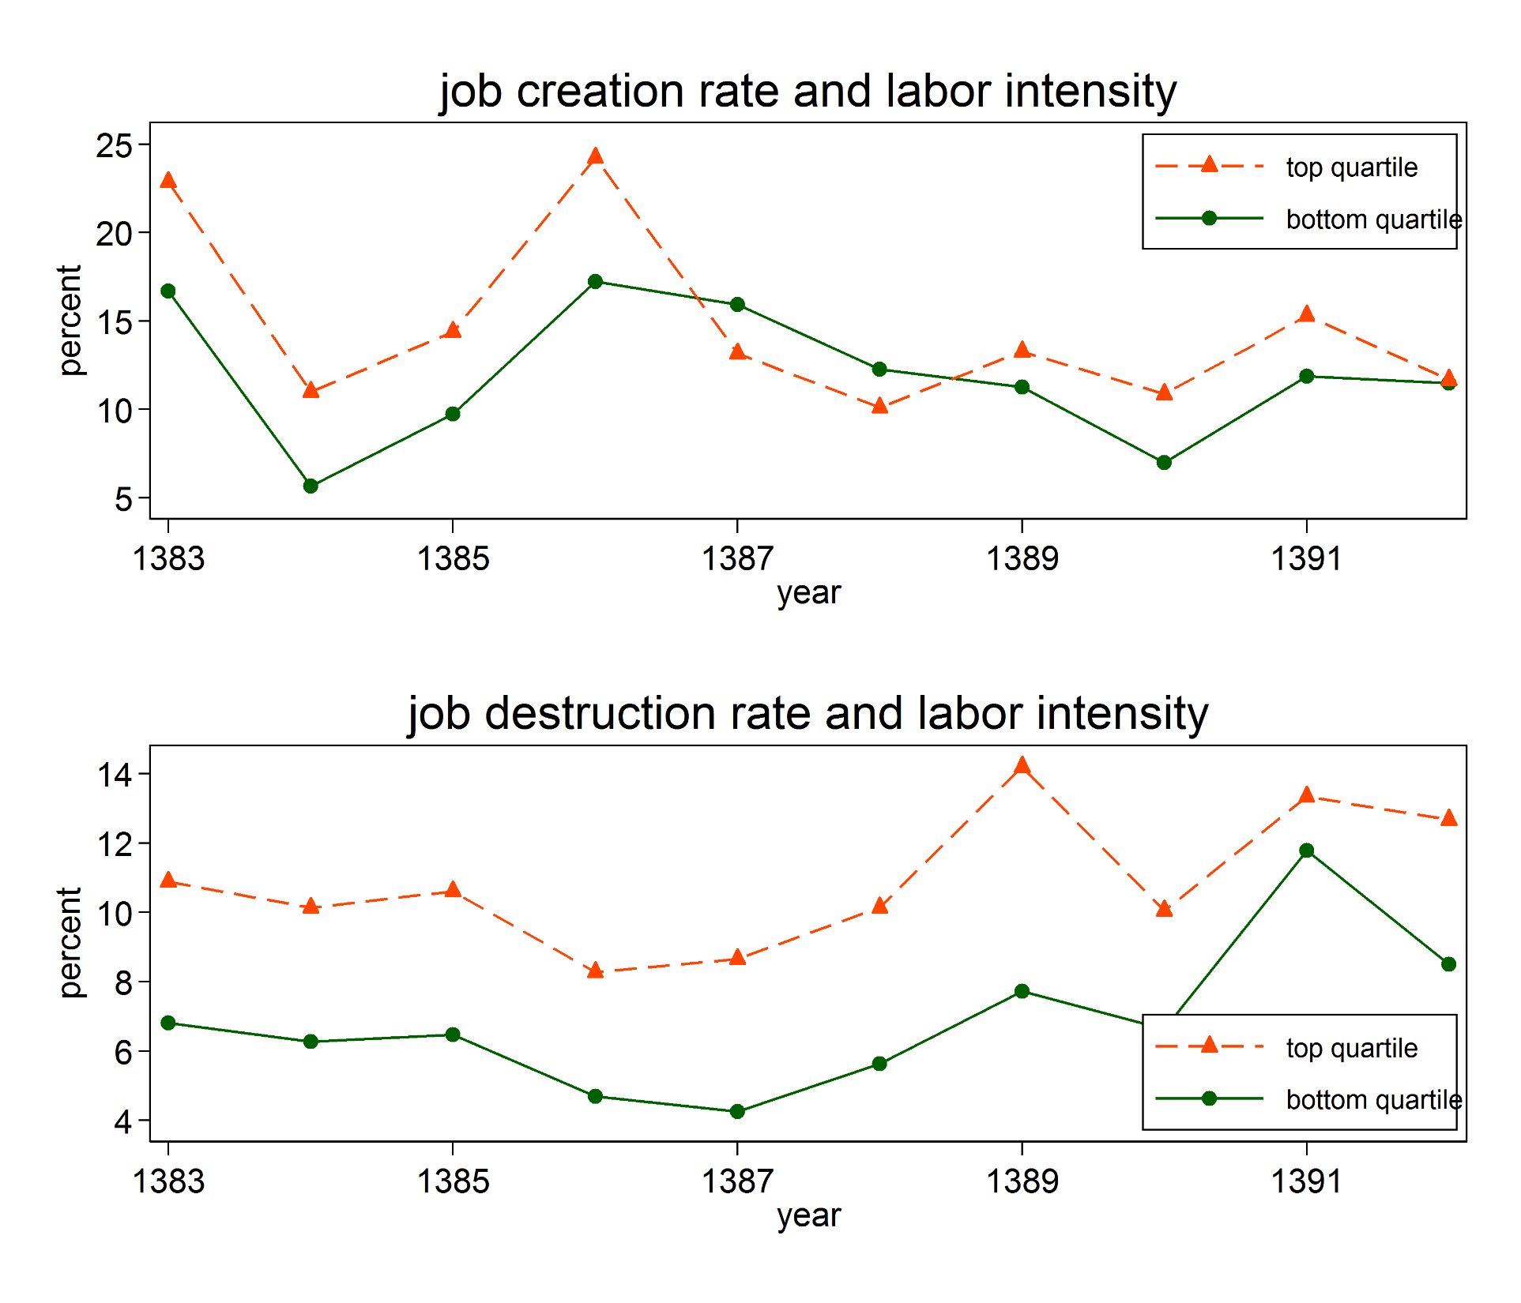
H. Joshaghani, K. Hoseiny

Slide 17
Job Flows: Summary
We find surprisingly large rates of job creation, destruction and reallocation:
Job creation and destruction in Iran: 11-15 percent
Job creation and destruction in the U.S.: 14-18 percent
This is persistent across industries and over time.
Job creation (and destruction) is more concentrated on:
Smaller plants
Younger plants
More labor intensive plants
H. Joshaghani, K. Hoseiny

Slide 18
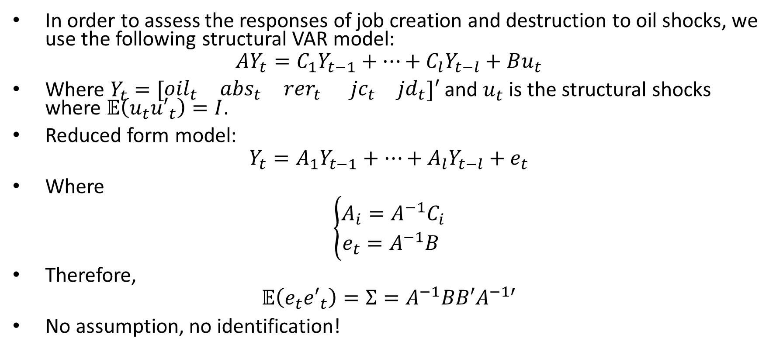
Responses to Oil and Real Exchange Shock
In order to assess the responses of job creation and destruction to oil shocks, we use the following structural VAR model:
$$AY_{t}=C_{1}Y_{t−1}+…+C_{l}Y_{t−l}+Bu_{t}$$
Where $Y_{t}=[\begin{matrix}{oil}_{t} & {abs}_{t} & {rer}_{t}\end{matrix} \begin{matrix}{jc}_{t} & {jd}_{t}\end{matrix}]′$ and $u_{t}$ is the structural shocks where $𝔼\left(u_{t}{u′}_{t}\right)=I$.
Reduced form model:
$$Y_{t}=A_{1}Y_{t−1}+…+A_{l}Y_{t−l}+e_{t}$$
Where
$$\left\{\begin{aligned}A_{i}={A^{−1}C}_{i} \\ &e_{t}=A^{−1}B \end{aligned}\right.$$
Therefore,
$$𝔼\left(e_{t}{e′}_{t}\right)=Σ=A^{−1}BB′A^{−1′}$$
No assumption, no identification!
H. Joshaghani, K. Hoseiny

Slide 19
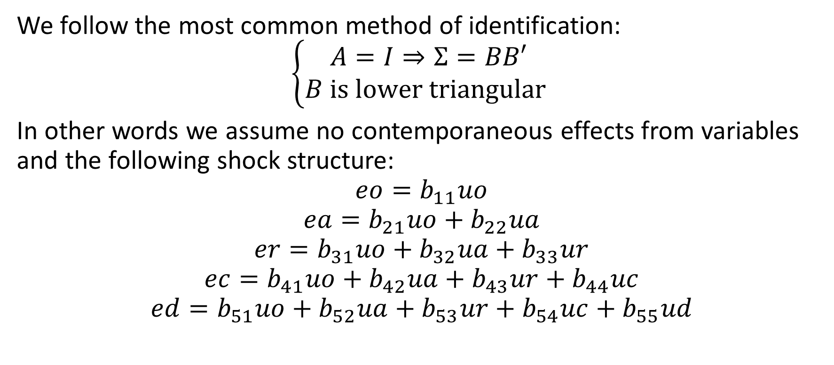
Cholesky Identification
We follow the most common method of identification:
$$\left\{\begin{aligned}A=I⇒Σ=BB′ \\ &B is lower triangular \end{aligned}\right.$$
In other words we assume no contemporaneous effects from variables and the following shock structure:
$$eo=b_{11}uo$$
$$ea=b_{21}uo+b_{22}ua$$
$$er=b_{31}uo+b_{32}ua+b_{33}ur$$
$$ec=b_{41}uo+b_{42}ua+b_{43}ur+b_{44}uc$$
$$ed=b_{51}uo+b_{52}ua+b_{53}ur+b_{54}uc+b_{55}ud$$
H. Joshaghani, K. Hoseiny

Slide 20
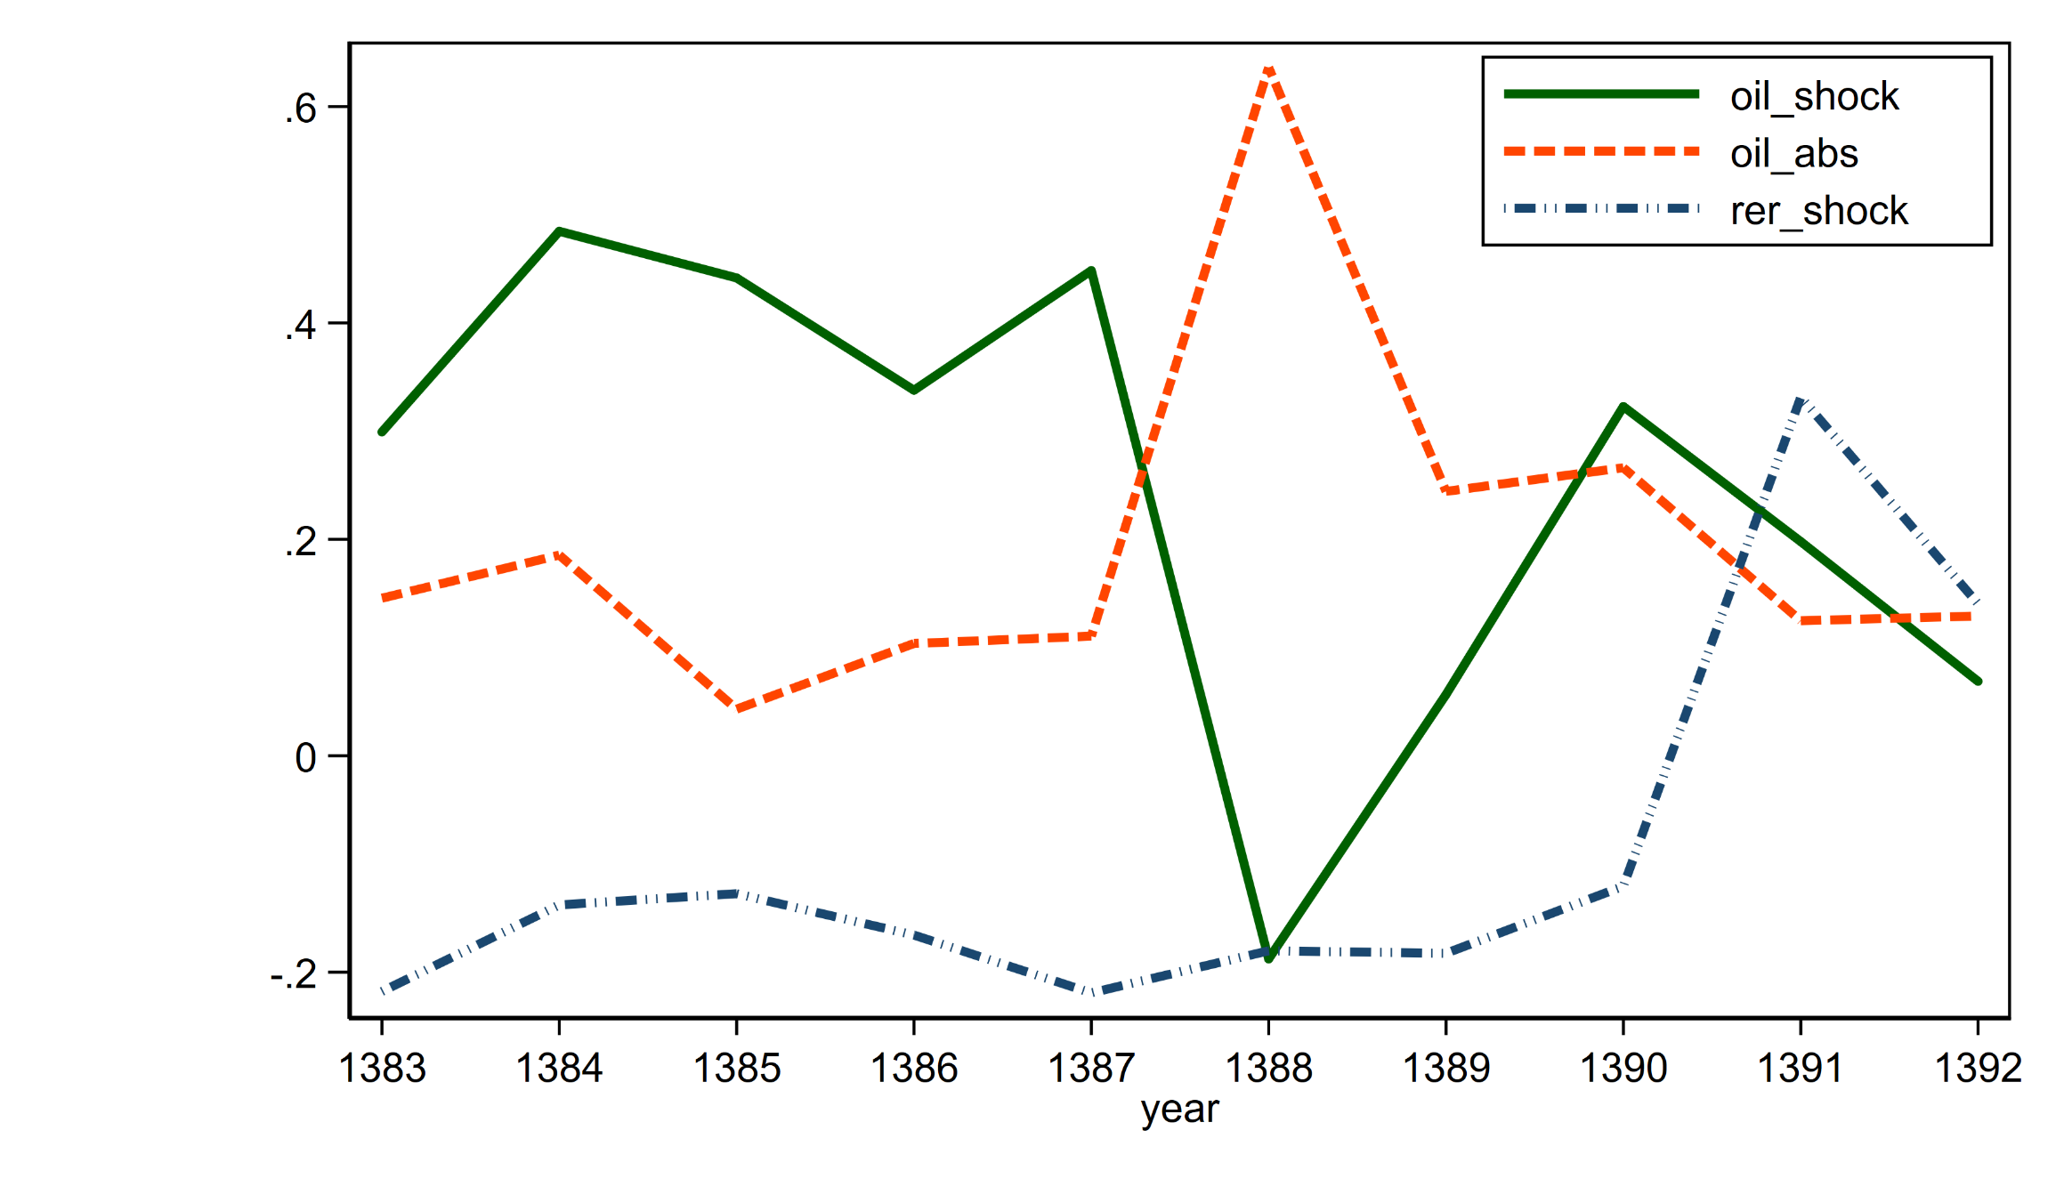
Oil and Real Exchange Rate Shocks
H. Joshaghani, K. Hoseiny

Slide 21
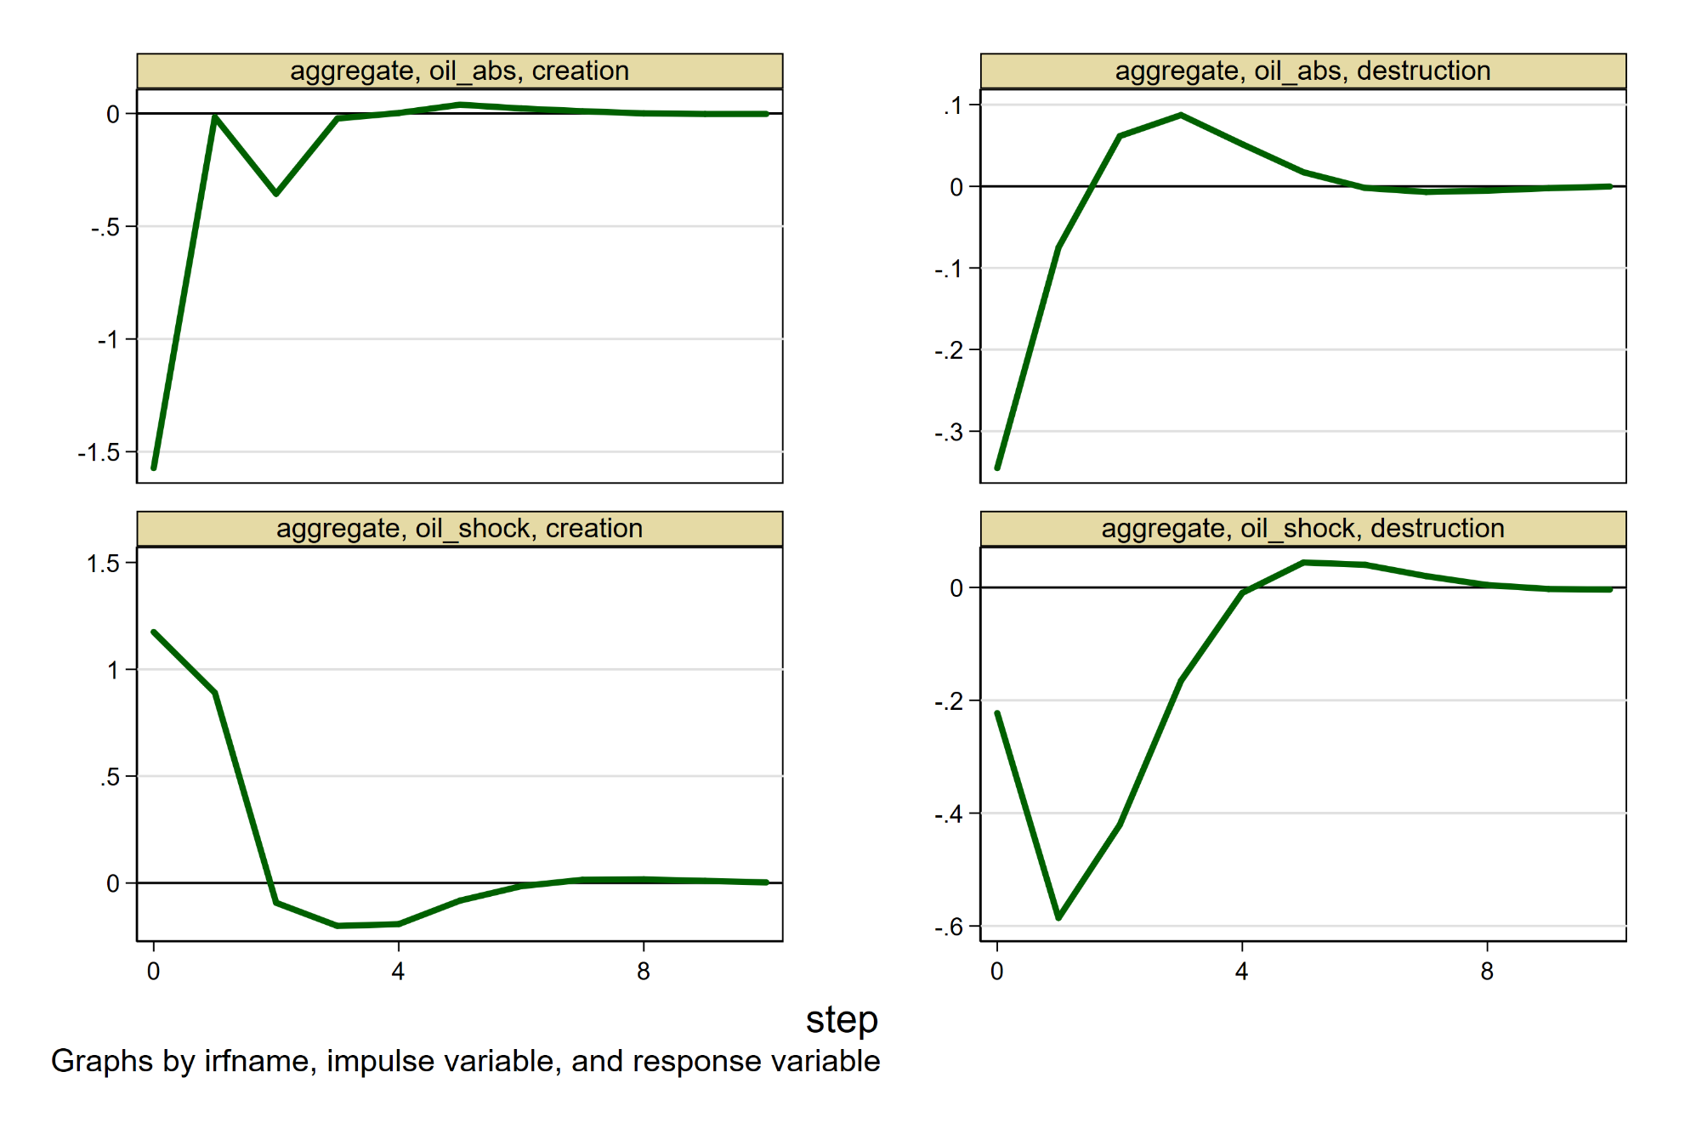
Responses of Job Creation and Destruction To Oil Shocks
H. Joshaghani, K. Hoseiny

Slide 22
Summary of OIL shocks
Positive oil shocks increase job creation but decrease job destruction →aggregate effects dominate reallocation effects
Oil shocks are not symmetric: positive and negative shocks are different
H. Joshaghani, K. Hoseiny

Slide 23

Oil Shocks versus Real Exchange Rate Shocks
Now let’s include shocks to the real exchange rate in the structural VAR:
$$Y_{t}=[\begin{matrix}{oil}_{t} & {abs}_{t} & {rer}_{t}\end{matrix} \begin{matrix}{jc}_{t} & {jd}_{t}\end{matrix}]′$$
RER shocks increase job destruction and decrease job creation rates → the aggregate effect dominates reallocative one
H. Joshaghani, K. Hoseiny

Slide 24
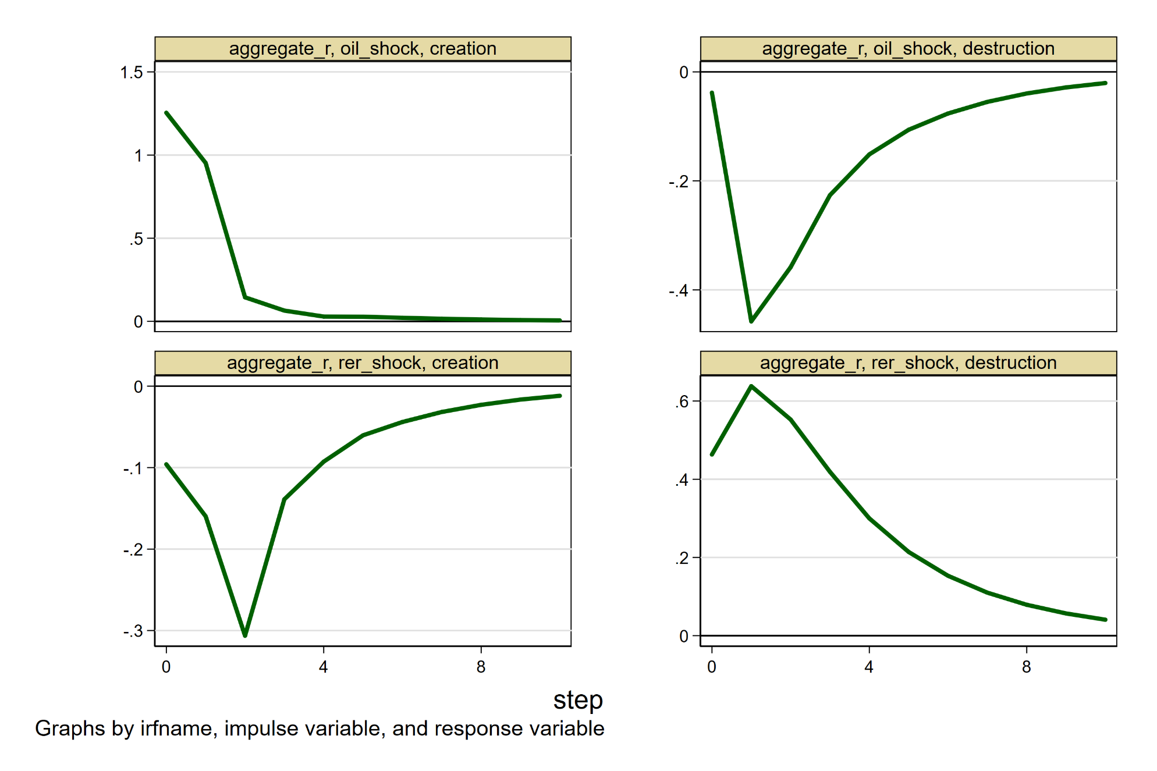
Responses of Job Flows To Oil and RER Shocks
H. Joshaghani, K. Hoseiny

Slide 25
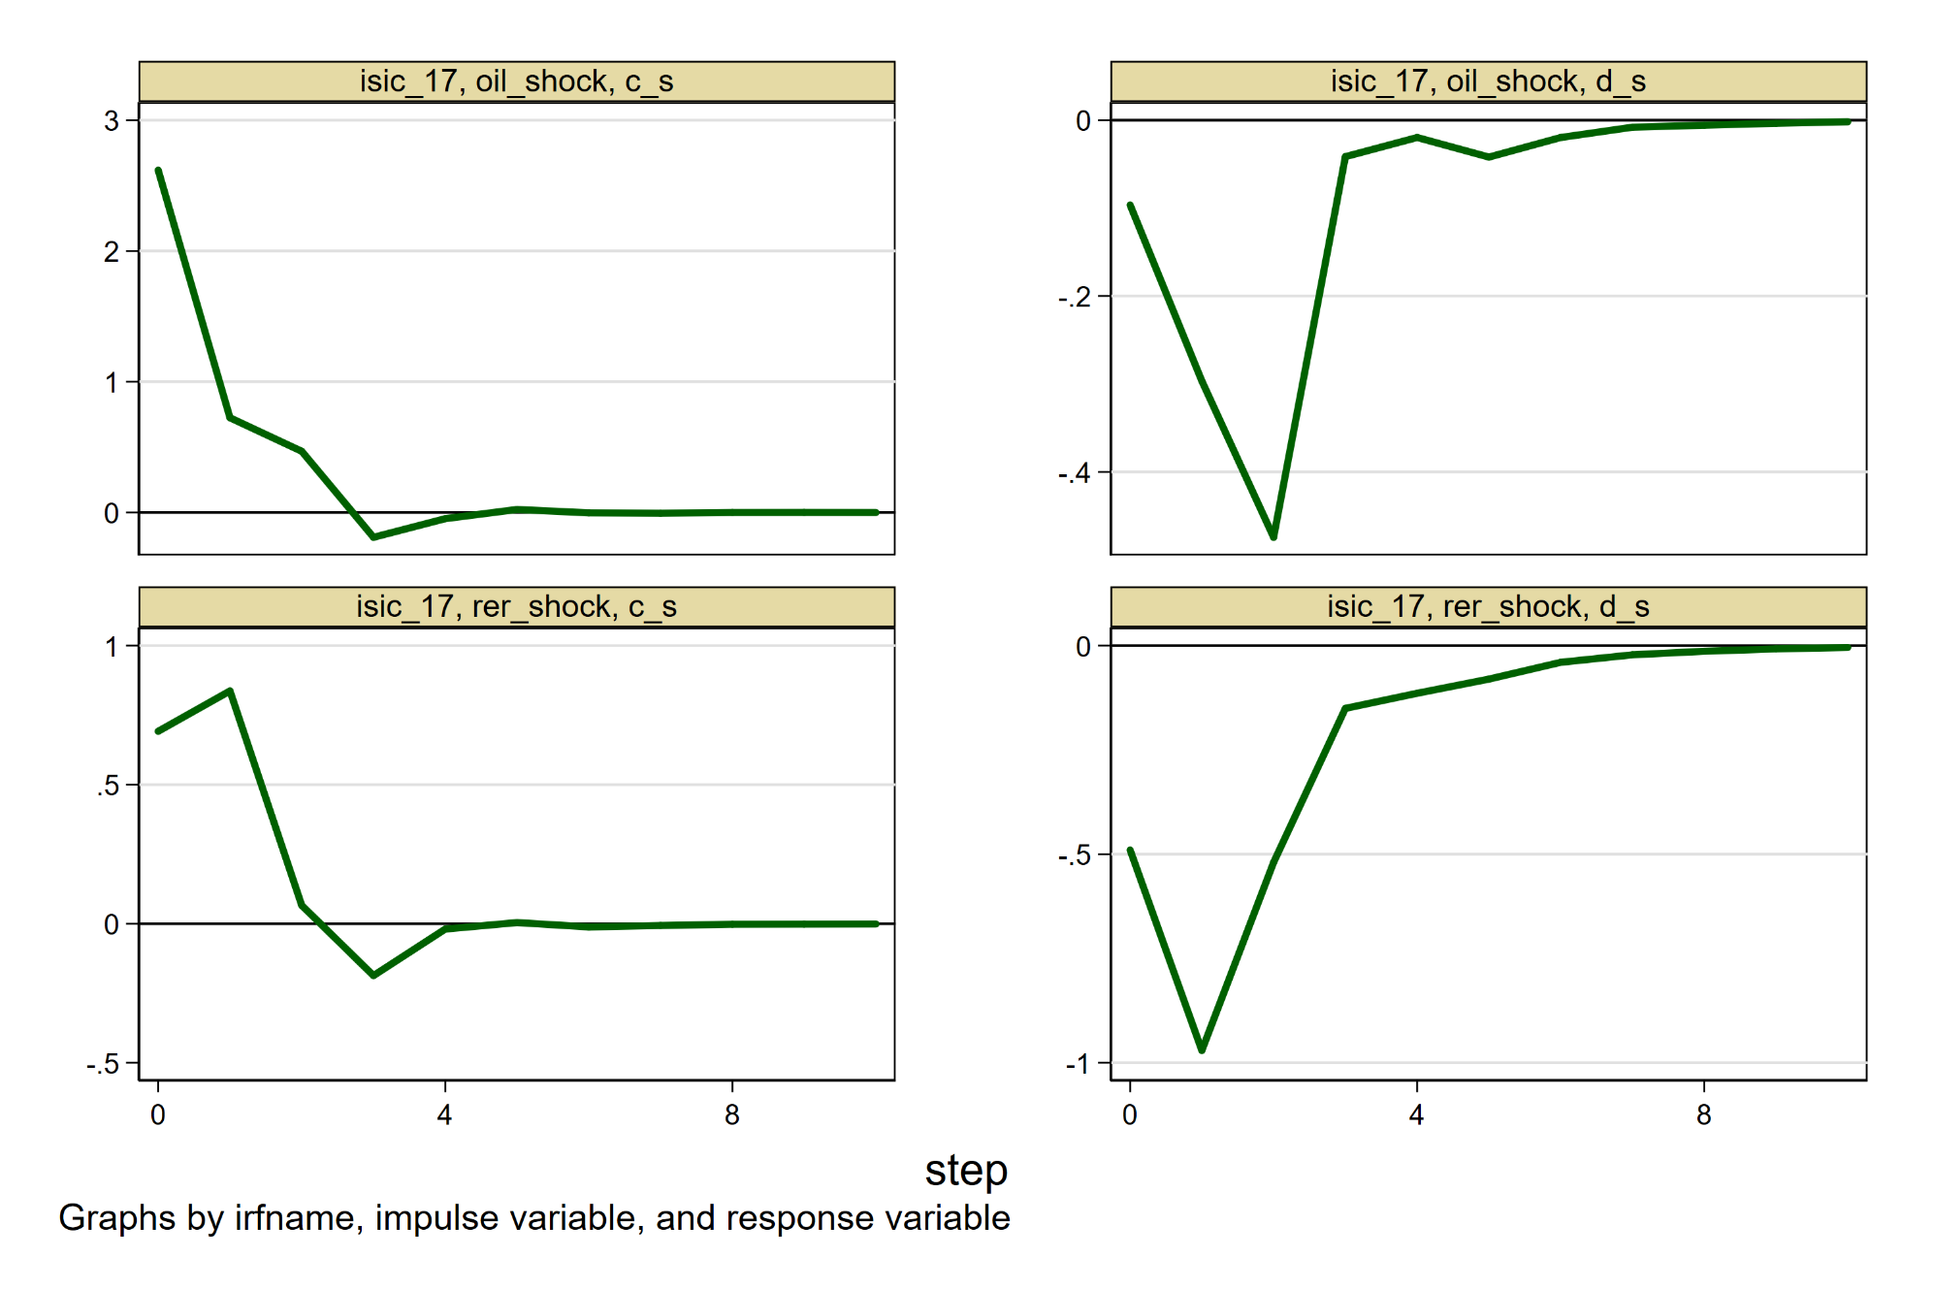
Are the responses the same across sectors? No!
Textile
8%
Employment
Share
H. Joshaghani, K. Hoseiny

Slide 26
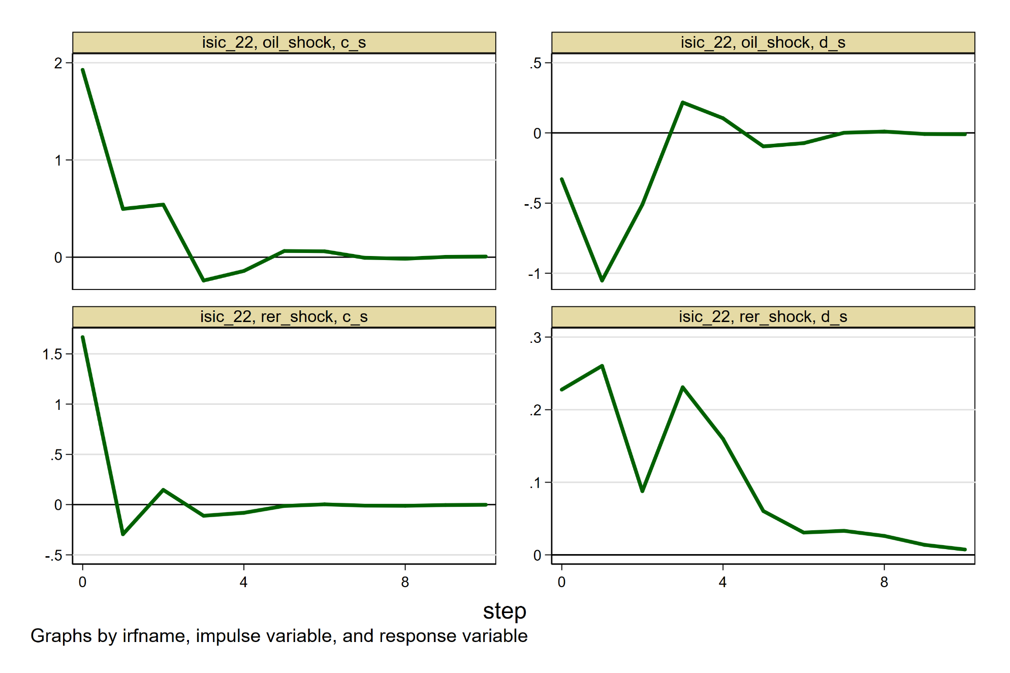
Are the responses similar across sectors? No!
Printing
& Paper
2.4%
Employment
Share
H. Joshaghani, K. Hoseiny

Slide 27
Conclusion
There are lot of information in sectoral labor market outcomes.
To understand aggregate phenomena, such as jobless recoveries, low FLFP, etc. , one needs sectoral analysis.
Oil and real exchange rate shocks both affect the economy through aggregate channels.
Though some sectors reallocation effect of the shocks dominate.
H. Joshaghani, K. Hoseiny

