Slide 1
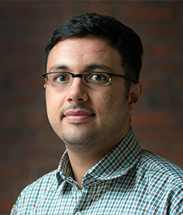
Jamal Ibrahim Haidar
Postdoctoral Research Fellow, Kennedy School of Government, Harvard University
Ph.D. in Economics, Paris School of Economics,
Université Paris 1 Panthéon-Sorbonne
International Economics, Development Economics,
and Political Economy

Slide 2
Do Political Connections Reduce Job Creation?
Evidence from Labanon
Ishac Diwan (Columbia University)
Jamal Ibrahim Haidar (Harvard University)
September 2017

Slide 3
Motivation
Why do firms in some countries not create more jobs?
Do political connections affect job creation at the firm-level?
An assessment is needed for two opposing mechanisms:
Privileged firms may have an obligation to pay back the favor by providing jobs for their constituencies
Unfair privileges to particular firms can reduce the incentives of their competitors to innovate and grow
The case of Lebanon serves the purpose of this study:
Sectarian oligarchs whose power rests on the distribution of clientelistic rents
Politicians in Lebanon find employment for their constituents in exchange for votes
Three quarters of university students surveyed by LCPS thought political connections were important to find jobs; 20% said that they had used them.
This paper:
Analyzes the micro foundations of employment growth in Lebanon
Examines whether PCFs affect job creation by similar non-PCFs

Slide 4
Related literature
Regulatory rents are at the basis of political settlements (Shleifer and Vishny, 1994).
Deals rather than rules characterize corporate environments in developing countries (Hallward-Driemeier and Pritchett, 2016).
Political connections of firms affect firm value, behavior of lenders, corporate transparency, tariff evasion, state capture, and capital controls:
China (Cull and Lixin, 2005), Malaysia (Johnson and Mitton, 2003), Pakistan (Khwaja and Mian, 2005), Indonesia (Fisman, 2001, Leuz and Oberholzer-Gee, 2006), Brazil (Claessens et al., 2008), Tunisia (Rijkers et al., forthcoming), and Egypt (Diwan et al., 2015)
Inverted U-shape relation between competition and growth (Aghion et al., 2001)
The effect of political connections on job creation has not been studied yet.

Slide 5
Main Findings
Large firms account for the bulk of net job creation in Lebanon.
The transition of firms between size groups, after starting-up, is limited.
PCFs are larger and create more jobs, but are also less productive and pay higher wages, than non-PCFs within their sectors.
PC firms dominate the sectors in which they operate.
PCFs reduce net job creation at the sector level by affecting growth of non-PCFs.
For every additional PCF in a sector, 6.8 % less jobs are created each year on average in that sector.

Slide 6
What’s Next?
Dataset
Empirical analysis

Slide 7
Dataset
Firm-level census data (MoF)
Time period: 2005-2010
Comprehensive coverage: all (141000) formal firms and sectors on annual basis: no size threshold
Quality check: compare MoF data to the CR data
Variables:
ID, sector, date of birth, capital, output, wages, and number of employees
Data on names and owners of firms (CR)

Slide 8
Dataset
Only formal firms that pay taxes and declare labor that pay social security contributions
In 2010: 775,540 compared to 777,000 workers (ILO) in TLF in formal sector
ILO report 613,000 informal workers, mainly in micro enterprises in Lebanon
To correct for weaknesses related to reporting errors, we dropped:
false firms: ones with high volatility in output per worker
firms with reporting errors – i.e., born in 2007 but paying taxes in earlier years
a total of 4.6% of the firms originally reported, 1.1% of which are false firms

Slide 9
Identifying Politically-connected Firms
Developed a list of PC individuals
Defined a person as PC if she or he is:
a parliament member, minister, or president who was in office between 1992 and 2010; a direct family member; or a publicly-known friend of any of the above
Used the Commercial Register at the MoJ to identify PCFs
CR: sector, date of birth, paid in capital, and owners of firms
Matched all the PCFs that we found in the CR with the MoF dataset
Focused on all firms with at least 50 employees in at least one year between 2005-2010 and that include at least one owner that is in our list of PC individuals
Identified 497 PCFs in 29 out of 289 4-digit sectors

Slide 10
Identifying PCFs
No way to capture ALL PCFs, but unlikely that any what we call PCF is not
Two types of errors
Incorrect exclusion (Type I) error, i.e., due to different spellings of names
Ignore titles and allow for common spelling variants
False inclusion (Type II) error, i.e., due to matching a firm to a politician but the match is incorrect as, for instance, different people may share the same name.
Match on the owner’s first, middle, and last names before classifying a firm as PC
Under-match if firms are PC through indirect means
underestimates of the true effect
Ownership does not change in our database

Slide 11
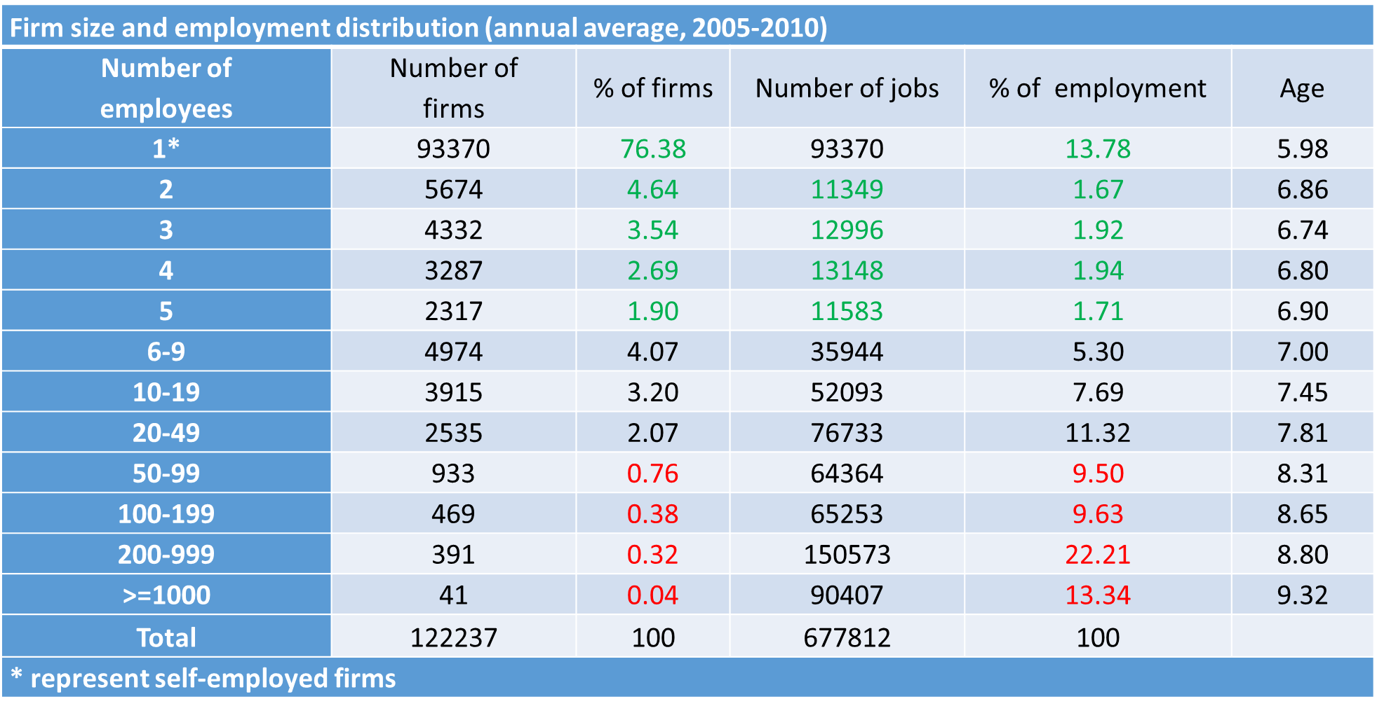
Large Share of Labor Works in Relatively Large Firms

Slide 12
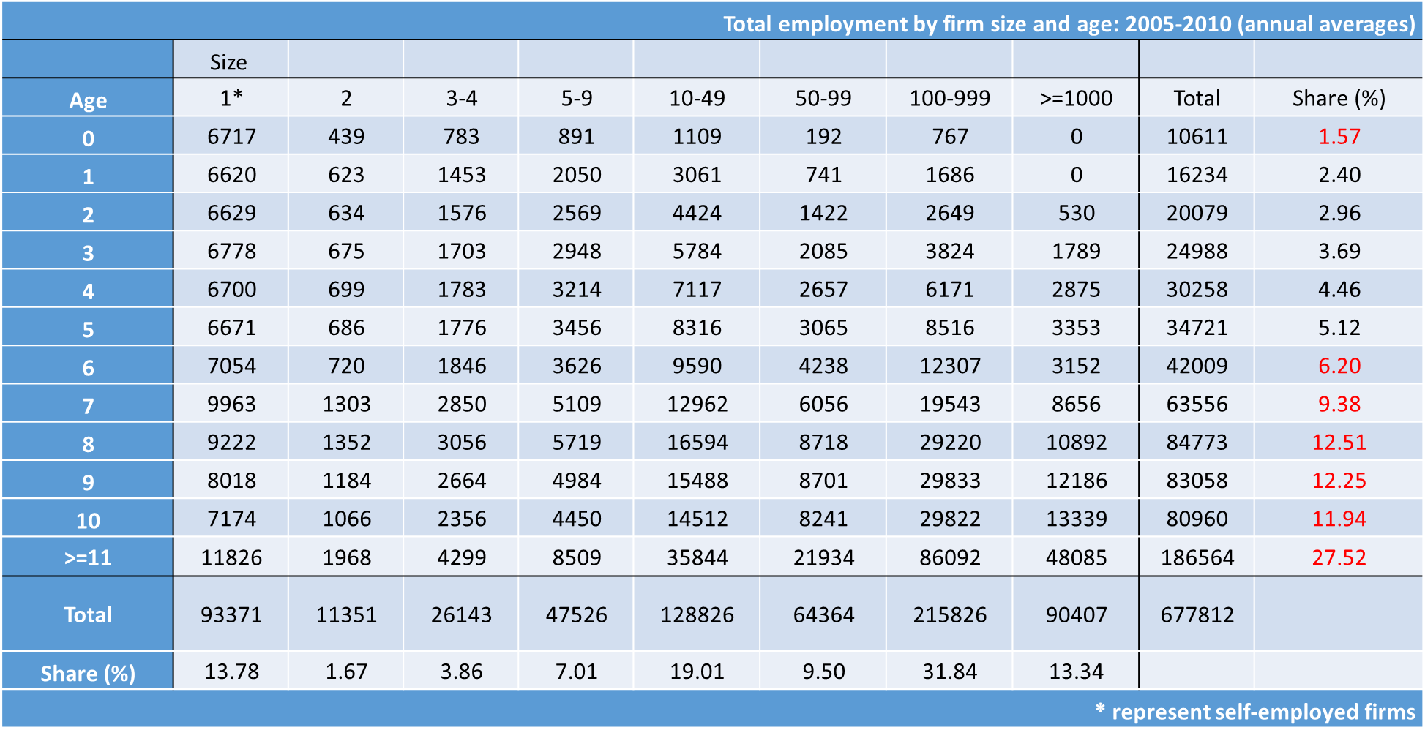
Employment Is Concentrated In Old Firms

Slide 13
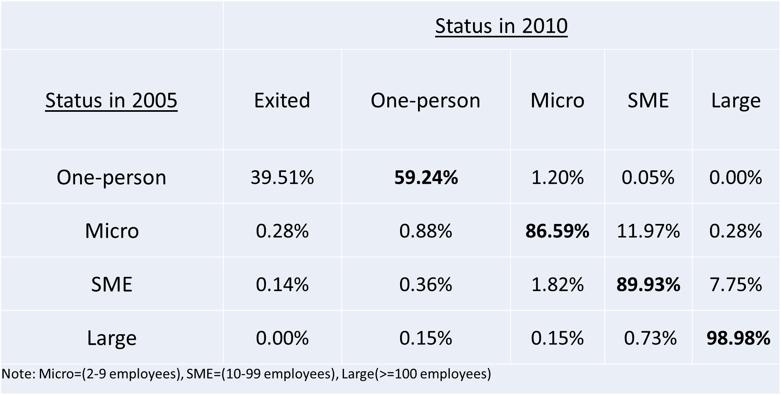
Firm Growth Is Limited

Slide 14
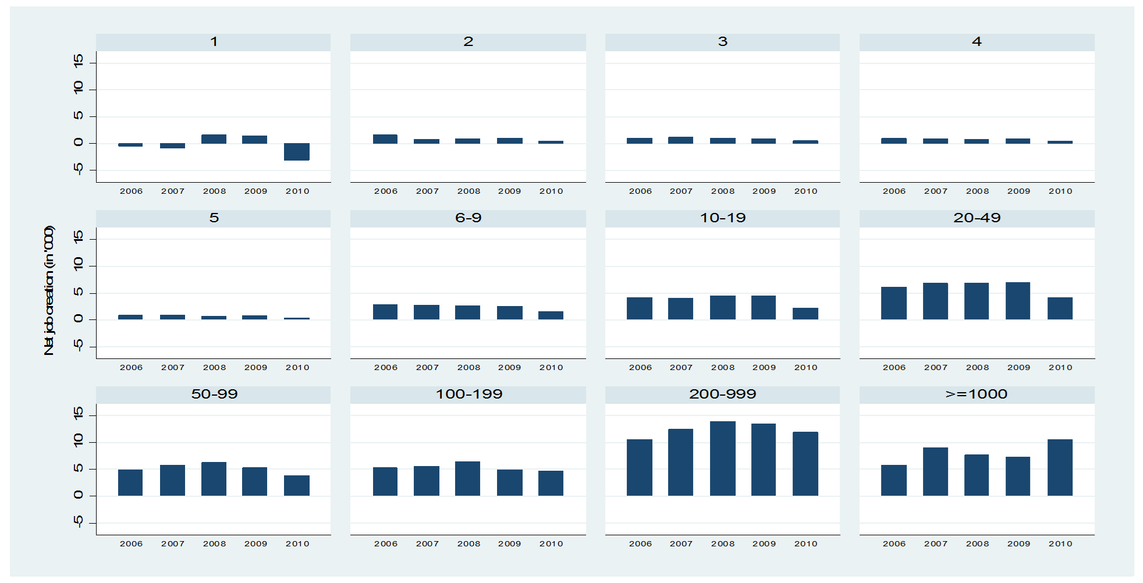
Net Job Creation Is Largely Driven By Large Firms

Slide 15
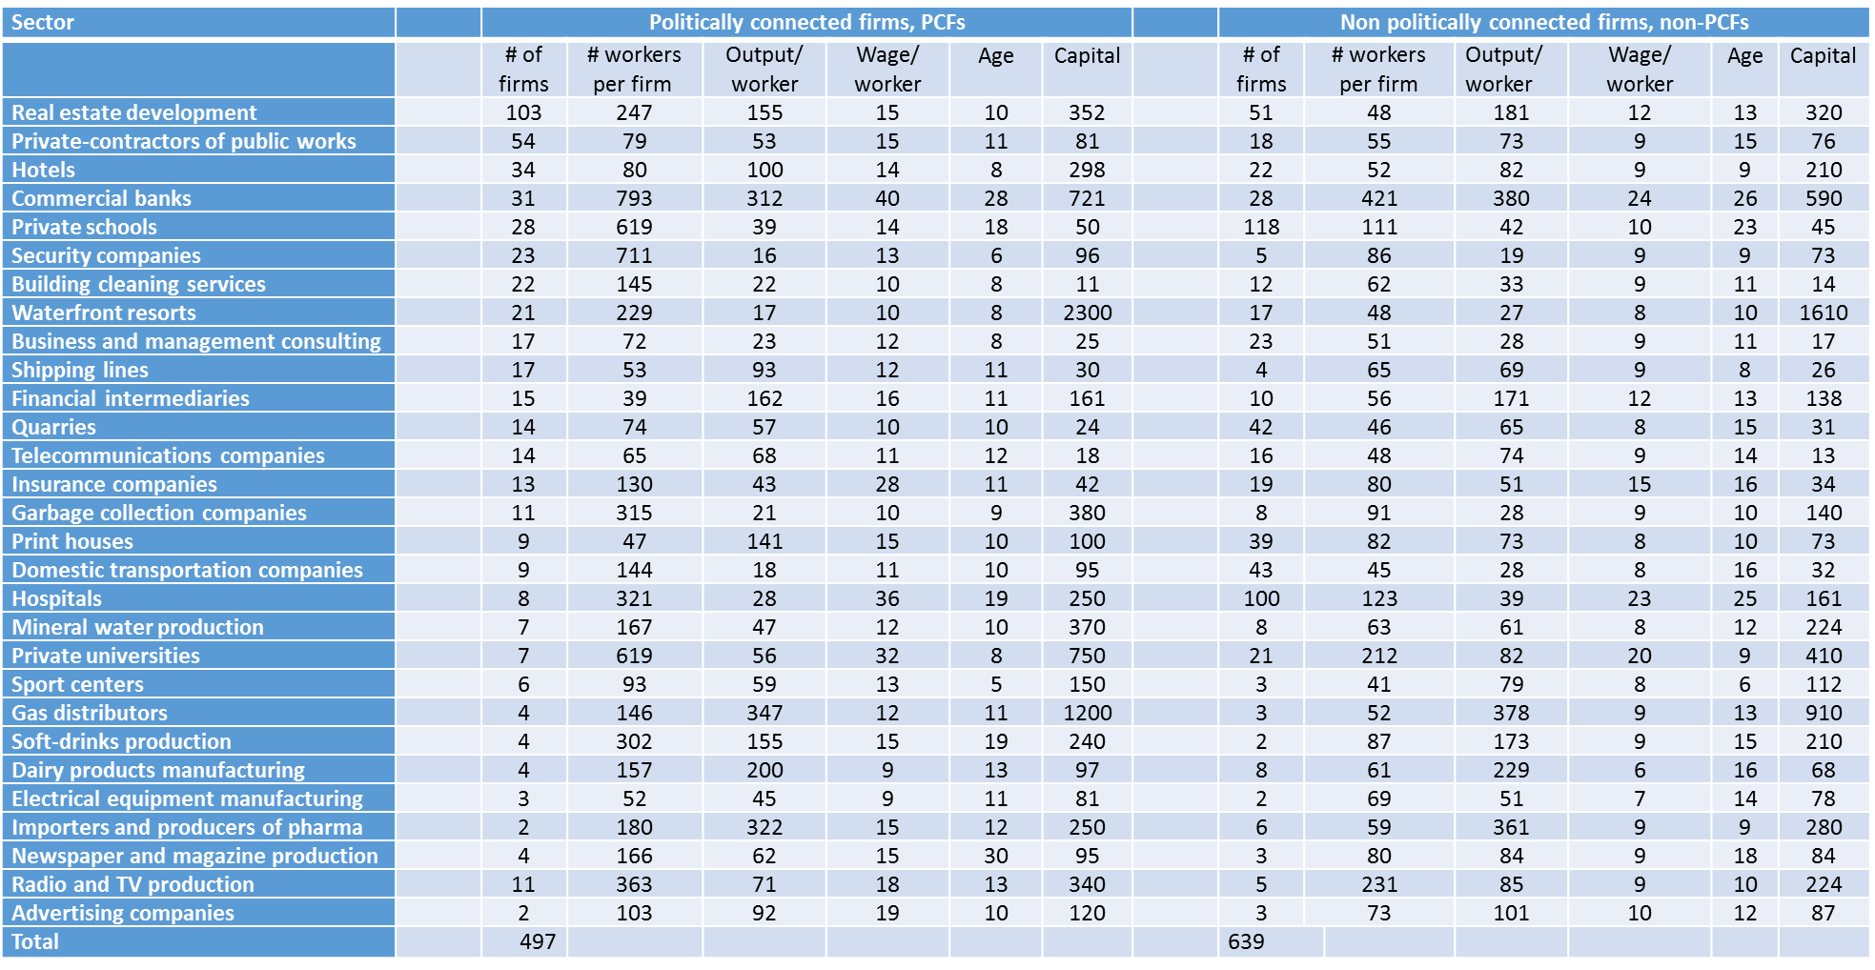
Characteristics Of Pcfs In Lebanon

Slide 16
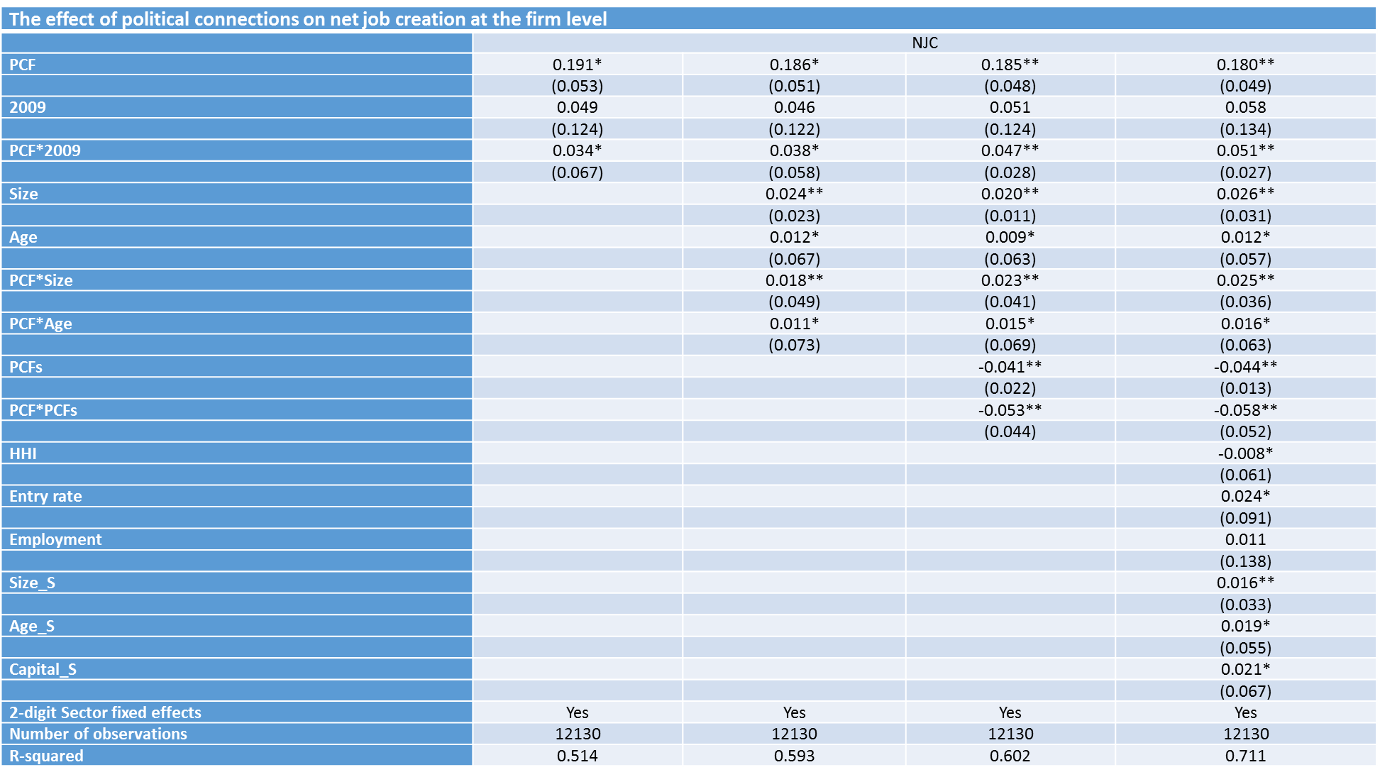

Slide 17
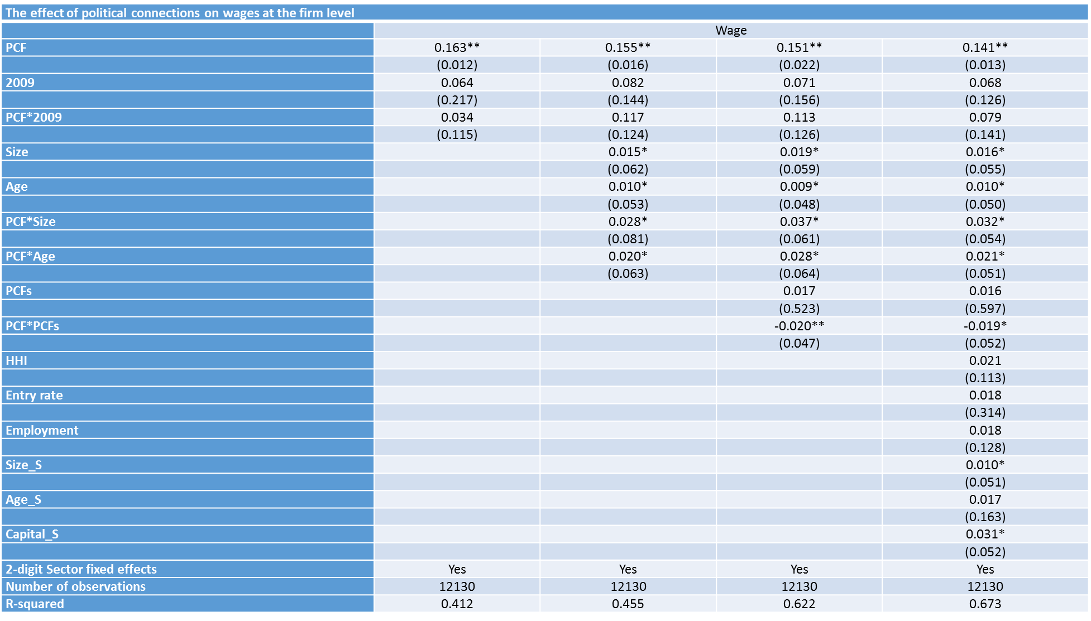

Slide 18
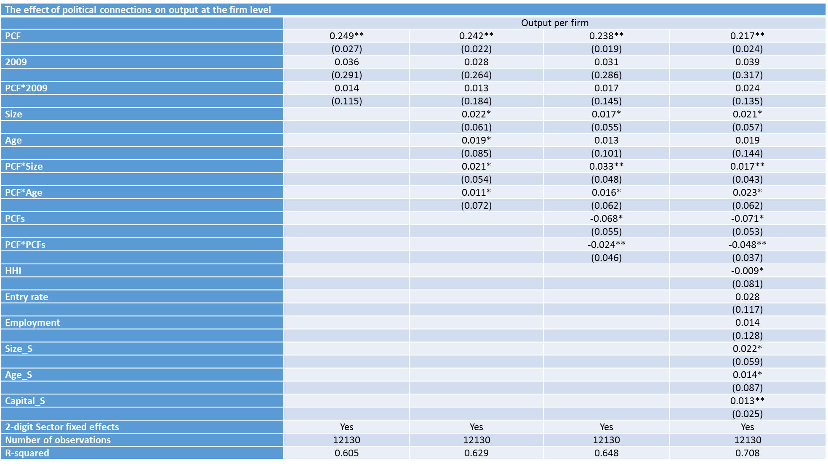

Slide 19


Slide 20
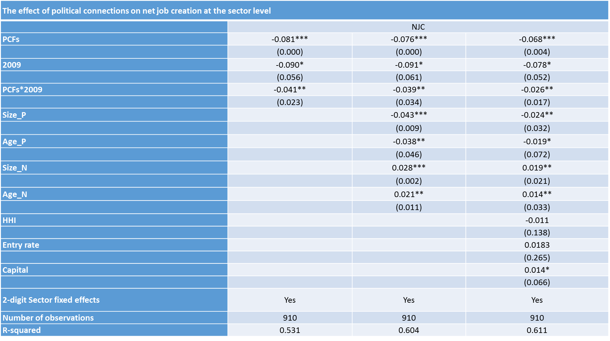

Slide 21
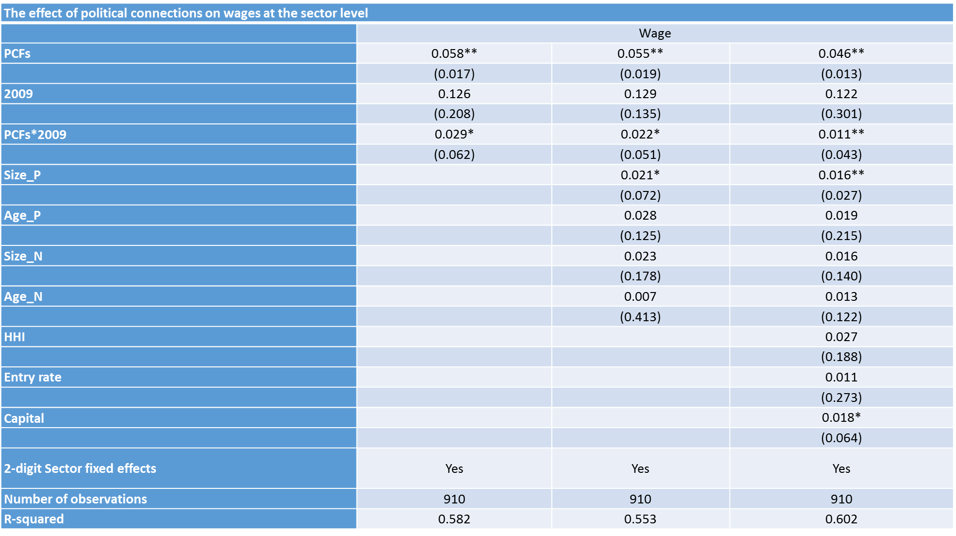

Slide 22
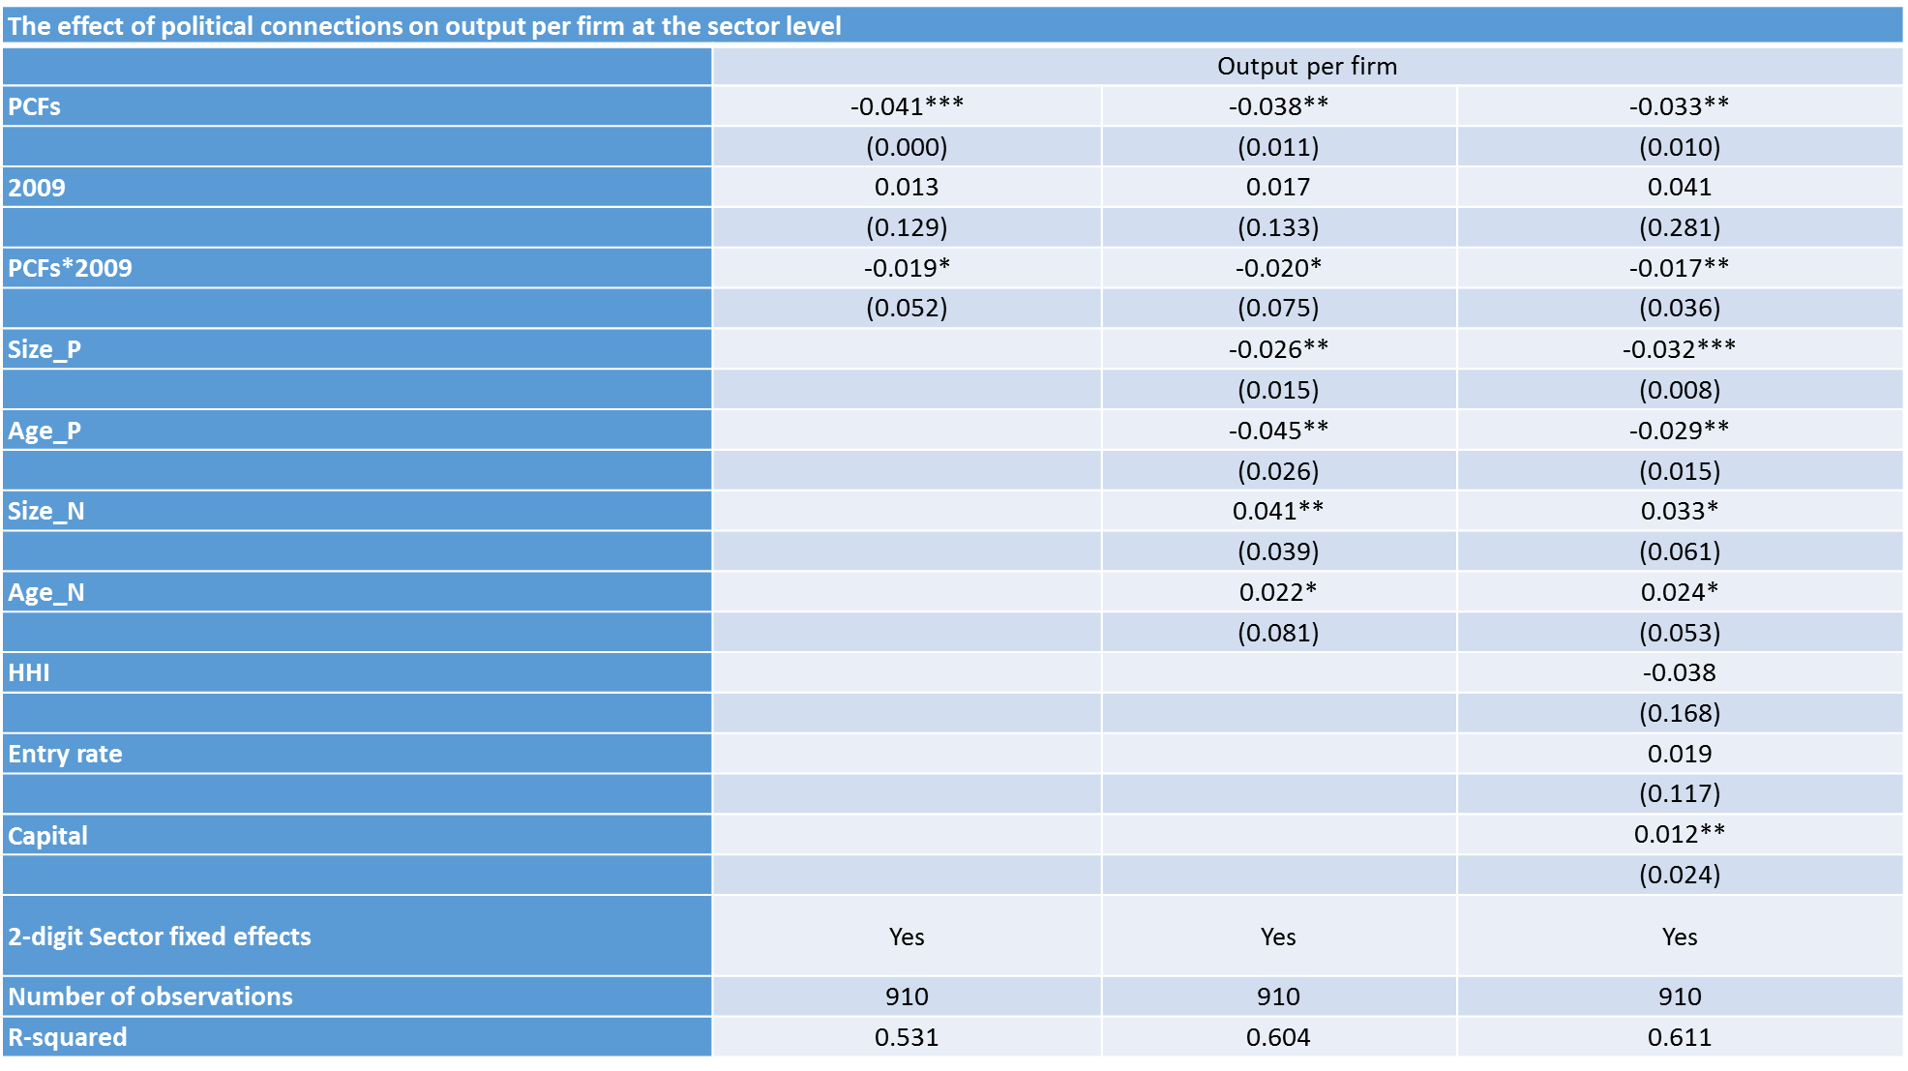

Slide 23
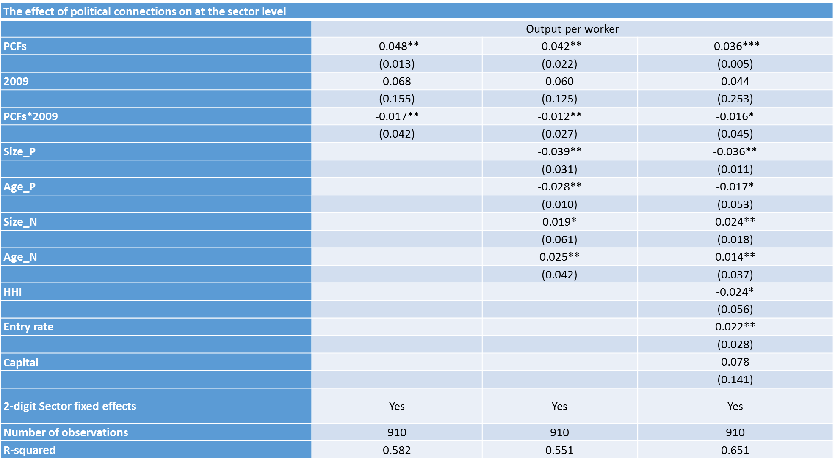

Slide 24
In A Nutshell
We find:
Large firms account for the bulk of net job creation in Lebanon.
PCFs are larger and create more jobs, but are also less productive and pay higher wages, than non-PCFs in their sectors.
For every additional PCF in a sector, 6.8 % less jobs are created each year on average in that sector
Policy recommendations:
Yes, competition could lead to more growth and job creation
But, competition may not support the current oligarchic political equilibrium, would possibly lead to political chaos

