Slide 1

Mahdi Majbouri
Assistant Professor of Economics at Babson College
Ph.D. Economics,
University of Southern California Los Angeles
development and labor economics,
economics of oil and gas, and applied econometrics

Slide 2
Fertility and the Puzzle of Female Employment in the Middle East
Mahdi Majbouri

Slide 3
Contents
Introduction
Econometric Model
Data
Results
Conclusion
M. Majbouri

Slide 4
Introduction
Mahdi Majbouri

Slide 5
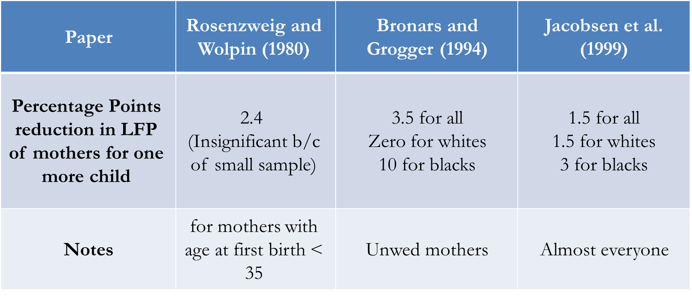
Papers using first-born twins as instrument for number of children (in the US)
Mahdi Majbouri

Slide 6
Why is this question interesting?
The results of the studies for the US are not surprising.
In MENA, fertility rates have decreased by about 2 children per woman between 1985 and 1995-2000.
But female labor force participation rates remained at their low levels of three decades ago.
So does reduction in fertility affect FLFP in MENA or not?
Mahdi Majbouri

Slide 7
Why is this question interesting?
Do government policies that help mothers, such as subsidized childcare, increase mother’s participation in the labor force?
Mahdi Majbouri

Slide 8
Preview of the Results
Mahdi Majbouri

Slide 9
Preview of the results
One more child does not reduce participation for mothers in Egypt, Jordan, Morocco, and Tunisia.
Mahdi Majbouri

Slide 10
Econometric Model
Mahdi Majbouri

Slide 11
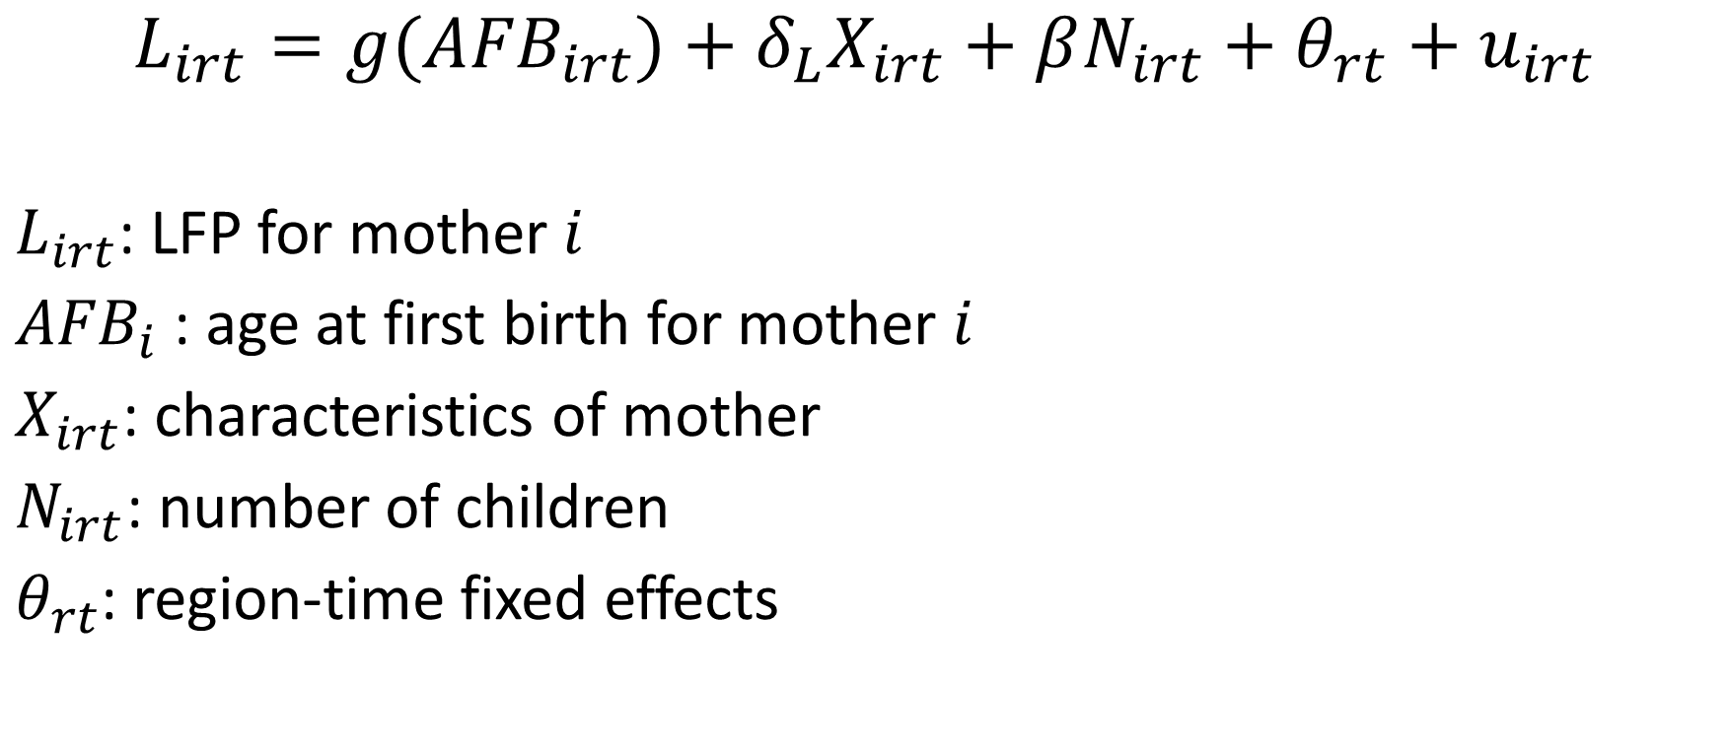
$$L_{irt}=g({AFB}_{irt})+δ_{L}X_{irt}+βN_{irt}+θ_{rt}+u_{irt}$$
$L_{irt}$: LFP for mother $i$
${AFB}_{i}$ : age at first birth for mother $i$
$X_{irt}$: characteristics of mother
$N_{irt}$: number of children
$θ_{rt}$: region-time fixed effects
Mahdi Majbouri

Slide 12

$$N_{irt}=f\left({AFB}_{irt}\right)+δX_{irt}+γT_{irt}+μ_{rt}+e_{irt}$$
$T_{irt}$ is whether mother has a twin
Using $T_{i}$ as instrument for $N_{i}$
Mahdi Majbouri

Slide 13
Data
Mahdi Majbouri

Slide 14
Data
DHS data sets:
Egypt (1988, 1992, 1995, 2000, 2003, 2008, 2014),
Jordan (1990, 1997, 2002, 2007, 2012),
Morocco (1987, 1992, 2003-04),
Tunisia (1988)
105,161 mothers, 1200+ with multiple first births
Mahdi Majbouri

Slide 15
Results
Mahdi Majbouri

Slide 16
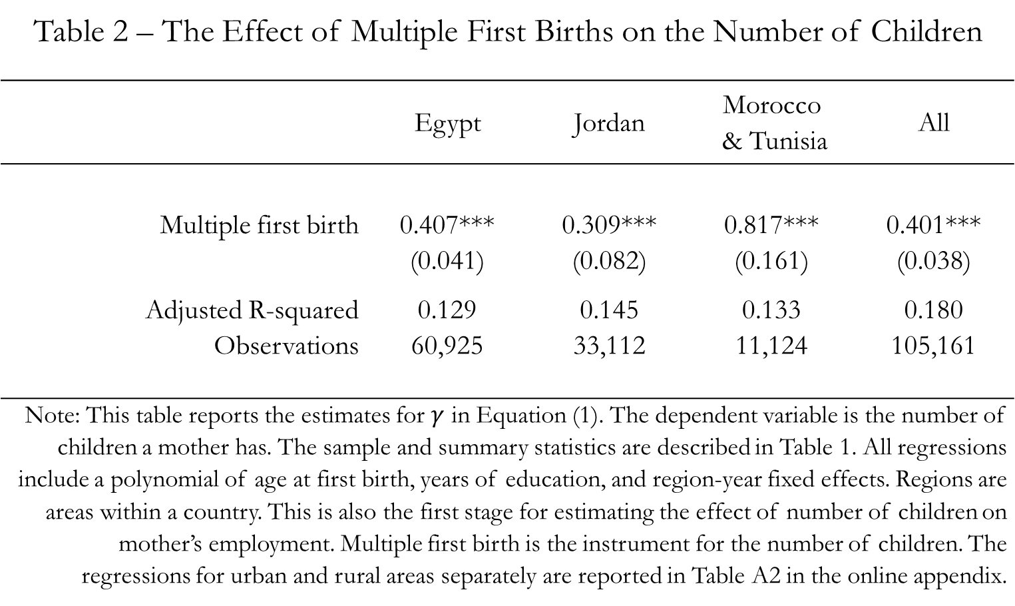
Mahdi Majbouri

Slide 17
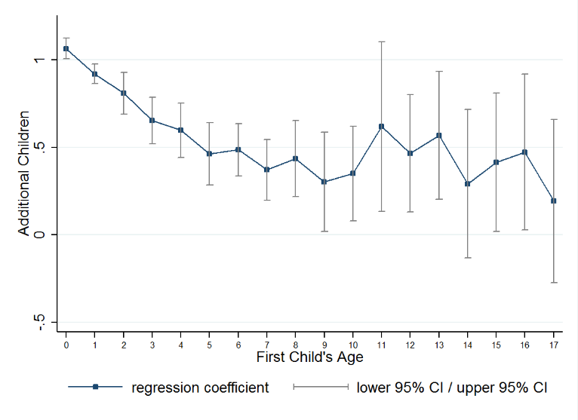
Effect of Having Twins on Number of Children Across the First Child’s Age (All Countries)
Mahdi Majbouri

Slide 18
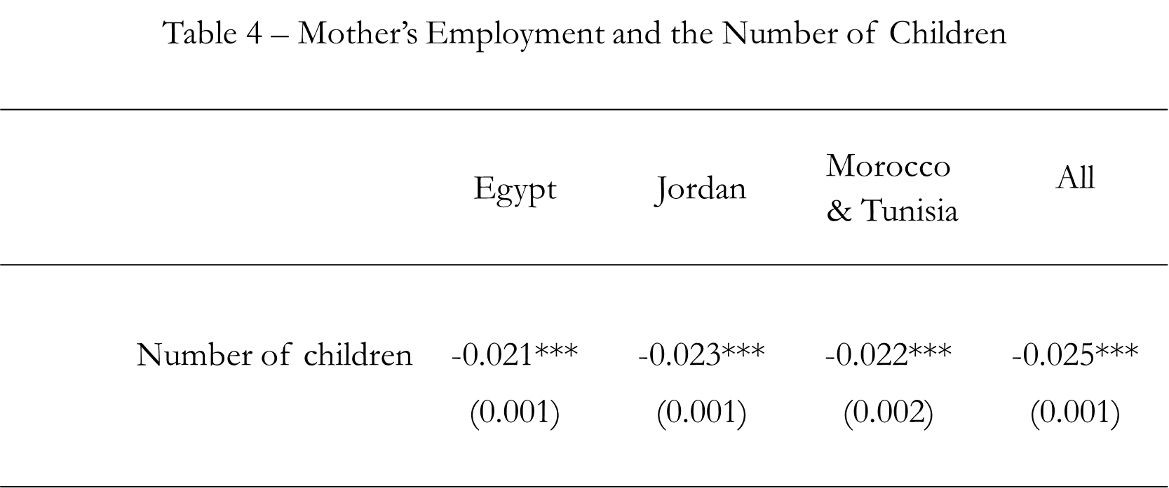
Mahdi Majbouri

Slide 19
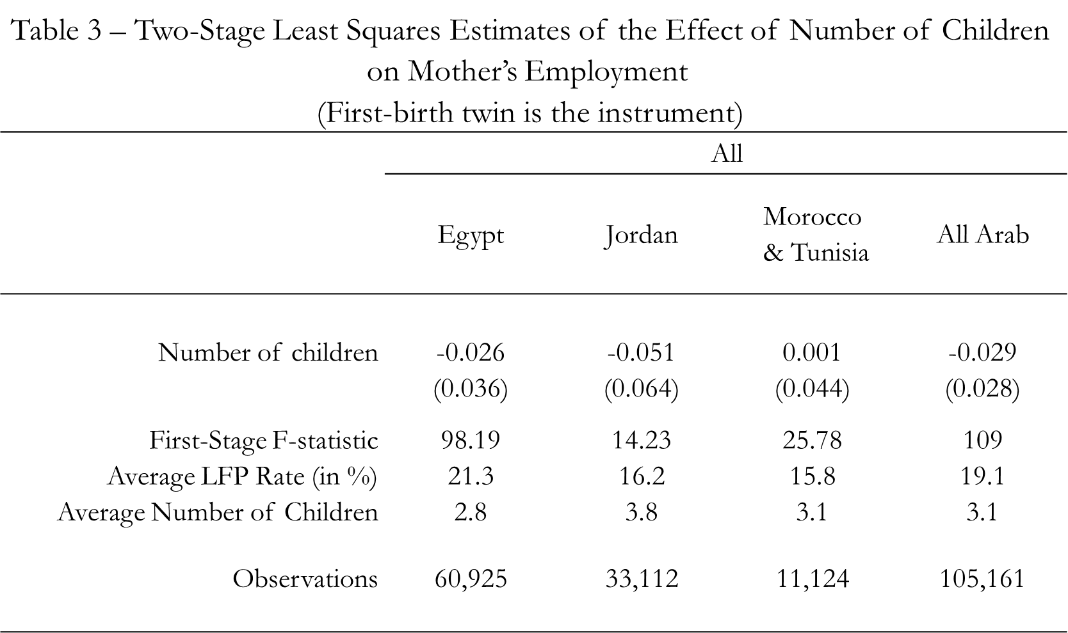
Mahdi Majbouri

Slide 20
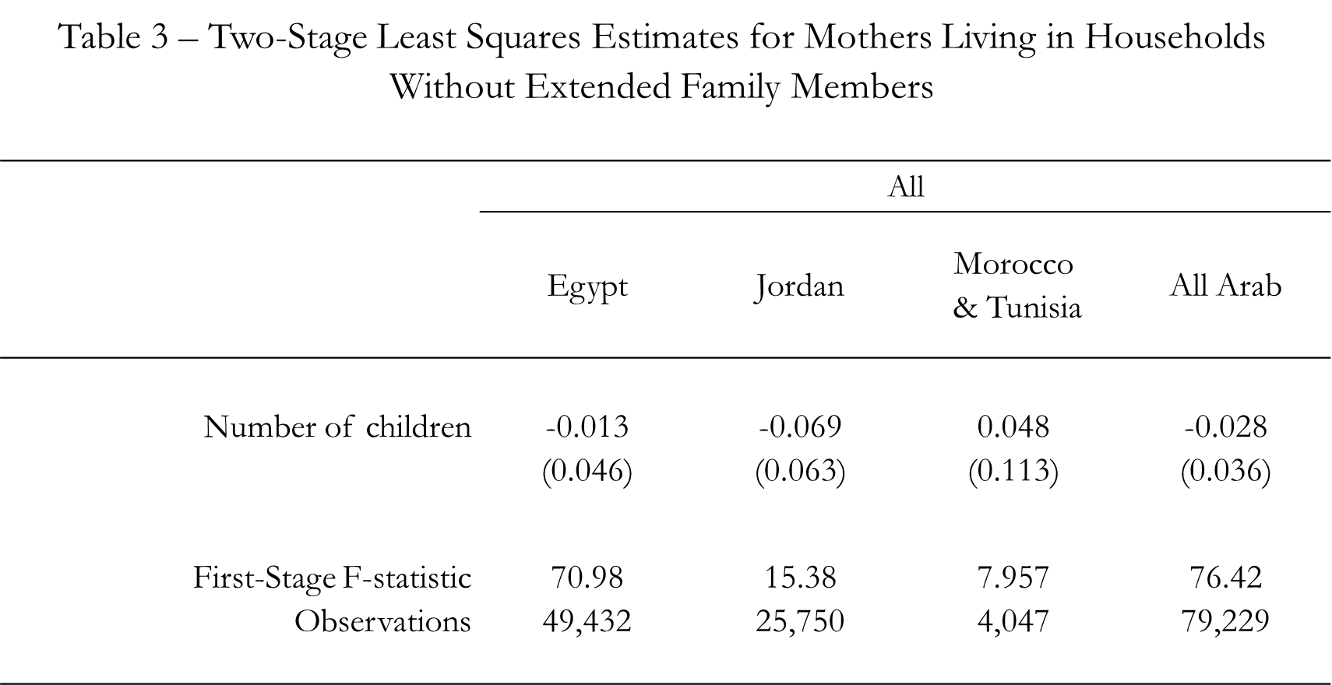
Mahdi Majbouri

Slide 21
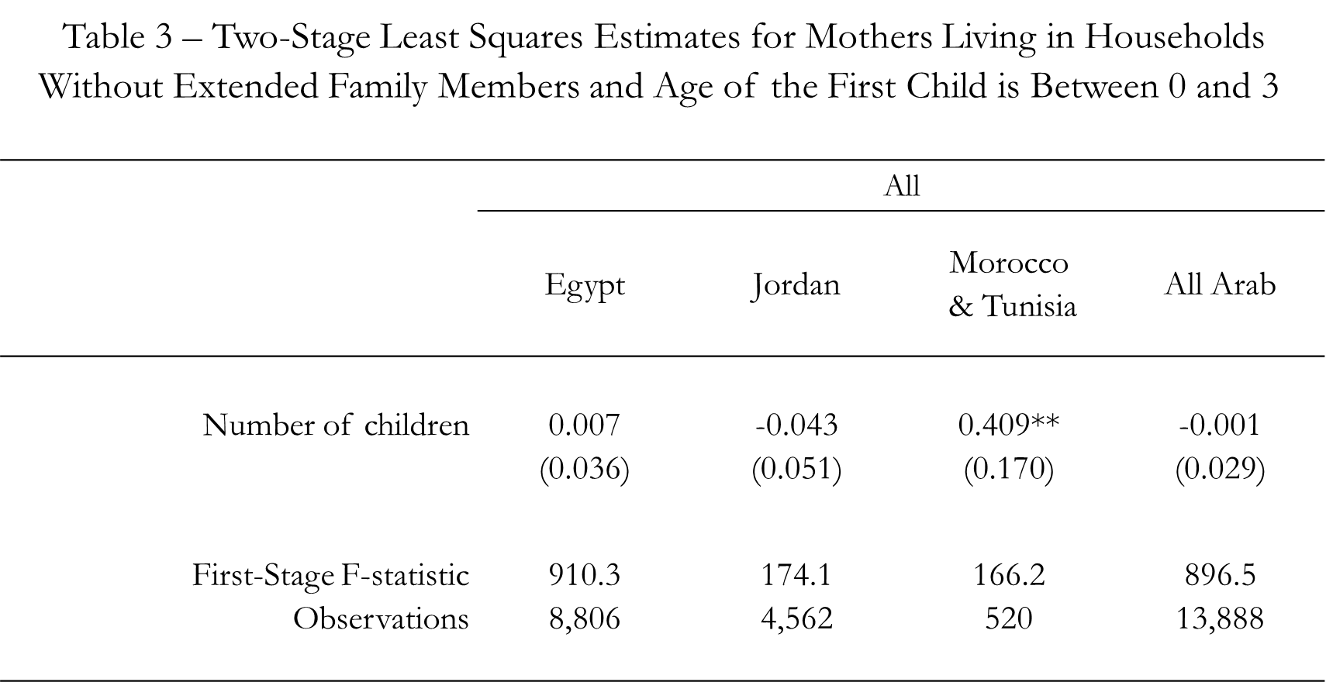
Mahdi Majbouri

Slide 22
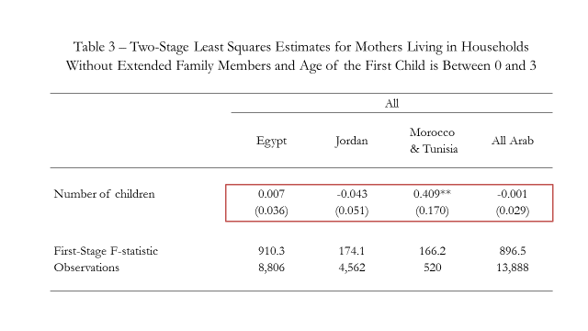
Mahdi Majbouri

Slide 23
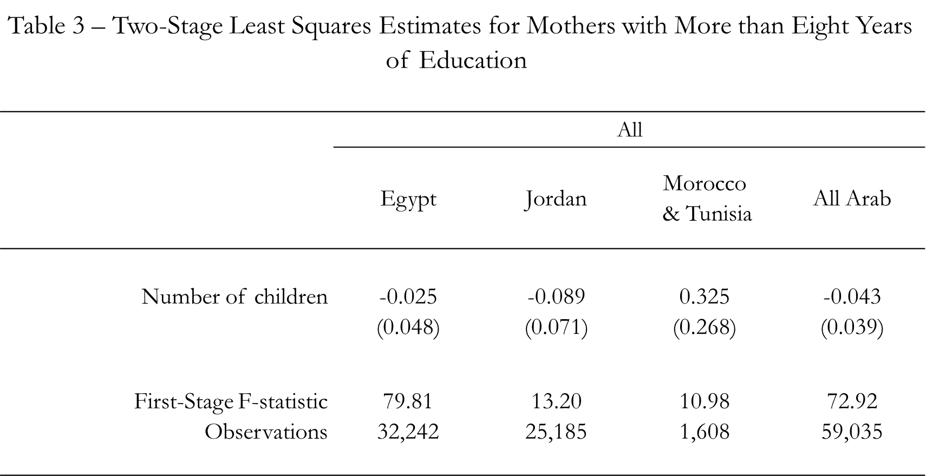
Mahdi Majbouri

Slide 24
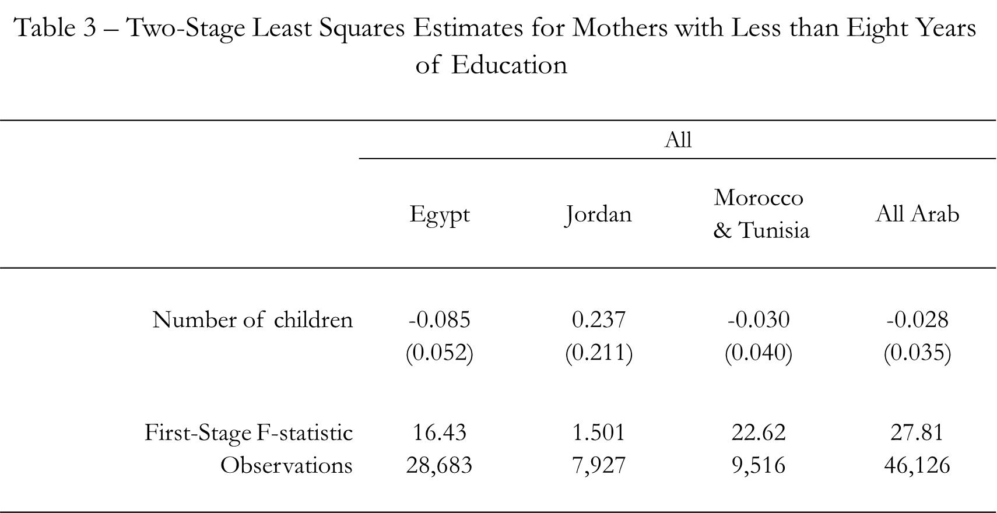
Mahdi Majbouri

Slide 25
Conclusion
Mahdi Majbouri

Slide 26
Conclusion
One more child does not reduce participation for in Egypt, Jordan, Morocco, and Tunisia.

