Slide 1

Alaedin Ezoji
Director General of Employment Policy and Development, Ministry of Cooperatives, Labor and Social Welfare
Ph.D. Candidate, Economics, Tarbiat Modarres University(TMU),
Macroeconomic, Labor Economic, Productivity, health economic, planning and Regional economic

Slide 2
Estimation of Employment Elasticity and Optimal Rate of Employment Growth in I.R. Iran Economic Sectors
Alaedin Ezoji
Fatemeh Jahangard

Slide 3
Inclusive Growth and Employment
Productivity
Growth
Employment

Slide 4
Combination of Output and Employment Growth
IV High growth of output and of employment (employment-intensive growth) | I High growth of employment and low growth of output (growth-less jobs)
III High growth of output and with low growth of employment (Jobless growth) | II Low growth of output and of employment
Employment Growth
Output Growth

Slide 5
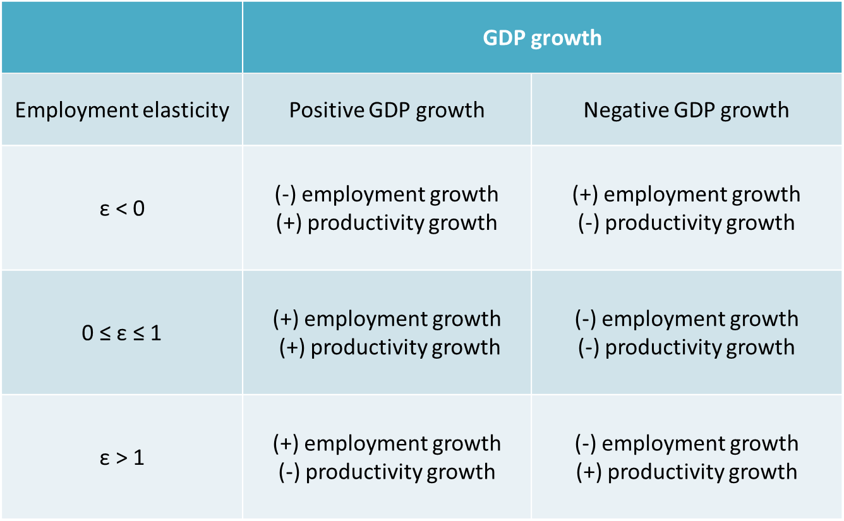
Interpreting employment elasticity

Slide 6
Global employment elasticity by age group and sex, 1991-2003
 | 1991-1995 | 1995-1999 | 1999-2003
Total | .34 | .38 | .30
Youth | -.02 | .11 | .06
Female | .40 | .44 | .33
Male | .30 | .34 | .29
GDP growth (%) | 2.9 | 3.6 | 3.5
???
Source: Steven Kapsos,2005

Slide 7
Global employment elasticity and value-added growth rates by economic sector, 1991-2013
Index | Agriculture | Industry | Services
Sector value-added elasticity | .41 | .28 | .57
Average annual value-added growth rate (%) | 2 | 2.1 | 3
Source: Steven Kapsos,2005

Slide 8
Trend of employment and labor productivity indicators in Agriculture(I.R.Iran)

Slide 9
Trend of employment and labor productivity indicators in Manufacturing(I.R.Iran)

Slide 10
Trend of employment and labor productivity indicators in Constrution(I.R.Iran)

Slide 11
Trend of employment and labor productivity indicators in Services(I.R.Iran)

Slide 14
Objectives:
General Objective:
Estimating Employment Elasticity and optimal rate of employment growth in economic sectors(I.R.Iran)
Other Objectives:
Calculating the Employment Elasticity at the macro level and economic sectors
Calculating the optimal rate of employment growth at macro level and economic sectors
Applied Policy of Employment Elasticity and Optimal Growth and New Approaches to Realizing the Growth of Employment

Slide 15
A- Estimation of Model
Estimation of Employment Elasticity(EE) model:
${EM}_{t}$ = $α_{0}{+α}_{1}Y_{t}+α_{2}({K/L)}_{t}{+α}_{3}{CI}_{t}+ε_{t}$
${LEM}_{t}$= C(1)* ${LEM}_{t−1}$ + C(2)* ${LY}_{t}$+ C(3)* ${L(K/L) }_{t}$ + C(4)* ${LCI}_{t}$+${ ε}_{t}$
Log (employment)
Log
(employment(-1))
log GDP
log capital per capita
log production ratio to t-1 capital stock
Error

Slide 16
Sustainability Growth
Production/ Value added
Production Factors Price
Capital to Labor ratio
Employment Growth
Capital Capacity
Capability
Felexcibilty
Employment Lag(-1)

Slide 17
Table 1:Static test result of variable; ADF Test
Variable | Total |  | Without Oil
 | Statistic(t) | prob | Statistic(t) | prob
LEM | -1.074431 | .7162 | -1.070906 | .7176
LY | -3.850248 | .0244 | -3.451824 | .3489
L(K/L) | -0.510946 | .4887 | -2.116180 | .5210
LCI | -5.626342 | .0002 | -5.905162 | .0000
Source: Authors

Slide 18
Determine the number of optimal lag for variables
Lag | LogL | LR | FPE | AIC | SC | HQ
1 | 670.5375 | NA | 1.29e-20* | -34.44934* | -33.75983* | -34.20402*
2 | 676.3432 | 9.166854 | 2.25e-20 | -33.91280 | -32.53378 | -33.42215
3 | 686.9204 | 14.47413 | 3.20e-20 | -33.62739 | -31.55886 | -32.89142
Source: Authors

Slide 19
Estimation result of employment elasticities
Aggregated(Total)
variable | Total | Total (without Oil sector)
LEM(-1) | .52370 | .95183
LY | .47934 | .42726
L(K/L) | -.52520 | -.15919
LCI | .42089 | .029263

Slide 20
Estimation result of employment elasticities;
Economic Sectors
variable | Agriculture | Oil | Mines | Manufacturing | Electricity, Gas and Water | Construction | Transportation and Communication | Real Estate and Business Activities | Others Services | Total
LEM(-1) | .67631 | .48551 | .86240 | .70776 | .49124 | .56907 | .70021 | .20675 | .44120 | .52370
LY | 0.5371 | 0.4130 | 0.4332 | 0.4063 | 0.6994 | 0.4509 | 0.5324 | 0.5842 | 0.6996 | .47934
L(K/L) | -.31898 | -.47922 | -.19945 | -.36544 | -.76664 | -.34832 | -.36165 | -.82392 | -.54336 | -.52520
LCI | .31737 | .46225 | .093839 | .23368 | .60420 | .30388 | .28036 | .88158 | .47530 | .42089

Slide 21
Estimation results ;(1)
Employment with Lag:
The difference in coefficient of LEM(-1) {c(1)-1}, indicates the degree of flexibility of the labor market.
In the two models(Macro level) estimated model with the consideration of the oil added value is less flexible than the previous period's employment, and is therefore slightly labor market.
Adjusted speed is 2 periods in the services sector and in the agriculture and industry sectors are 3.3 periods.(gap between real and desirable employment).

Slide 22
Estimation results;(2)
Production Growth:
At the macroeconomic level, employment elasticity is about 0/48.
The results of employment elasticity in terms of production in agriculture, Manufacturing and service sectors is 0.5, 0.4 and 0.65(at least), respectively.
Employment elasticity in agricultural sector is 0.5, industry sector 0.4 and service sector is 0.7. Therefore, the sensitivity of employment in the service sector.

Slide 23
Estimation results ;(3)
Capital Per Capita:
In general, the negative effect of the relative price of factors is greater than the time when the share of oil in the economy is low. By increasing labor costs, firms prefer to hire less and replace capital as a substitute for labor.
This flexibility in the service sector is more than other sectors of the economy, including industry and agriculture.

Slide 24
Estimation results ;(4)
Capacity Index:
For each one percent increase in economic capacity equals 0.42 in the macro model and 0.33 percent in the total model without the oil sector, will increase employment.
Capacity coefficient among the three services, agriculture and industry sectors is 0.47, 0.23 and 0.22 respectively.
so, The impact of a shock on the Iranian economy, such as unexpected accidents, droughts, international constraints, and so on, is expected to have more job creation in the service sector relative to others sector.

Slide 25
B- Estimation of Optimal Rate of Employment Growth
Army Non-lineal Model and Laffer Curve:
${LEM}_{t}$==$β_{0}$+ $β_{1}$*${LY}_{t}$ + $β_{2}$*${LY}_{t}$^2+ $β_{3}$*${LK}_{t}$ + $β_{4}$*${LK}_{t}$^2+ $β_{5}$*${LCI}_{t}$ + $β_{6}$*${LCI}_{t}$^2 +$ε_{t}$
IV
Employment growth
Independence variable

Slide 26
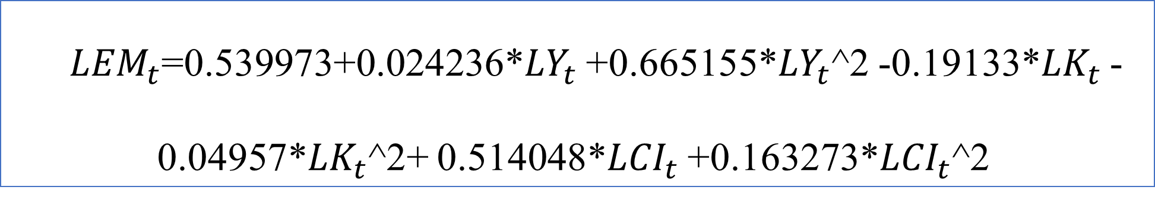
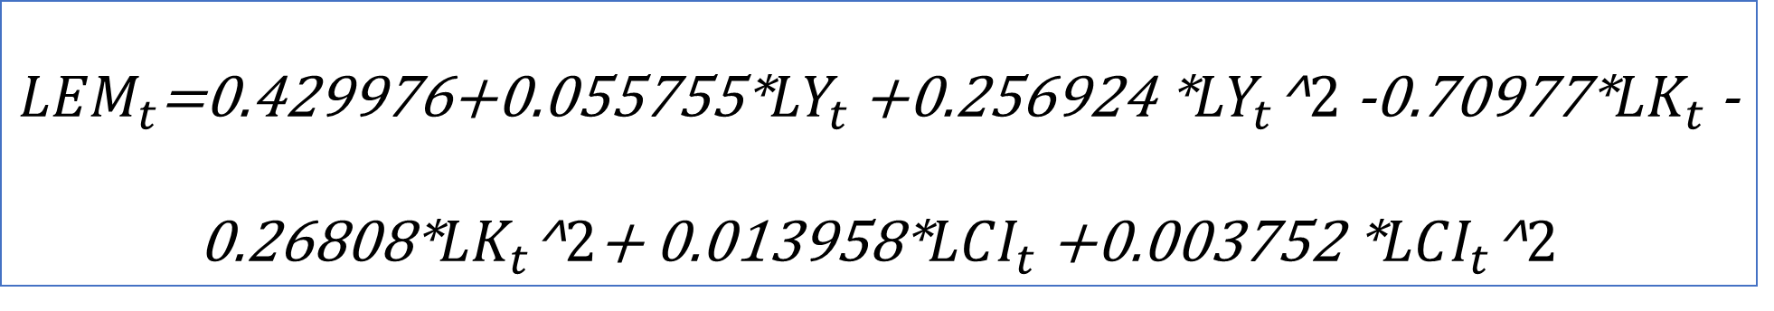
Estimation Results …
Total
Total
${LEM}_{t}$=0.429976+0.055755*${LY}_{t}$ +0.256924 *${LY}_{t}$^2 -0.70977*${LK}_{t}$ -0.26808*${LK}_{t}$^2+ 0.013958*${LCI}_{t}$ +0.003752 *${LCI}_{t}$^2
Total(without Oil sector)
${LEM}_{t}$=0.539973+0.024236*${LY}_{t}$ +0.665155*${LY}_{t}$^2 -0.19133*${LK}_{t}$ -0.04957*${LK}_{t}$^2+ 0.514048*${LCI}_{t}$ +0.163273*${LCI}_{t}$^2
Source: Authors

Slide 27
Estimation Results …
Total and sectors
variable | Agriculture | Oil | Mines | Manufacturing | Electricity, Gas and Water | Construction | Transportation and Communication | Real Estate and Business Activities | Others Services | Total
Optimal Rate of Employment Growth | 3.6 | 2.6 | 4.1 | 3.2 | 6.9 | 3.2 | 5.1 | 3.9 | 3.8 | 3.7

Slide 28
Analysis …
Total and sectors
The results show that at the level of macroeconomic, the optimal rate of employment growth is 3.7%.(3.2% without Oil sector).
In the services, industry and agriculture sectors, the optimal rate of employment growth was 3.8, 3.2 and 3.6 percent, respectively.
The relationship between employment growth and the optimal rate of employment growth among economic sectors.

Slide 29
Conclusion and Recommendations
A- Conclusion
Aggregate(macroeconomic) level
with Oil sector
without Oil sector
Sector level
The gap between the real and desirable employment in the service sector will be completed earlier than the agriculture and industrial sectors and will lead to decent employment.
There is more available capacity and higher degrees of flexibility in the service sector than other sectors of the economy, including industry and agriculture.

Slide 30
Estimating the Potential of Employment in Iran's Economic Sectors
index | Agriculture | Oil | Mines | Manufacturing | Electricity, Gas and Water | Construction | Transportation and Communication | Real Estate and Business Activities | Others Services | Total
Number Employment(2015) | 3,961 | 160 | 107 | 3,697 | 153 | 3,047 | 2,391 | 648 | 7,809 | 21,972
Optimal Rate of Employment Growth | 3.6 | 2.6 | 4.1 | 3.2 | 6.9 | 3.2 | 5.1 | 3.9 | 3.8 | 3.7
Number Employment(2021) | 4,906 | 186 | 135 | 4,453 | 227 | 3,671 | 3,215 | 815 | 9,756 | 27,364
Potential of Job Create (Annual) | 157 | 4 | 5 | 126 | 12 | 104 | 137 | 28 | 326 | 899
 | 157 | 4 | 247 |  |  |  | 491 |  |  | 899
54/6
27/5
0/4
17/5

Slide 31
B- Recommendations
The effect of the growth of production on employment growth and some kind of confirmation of compatibility between growth of production and employment growth.
The degree of greater flexibility of wages in the service sector than in other sectors, the relative price correction of policy makers aimed at encouraging firms to employ labor force to replace capital and equipment.
Basic and structural reforms for the development of new businesses as well as the importance of using existing capacities with a view of the overall economy's productivity.
The desire for graduate education in the service sector.

Slide 32
Tank You

