Slide 1

Ragui Assaad
Assistant Professor, University of Minnesota
Ph.D. in City and Regional Planning, Cornell University.
international economic development;
labor market analysis;
politics and economics of the Middle East and North Africa

Slide 2
Excluded Generation:
The Growing challenges of Labor Market Insertion for Egyptian Youth
By
Ragui Assaad, Humphrey School of Public Affairs and Caroline Krafft, St. Catherine’s University

Slide 3

Introduction

Slide 4
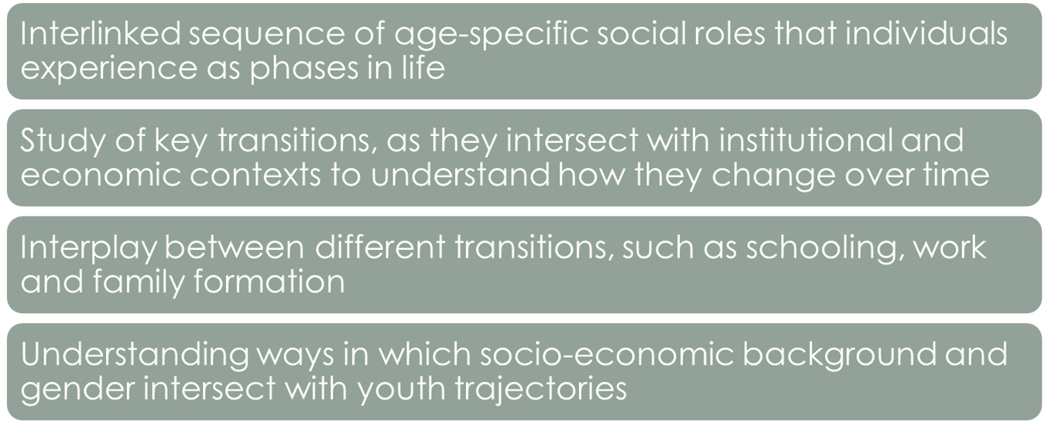
Life Course Perspective

Slide 5
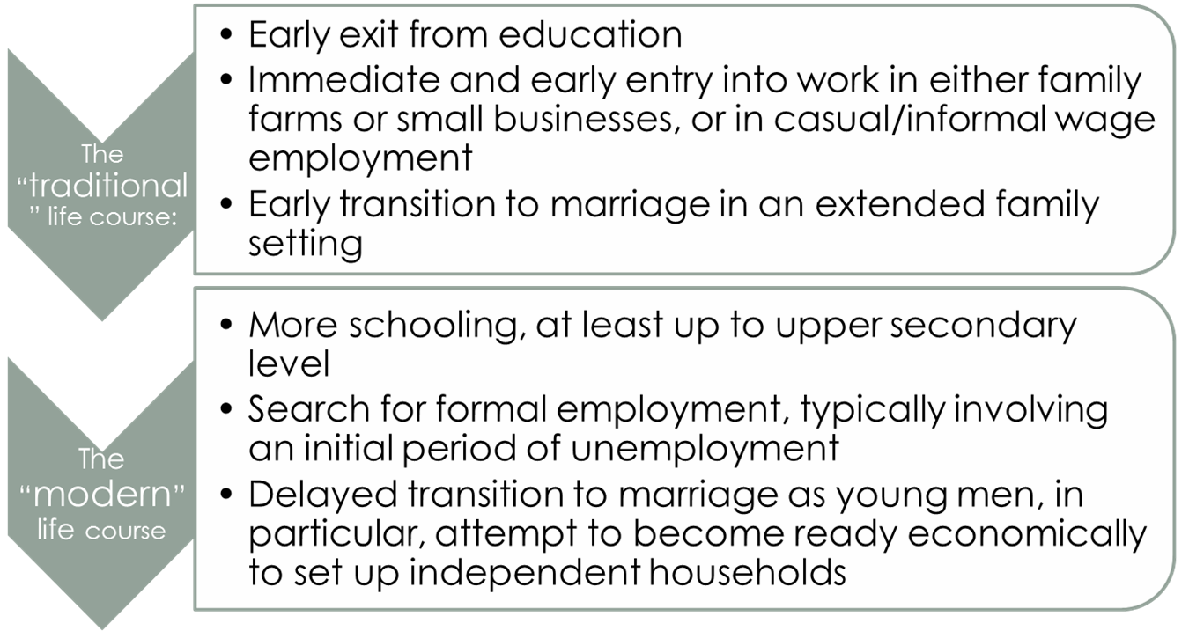
A Typology Of Life Courses

Slide 6
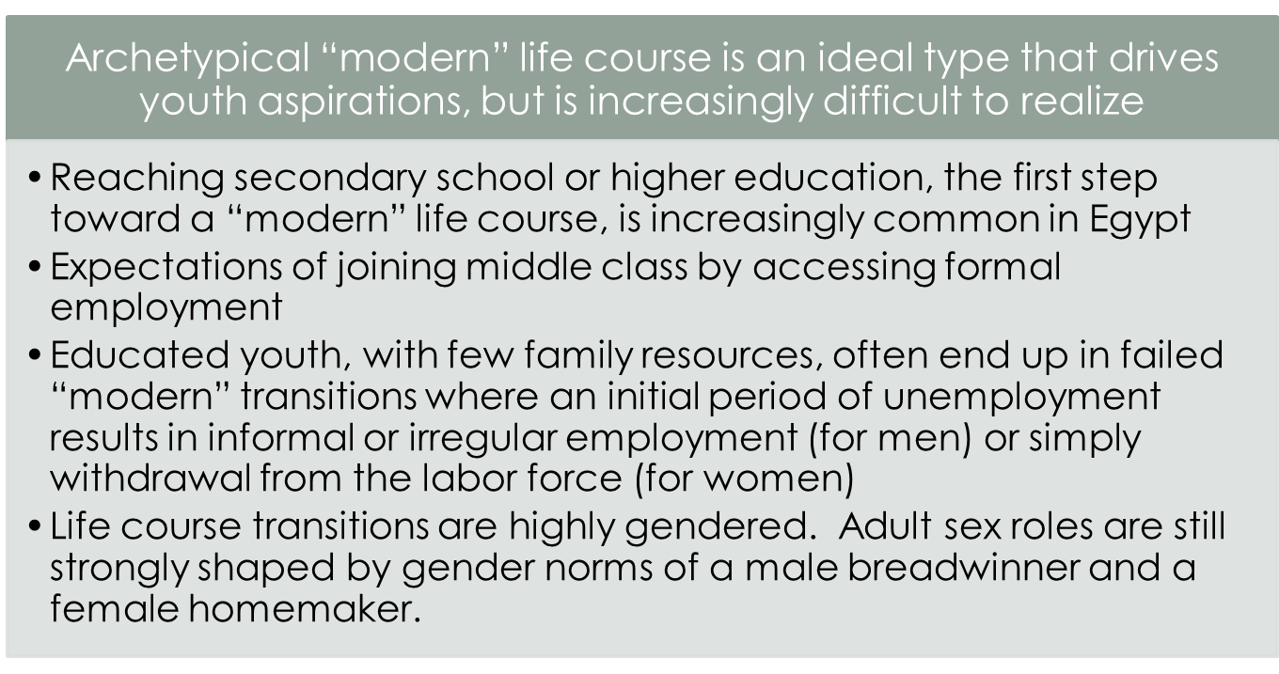
A Typology Of Life Courses

Slide 7

Data

Slide 8
Methodology
Create an education/social class taxonomy for youth, based on own education and education of of father.
  less than upper secondary education
  completed upper secondary education
  completed higher education but father less than secondary
  Complete higher education but father secondary and above

Slide 9
Methodology
Undertake simple descriptive analysis of transition to first employment of young people, 25-34 in 2012, comparing it to the first transition of an older generation, 45-54 in 2012
Estimate a multinomial logit model for transition to first employment outcome
  Test differential transitions trajectories across educational/social class taxonomy and across three different cohorts: 25-34, 35-44, 45-54, separately for men and women
  Regressors educational/class taxonomy, age cohorts and all their interactions.

Slide 10
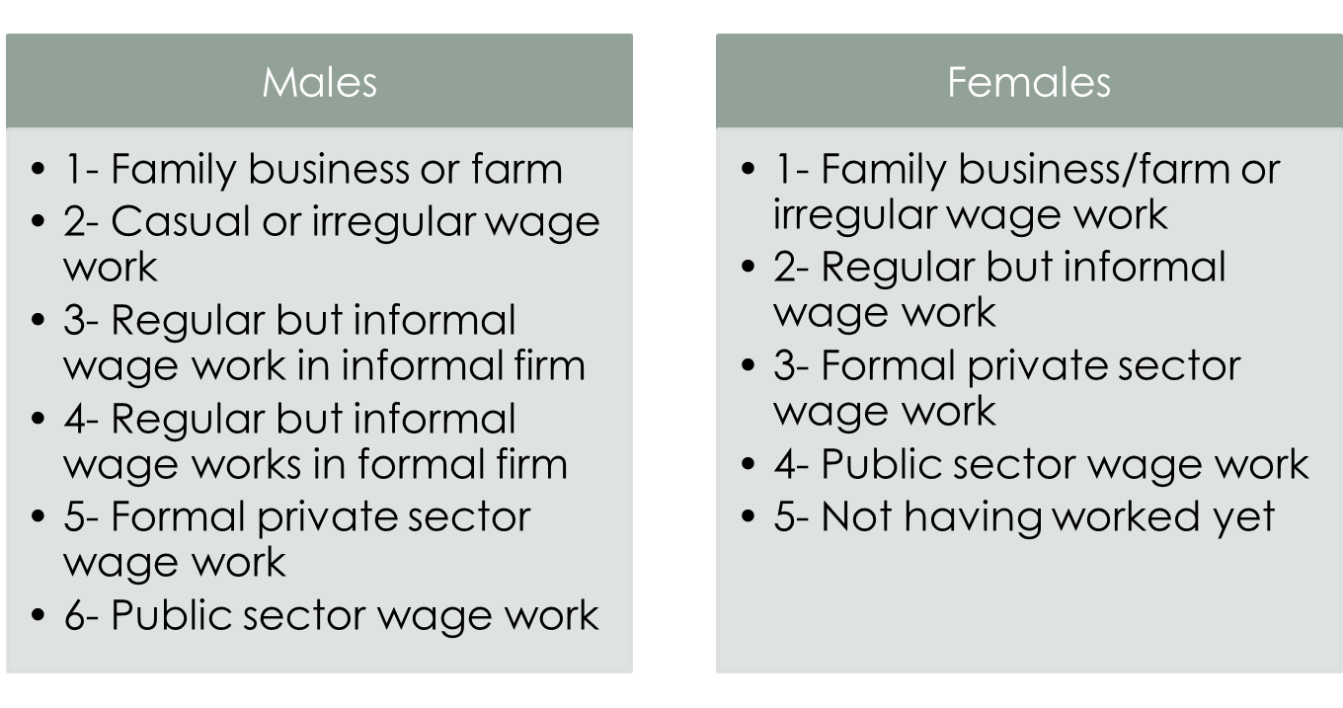
Outcome Variables

Slide 11
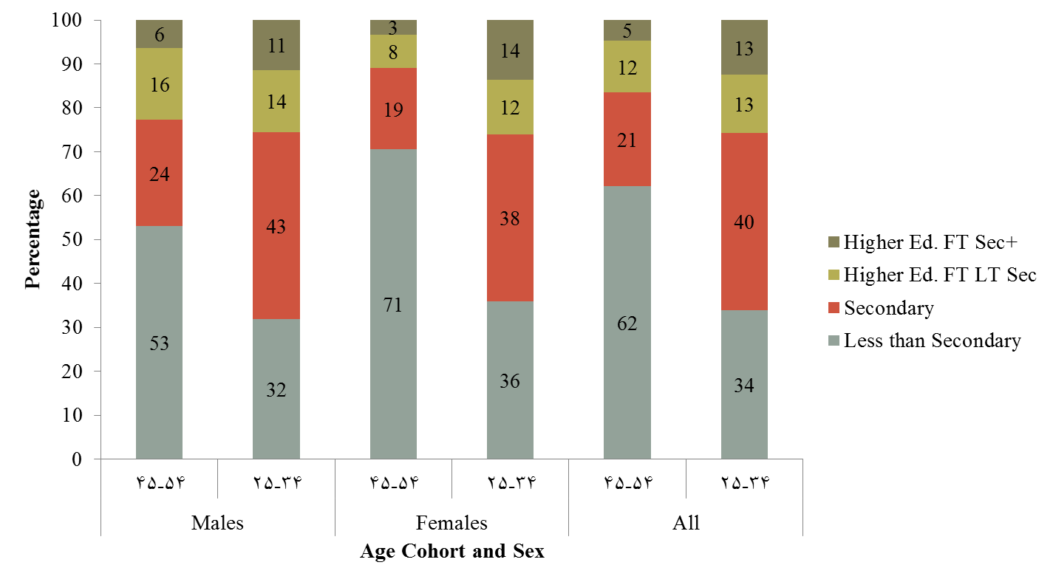
Change in educational attainment very apparent when we compare across the young and old generations. Higher education increase is more apparent among young women.

Slide 12
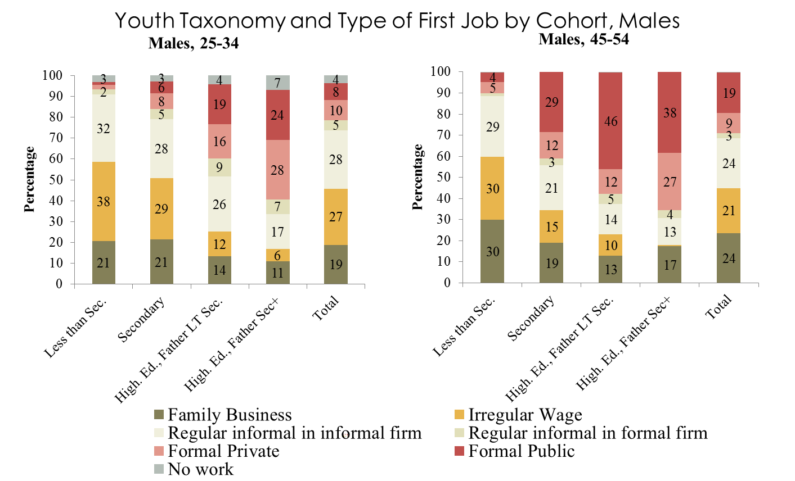
Less educated youth of both generation can only aspire to and obtain informal, casual or family-related employment. Secondary education used to allow significant access to formal employment, but does not anymore. Even higher education has been strongly de-valued in terms of its ability to ensue a modern employment transition, especially for youth from lesser social backgrounds

Slide 13
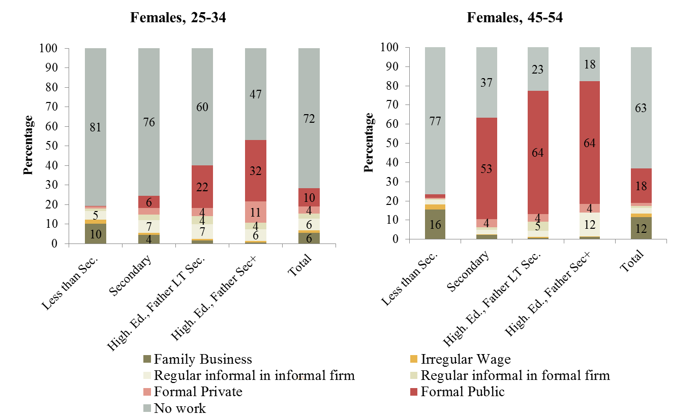
For young women the option of joining the informal economy is much more restricted. If they cannot obtain a formal job, as the older generation was able to, they are most likely to withdraw from the labor force altogether

Slide 14
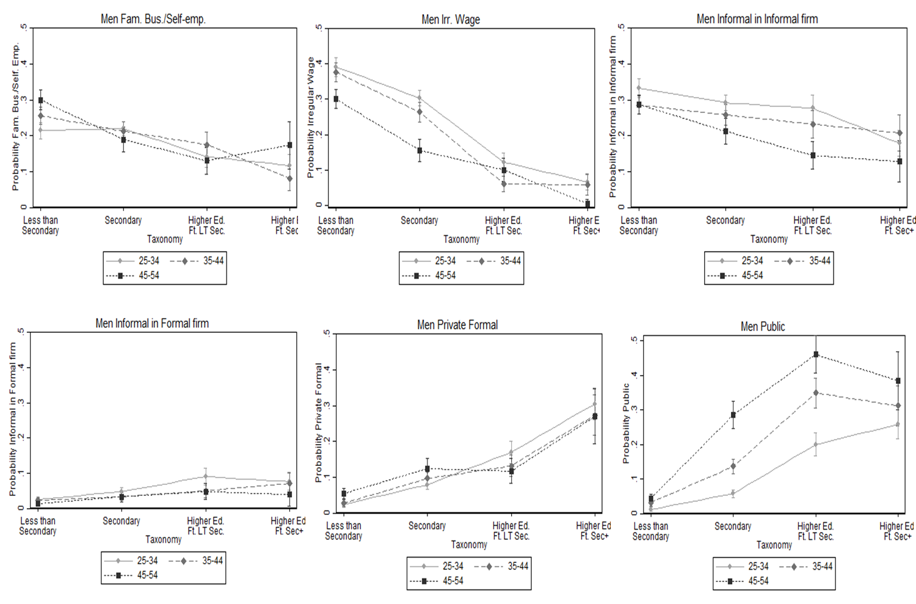
Predictions From Multinomial Logit Model, Males

Slide 15
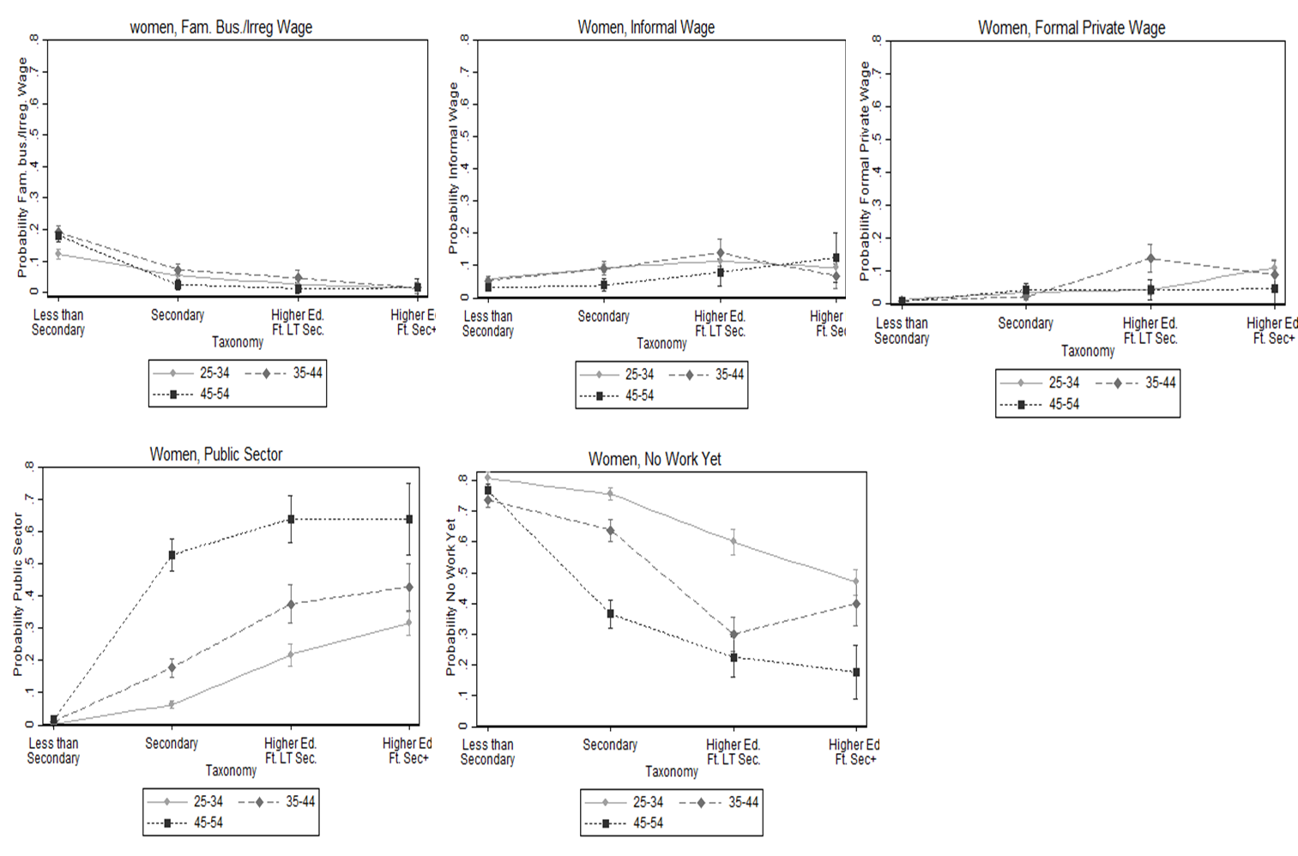
Predictions From Multinomial Logit Model, Females

Slide 16
Why Have The Employment Prospects Of Educated Egyptian Youth Deteriorated So Much?
Rapid increases in educational attainment was not matched by a similar increase in formal employment opportunities
Public sector employment which was the mainstay of educated youth employment among the older generation was severely curtailed due to fiscal problems and economic restructuring
Despite a turn to a more market-led economy, a globally competitive and dynamic private sector never materialized
  What emerged instead is a bifurcated private sector with large firms operating in an essentially non-competitive environment on one end and very small firms hiding in the shadows of informality on the other end

Slide 17
Policies To Promote Successful Transitions To Employment For Egyptian Youth?
Active Labor Market Policies (ALMPs)
  ALMPs are policies that aim to upgrade workers skills, assist in matching between workers and jobs, and reduce frictions in the labor market
    Include such interventions as job training, job-search assistance, employability skills, subsidized apprenticeships, even wage subsidies for new workers.
  In the absence of increases effective labor demand, ALMPs are unlikely to increase the supply of good jobs and may just result in worker displacement
  Some evidence of the existence of skill shortages in parts of the formal private sector, which can be met with such policies, if well-designed

Slide 18
Policies To Promote Successful Transitions To Employment For Egyptian Youth?
Must go beyond labor market to improve investment and operating environment for micro and small firms to allow them to grow and create jobs
  Regulatory environment imposes high fixed costs of formality. These costs loom very large for small firms
  Large firms can absorb high cost of formality, or can make “deals” to reduce them
  Easing of regulations for micro and small enterprises, particularly with regard to tax and social insurance regulations

