Slide 1

Arash Alavian Ghavanini
Economic Researcher
Ph.D student at sharif university

Slide 2
Labor Market Flows: Facts from Iran’s Labor Market
Arash Alavian Ghavanini
Mehran Behnia

Slide 3
Contents
Facts and Questions
Data and Methodology
Key Findings
Conclusion and policy implications
A. Alavian Ghavanini, M. Behnia

Slide 4
Contents
Facts and Questions
Data and Methodology
Key Findings
Conclusion and policy implications
A. Alavian Ghavanini, M. Behnia

Slide 5
Facts and Questions
Labor Force Participation Rate
Source: LFS (2005-2015)
A. Alavian Ghavanini, M. Behnia

Slide 6
Facts and Questions
Youth (20-24) Unemployment Rate
Source: ILO, Key Indicators of the Labor Market, 9th edition, 2015,
A. Alavian Ghavanini, M. Behnia

Slide 7
Facts and Questions
Youth Unemployment Rate by education and unemployment duration
Source: LFS (2016)
A. Alavian Ghavanini, M. Behnia

Slide 8
Facts and Questions
Number of University students (thousand)
Source: Statistical Center of Iran
A. Alavian Ghavanini, M. Behnia

Slide 9
Facts and Questions
participation rate both for young men and women decreased in ten recent years despite of entrance of baby boomer in the working age population.
Youth unemployment rate both for men and women is persistently high
Youth with high level of schooling has higher unemployment rate and long duration of unemployment
number of university students was always increasing
A. Alavian Ghavanini, M. Behnia

Slide 10
Facts and Questions
How labor market transitions between active and inactive population can justify decrease in labor force participation rate?
Why despite of increase in youth unemployment rate by educational level, they still try to increase their schooling?
A. Alavian Ghavanini, M. Behnia

Slide 11
Contents
Facts and Questions
Data and Methodology
Key Findings
Conclusion and policy implications
A. Alavian Ghavanini, M. Behnia

Slide 12





Data and Methodology
Data
the labor force survey is conducted on a seasonal basis across the nation by using Rotation Sampling under provision of Statistical Center of Iran
The statistical method of rotation sampling makes it possible to estimate market flows and transition probabilities both annually and seasonally.
The survey was first conducted in 2005 and since then has regularly been taken in the middle month of every season.
The survey consists of demographic and labor market characteristics of about 50000 household and 170000 members in each season
A. Alavian Ghavanini, M. Behnia

Slide 13
Data and Methodology
Transition Matrix
 |  | State in Period T-1
 |  | Under 10 in Period t-1 | Employed in Period t-1 | Unemployed in Period t-1 | Inactive in Period t-1
State in Period T | Employed in Period t | NE | EE | UE | IE
 | Unemployed in Period t | NU | EU | UU | IU
 | Inactive in Period t | NI | EI | UI | II
A. Alavian Ghavanini, M. Behnia

Slide 14
Contents
Facts and Questions
Methodology
Key Findings
Conclusion and policy implications
A. Alavian Ghavanini, M. Behnia

Slide 15
Key Findings
Men and women (20-34) average annually inflow and outflow to labor force
Source: LFS (2005-2015)
A. Alavian Ghavanini, M. Behnia

Slide 16
Key Findings
men (20-34) analysis of inflow and outflow
27% of men with primary and secondary level of education become unemployed after enter to labor force and 17% of them enter to low quality jobs (underemployment), but for men with tertiary level of education 39% of them enter to unemployment and 26% of them employed in low quality jobs
40% of active men who transit to inactive population, enroll as student to increase their education (but why?)
A. Alavian Ghavanini, M. Behnia

Slide 17
Key Findings
Women (20-34) analysis of inflow and outflow
35% of women with primary and secondary level of education become unemployed after enter to labor force and 26% of them enter to low quality jobs.
60% of women (20-34) with tertiary level of education enter to unemployment and 19% of them employed in low quality jobs
25% of active women who transit to inactive population, enroll as student to increase their education (but why?)
A. Alavian Ghavanini, M. Behnia

Slide 18
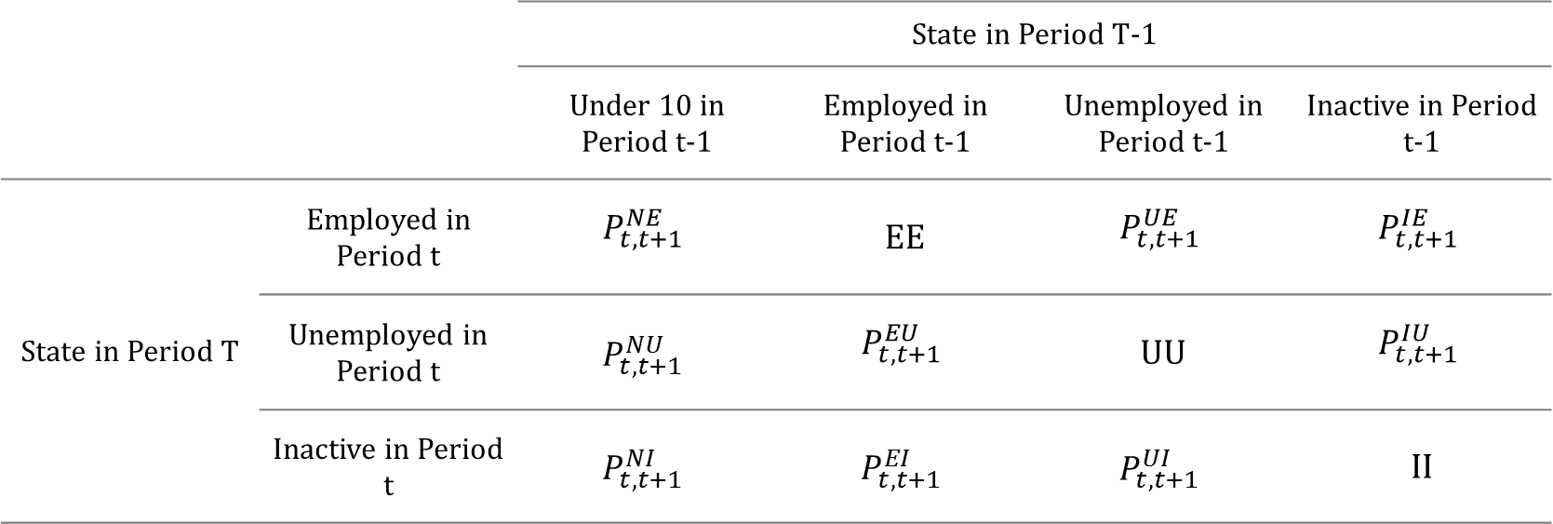
Transition Probabilities
 |  | State in Period T-1
 |  | Under 10 in Period t-1 | Employed in Period t-1 | Unemployed in Period t-1 | Inactive in Period t-1
State in Period T | Employed in Period t | $$P_{t,t+1}^{NE}$$ | EE | $$P_{t,t+1}^{UE}$$ | $$P_{t,t+1}^{IE}$$
 | Unemployed in Period t | $$P_{t,t+1}^{NU}$$ | $$P_{t,t+1}^{EU}$$ | UU | $$P_{t,t+1}^{IU}$$
 | Inactive in Period t | $$P_{t,t+1}^{NI}$$ | $$P_{t,t+1}^{EI}$$ | $$P_{t,t+1}^{UI}$$ | II
A. Alavian Ghavanini, M. Behnia

Slide 19
Key Findings
Probability of become unemployed after entrance (by education level and age groups)
Source: LFS (2005-2015)
A. Alavian Ghavanini, M. Behnia

Slide 20
Key Findings
labor demand characteristic of public sector
Average wage in public sector is 81% more than private sector (source: HIES)
Public sector has higher demand for worker with university certificate. Share of workers with university degree from total employment in private sector has been increased from 6.1% in 2005 to 13% in 2015, but at the same time increase in public sector has been 47% to 67%
Public sector demand is narrow and contains about 20% of total employment.
Consequence of mismatch between labor market supply and demand side is higher unemployment rate and duration for youth participant.
A. Alavian Ghavanini, M. Behnia

Slide 21
Contents
Facts and Questions
Methodology
Key Findings
Conclusion and policy implications
A. Alavian Ghavanini, M. Behnia

Slide 22
Conclusion
participation rate both for young men and women decreased in ten recent years despite of entrance of baby boomer in the working age population.
Youth unemployment rate both for men and women is persistently high
Youth outflow from active population has been greater than inflow in recent years
A. Alavian Ghavanini, M. Behnia

Slide 23
Conclusion
44 percent of young men with primary or secondary level of education and 61% of them who have tertiary certificate become unemployed or employed in low quality jobs after enter to labor force
61 percent of women with primary or secondary level of education and 79% of them who have tertiary certificate become unemployed or employed in low quality jobs after enter to labor force
Most of youth that exit from active population try to increase their level of education
By increase in level of education probability of successful entrance to labor market decrease
A. Alavian Ghavanini, M. Behnia

