Slide 1

Mohammad Vesal
Assistant Professor at Sharif University of Technology
Ph.D. Economics,
London School of Economics and Political Science (LSE)
Public Economics, Development Economics
Assistant Professor of Economics
Sharif University of Technology

Slide 2
The Long Run Educational Impact of Iran-Iraq War
Mohammad Vesal

Slide 3
Research question
What are the effects of Iran-Iraq war on human capital accumulation of children?
How does war exposure at various stages of childhood affect human capital accumulation?
M. Vesal

Slide 4
Motivation
War might be rare nowadays, but disruptive events like natural disasters are quite common.
These could inflict large long lasting losses on individuals if the process of human capital accumulation is disrupted.
Identifying the most vulnerable groups could guide policy.
No econometric estimate of the impact of the second-longest war of the twentieth century!

Slide 5
Outline
Introduction
Context and Data
Method
Results
Alternative stories
Conclusions

Slide 6
Context and Data
Children start primary at age 6
  Expected to finish grade 12 by age 18.
High school: equals 1 if 11 years of education or more
Rapid expansion of primary and secondary education during 1960-1980.
Iran-Iraq War: 22 Sep 1980 – 20 August 1988
  Claimed more than 200,000 Iranian lives.
War provinces: 5 provinces bordering Iraq
Exposure defined based on age at the onset of war
  Early: [-6,-2], Double: [-1,5], Primary: [6,10]
  Control: [11,38]

Slide 7
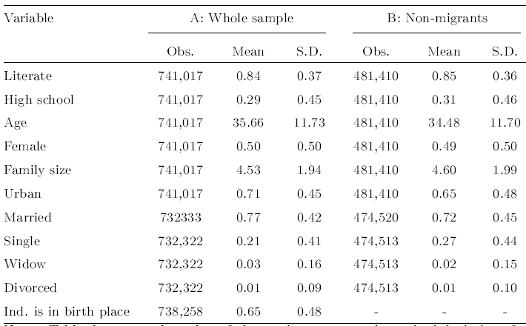
Data: 2 percent individual data of 2006 Population Census

Slide 8
Outline
Introduction
Context and Data
Method
Results
Alternative stories
Conclusions

Slide 9
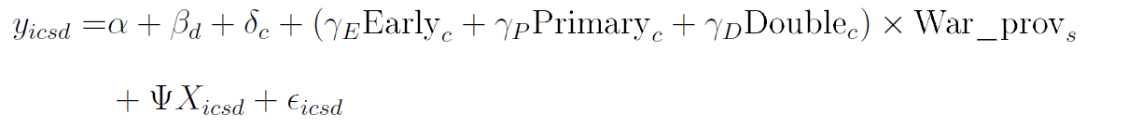
Method: Difference-in-differences
Region of birth and year of birth define treatment status
Alternative specification

Slide 10
Outline
Introduction
Context and Data
Method
Results
Alternative stories
Conclusions

Slide 11
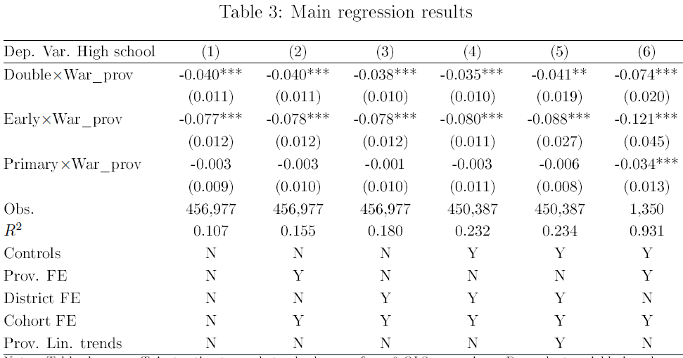
Results

Slide 12
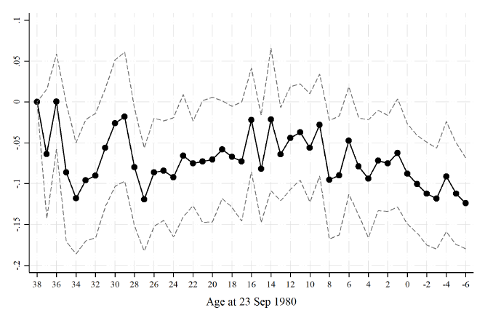
Full interactions- Males

Slide 13
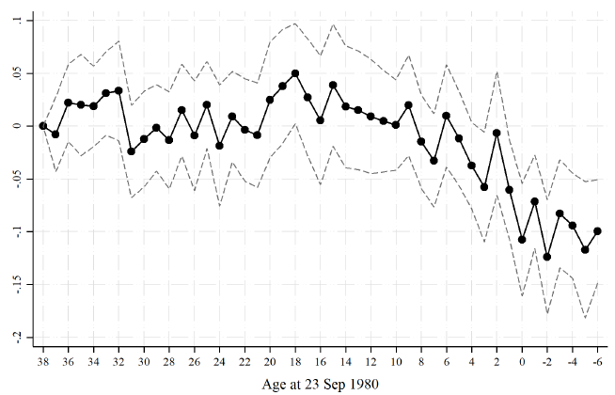
Full interactions- Females

Slide 14
Outline
Introduction
Context and Data
Method
Results
Alternative stories
Conclusions

Slide 15
Alternative stories
Sample selection due to migration
  Redefine treatment status based on current residence.
  Aggregate evidence on dominance of intra-province migration and return of war migrants.
  Migration probability is not affected differentially.
Post revolution confounding events
  Baby boom: control for number of primary schools and students.
  Rebellions in Kordestan: exclude this province.
  Terrorist activities between 1979-1982: exclude provincial capitals.
  Cultural revolution: closure of universities between 1980-1982.

Slide 16
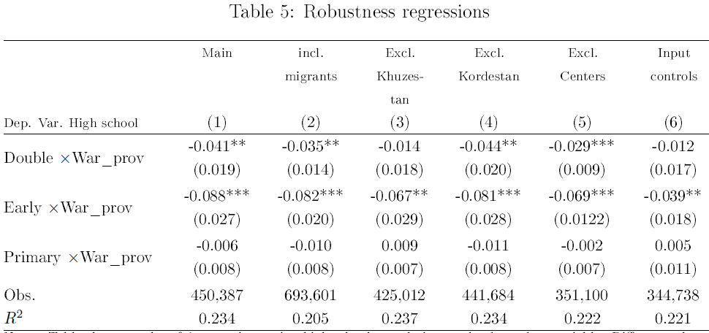
Ruling out alternative stories

Slide 17
Outline
Introduction
Context and Data
Method
Results
Alternative stories
Conclusions

Slide 18
Conclusions
Iran-Iraq War seems to have reduced probability of finishing high school by
  4 percentage points for double treated cohorts, aged [-1,5] at war onset.
  8 percentage points for early cohorts, aged [-6,-2] at war onset.
  No significant effect for primary cohorts, aged [6,10] at war onset.
  varying war intensity?
The effect seems to be more robust for females.
Several attempts made to rule out alternative stories.

Slide 20
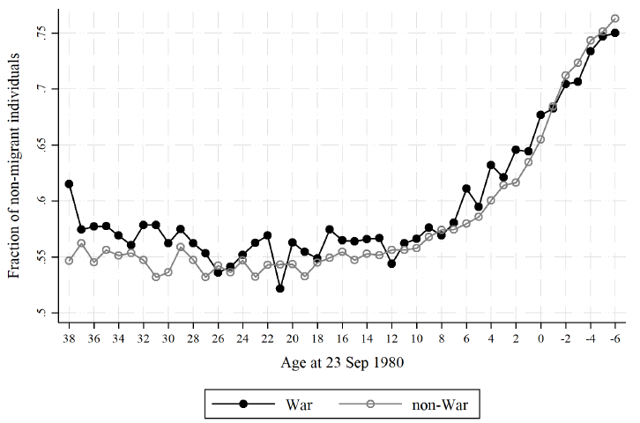
Fraction of non-migrants over cohorts

Slide 21
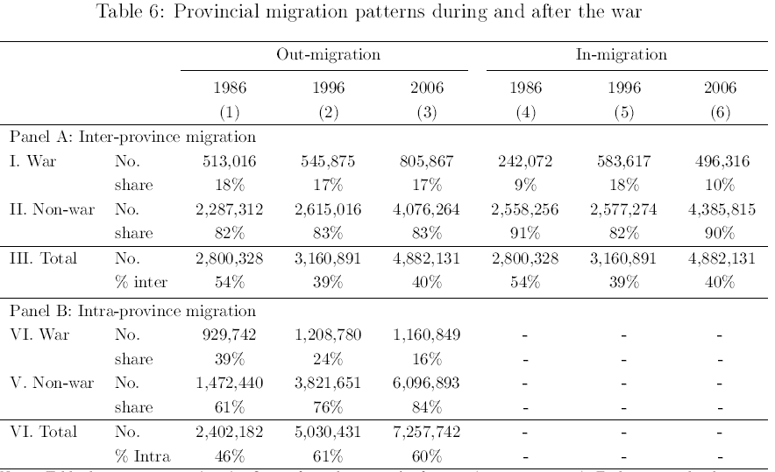
Dominance of intra-province migration and return of migrants

Slide 22
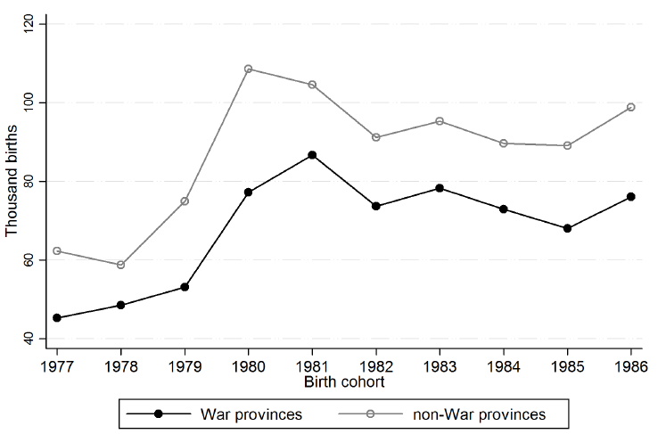
Number of birth in war and non-war provinces

