Slide 1
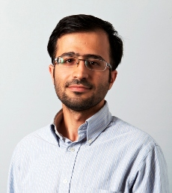
Mohammad Vesal
Assistant Professor at Sharif University of Technology
Ph.D. Economics,
London School of Economics and Political Science (LSE)
Public Economics, Development Economics
Assistant Professor of Economics
Sharif University of Technology

Slide 2
The role of Iran’s education system in human capital formation
Javad Salehi-Isfahani
Mohammad Vesal

Slide 3
Outline
Introduction
Stylized Facts
Conceptual Framework
Higher Education
TVE
Reform policies
M. Vesal, J. Salehi-Isfahani

Slide 4
Basic questions
Does education improve labor market outcomes?
Probability of employment?
Earnings?
Is Iran’s education system effective in enhancing skills?
What are potential barriers to skill formation?
What is the role of labor and education institutions?
M. Vesal, J. Salehi-Isfahani

Slide 5
Outline
Introduction
Stylized Facts
Conceptual Framework
Higher Education
TVE
Reform policies
M. Vesal, J. Salehi-Isfahani

Slide 6
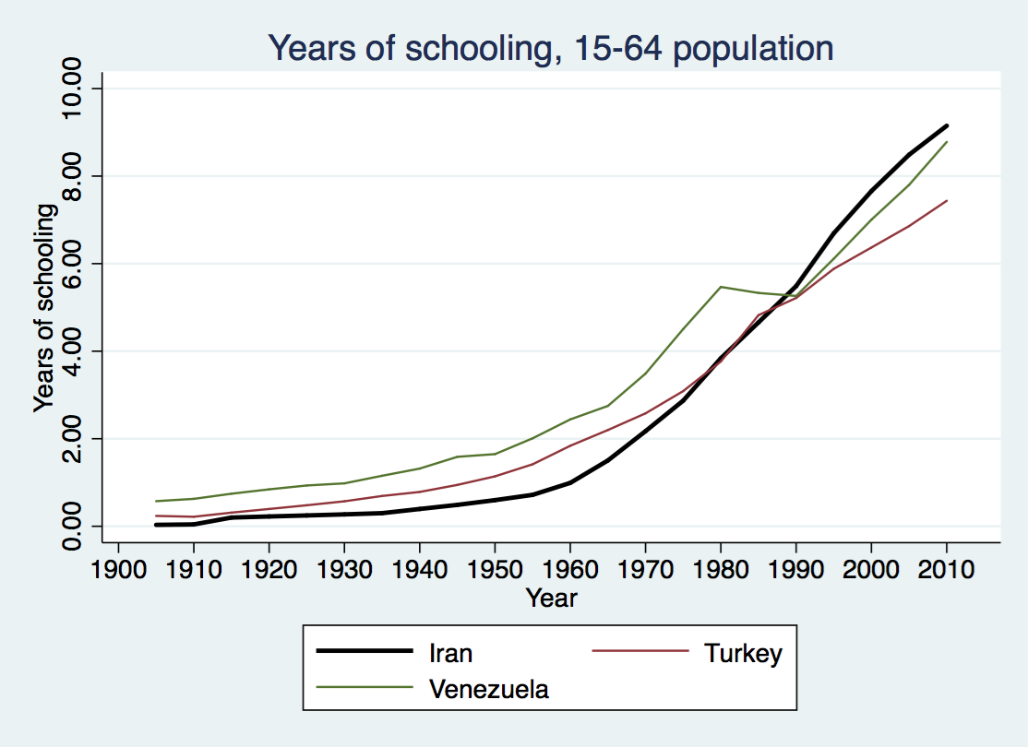
By and large Iran was successful in increasing educational attainment
M. Vesal, J. Salehi-Isfahani

Slide 7
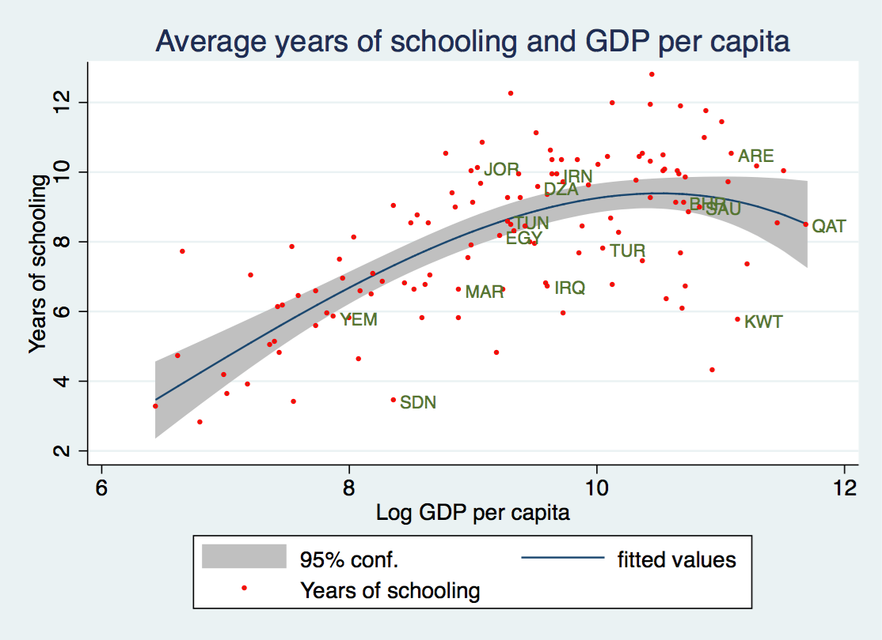
Even in a regional and global context
M. Vesal, J. Salehi-Isfahani

Slide 8
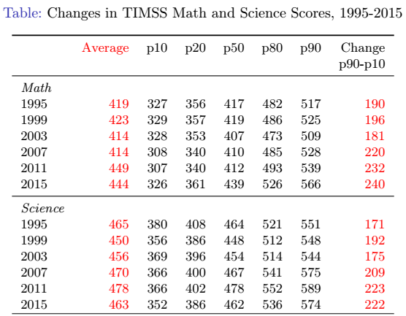
But achievement is lower than global average(500), and lower deciles are falling behind
M. Vesal, J. Salehi-Isfahani

Slide 9
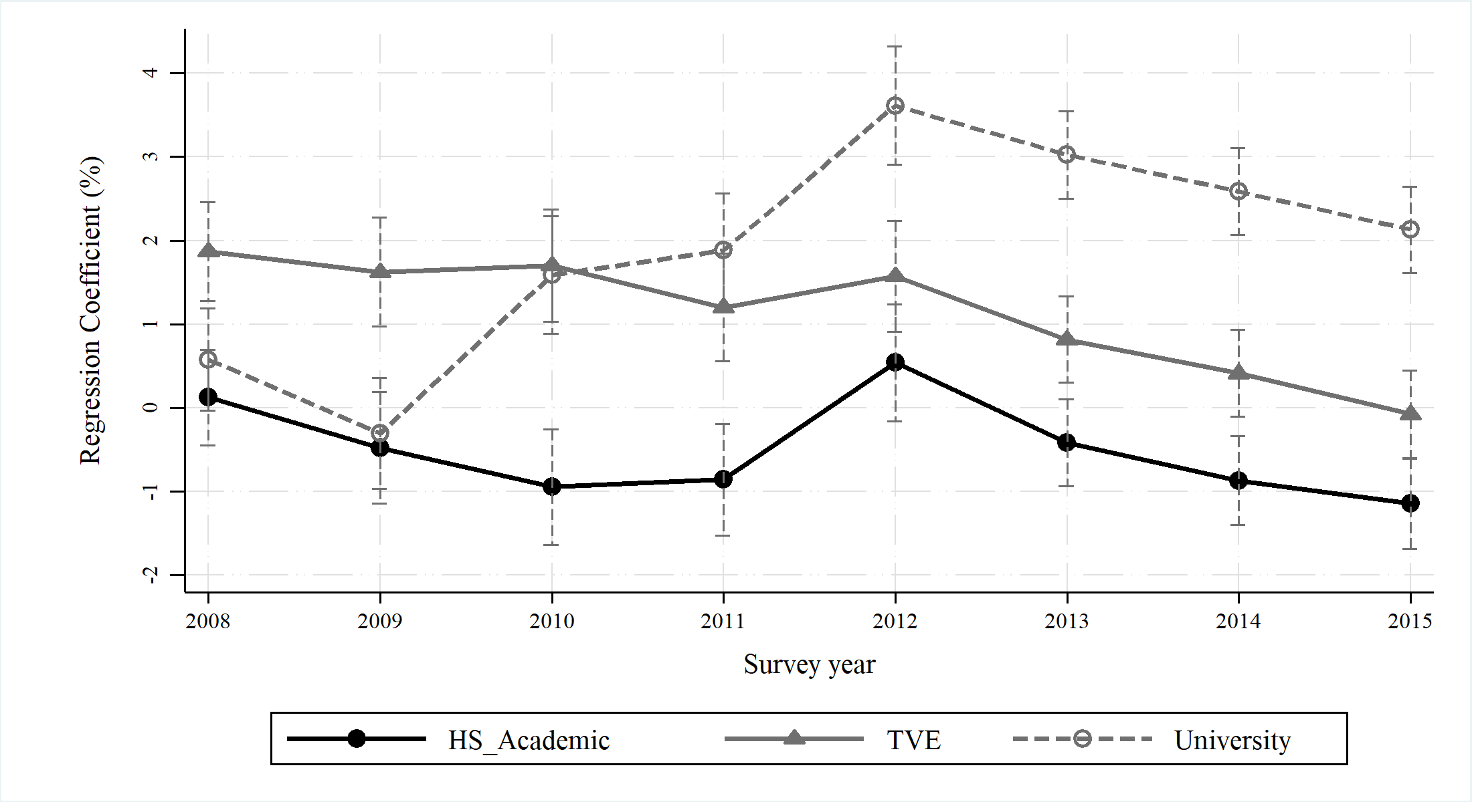
Labor market outcomes also disappointing: Higher and rising change unemployment for educated workers
M. Vesal, J. Salehi-Isfahani
Notes:
Graph show coefficient estimates and 95 percent confidence intervals from regressions of unemployed dummy on three education level dummies and other covariates. HS_Academic is one for individuals who has finished the academic track of high school. TVE is one for individuals with technical and vocational diploma or above diploma education. University is equal to one for those with a university degree. The omitted education category is less than high school which includes the illiterate individuals. Other covariates included in the regression are dummies for age, marital status, season, and province. We run separate regressions for each survey year and restrict the Labor Force Survey sample to Iranian men aged between 18 to 54 living in urban areas. The regression sample is around 80,000 individuals for each year.

Slide 10
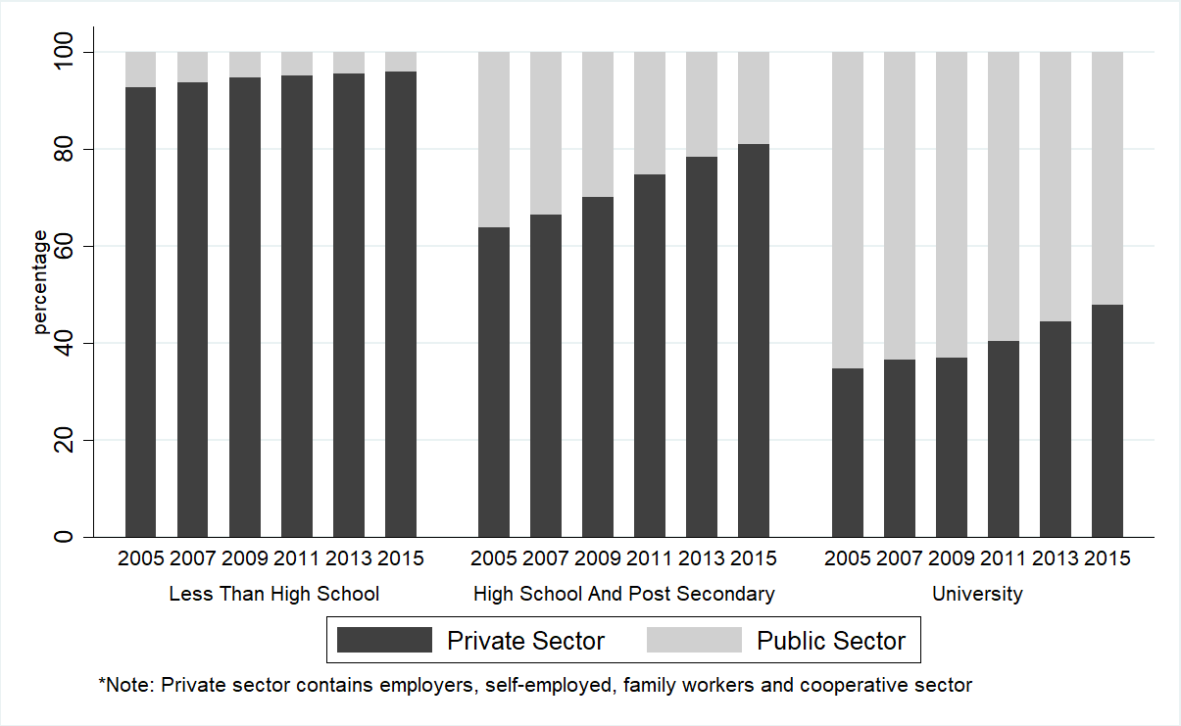
Declining share of public sector employment
M. Vesal, J. Salehi-Isfahani
Notes:
Figure shows percentage of individuals employed in public and private sectors in each survey year and for the indicated education categories. Source: Labor Force Survey.

Slide 11
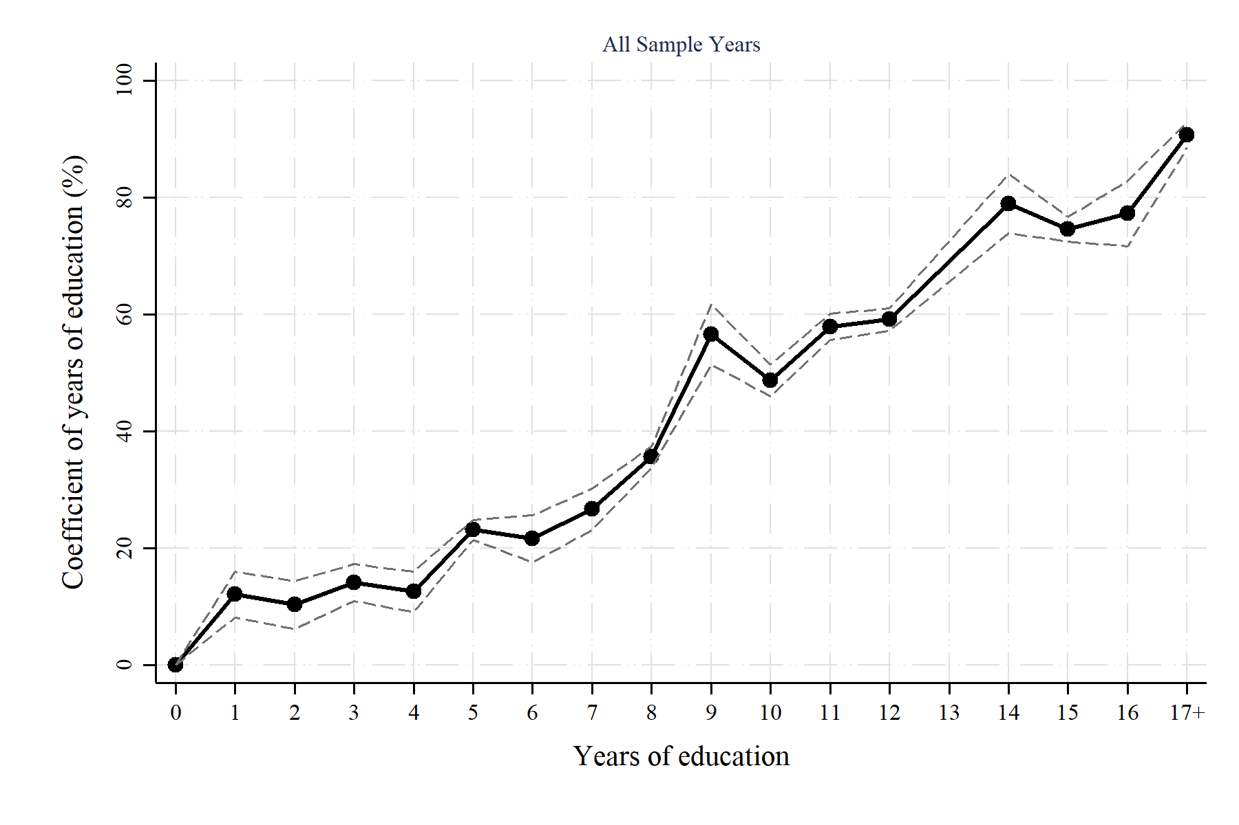
Convexity of returns to education
M. Vesal, J. Salehi-Isfahani
Notes:
Graph shows regression coefficients and 95 percent confidence intervals from a regression of log wages on 17 dummies for each year of education. Covariates include dummies for years of experience and survey year. Sample is HEIS wage earners between 2000-2015. We restrict the sample to urban men aged between 25-54 years old.

Slide 12
Outline
Introduction
Stylized Facts
Conceptual Framework
Higher Education
TVE
Reform policies
M. Vesal, J. Salehi-Isfahani

Slide 13
A simple conceptual framework
How should we think about the process of human capital accumulation?
Is there a model that could explain the stylized facts?
Interaction of markets for Education and Labor
Actors
Individuals: How much to invest in human capital?
Employers: What types of skills to demand and how to reward them?
Educational institutions: What types of skills to supply?
Ideally signals sent from employers to individuals and educational institutions coordinate actions. Educational institutions amplify labor market signals.
M. Vesal, J. Salehi-Isfahani

Slide 14
Presence of market failures
Externalities: mostly in basic education
Imperfect information:
Employers have imperfect information about ability and skills of workers.
education as a signal of innate ability.
on-the-job training and screening.
Workers lack knowledge of how education affects their employment prospects.
Credit constraints: poor individuals cannot borrow to invest in human capital
All these justify state intervention in both markets not just to alleviate market failures but also to increase equity and social mobility.
M. Vesal, J. Salehi-Isfahani

Slide 15
State intervention in education and labor markets in Iran
State-led expansion of primary and secondary formal education.
Free with near universal access at primary stage.
Increasing role for private schools.
State-led expansion of higher education.
Good quality free public universities coexist with lower quality private universities.
Historically the government was the main employer of graduates.
Well-paid, secure jobs offered to those with “acceptable credentials”.
A mandate to protect workers resulted in rigid labor regulations.
Employers put greater weight on ex ante signals of quality: credentials.
M. Vesal, J. Salehi-Isfahani

Slide 16
The “Credentialist Equilibrium” in Iran
Competition to get credentials from good universities together with the 1980s baby boom led to rationing of university seats.
Concour gained prominence as the screening mechanism.
Focus on skills needed for concour.
Labor market signals are distorted and masked.
Those with good enough credentials get a job. The majority have invested in skills not needed by private employers.
Government response to this was/is
Expand higher education.
Track out less able students to non-academic routes.
Give priority to university graduates in Active Labor Market Policies.
M. Vesal, J. Salehi-Isfahani

Slide 17
Outline
Introduction
Stylized Facts
Conceptual Framework
Higher Education
TVE
Reform policies
M. Vesal, J. Salehi-Isfahani

Slide 18
The heavy weight of state in higher education
Sluggish labor demand from the public sector increased market tightness for university graduates.
Raised the bar in employment, ratcheting up demand to M.Sc. and Ph.D. Leading to further expansion of higher education.
Competitive recruitment examinations!
Leading universities are public and hence have poor incentives to engage with employers and almost all lack a career service unit!
Radical expansion of B.Sc. and later M.Sc. resulted in a)deterioration quality, b)entry of less able students, c)higher reservation wages.
Resources needed to survive in this competition is a killer of social mobility.
M. Vesal, J. Salehi-Isfahani

Slide 19
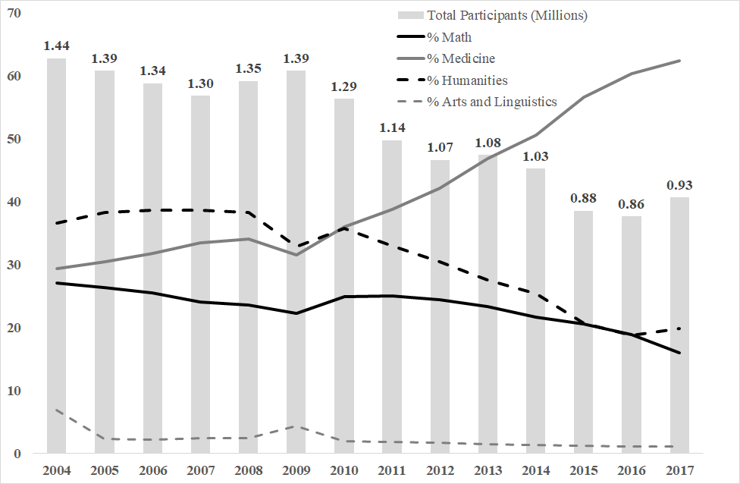
Intense competition to enter university
M. Vesal, J. Salehi-Isfahani

Slide 20
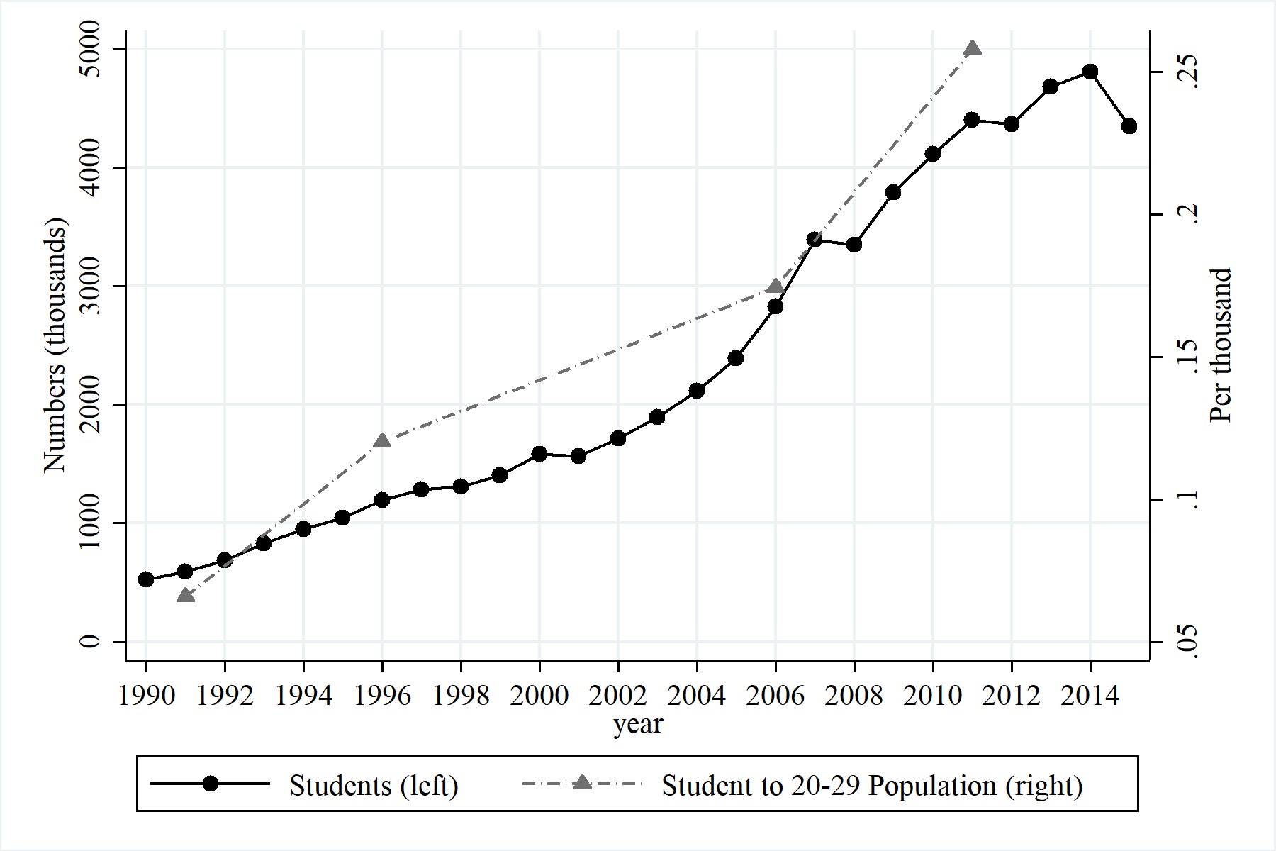
Sharp increase in higher education
M. Vesal, J. Salehi-Isfahani

Slide 21
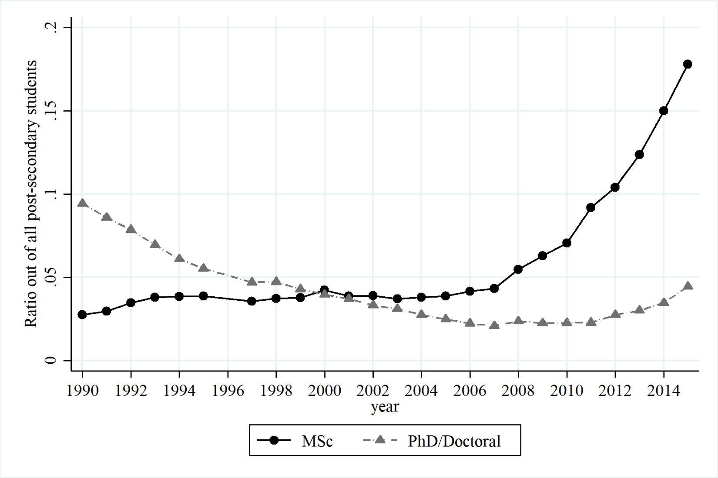
Followed by sharp increase in post-graduate degrees
M. Vesal, J. Salehi-Isfahani

Slide 22
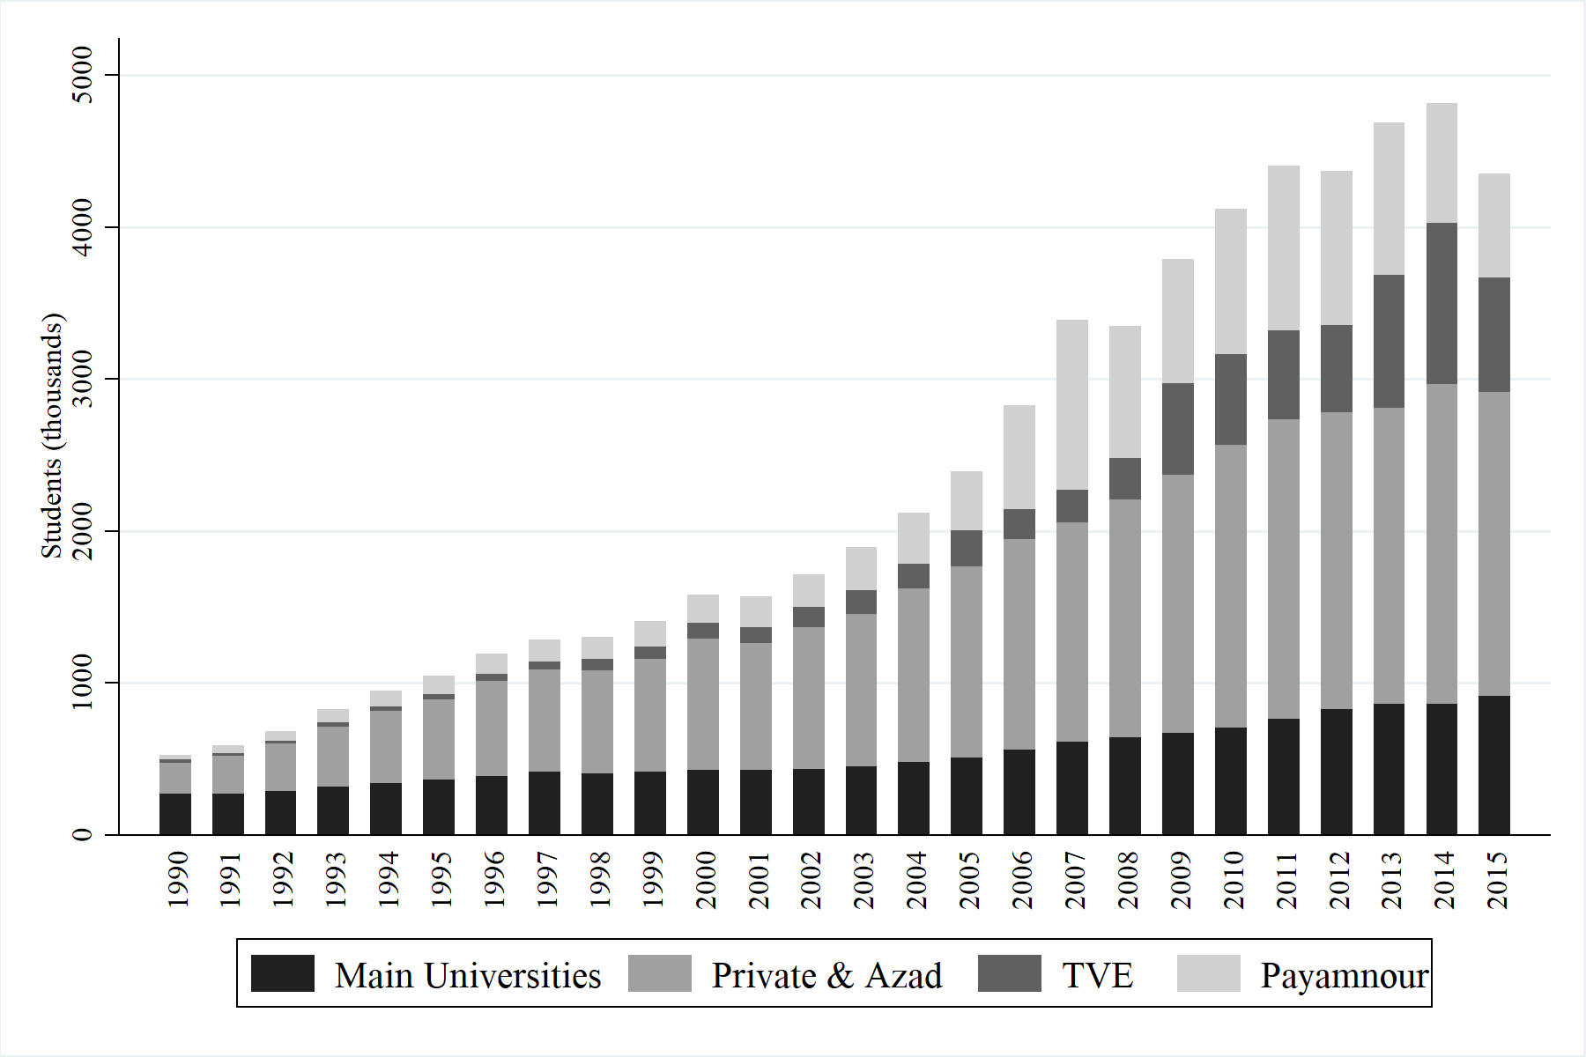
Expansion mainly coming from private and distance learning universities
M. Vesal, J. Salehi-Isfahani

Slide 23
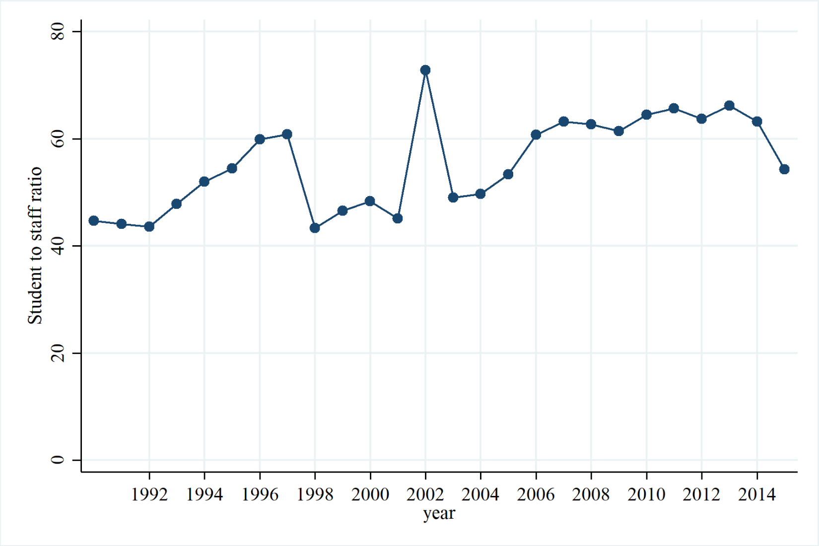
A gentle rise in student to staff ratio in universities
M. Vesal, J. Salehi-Isfahani

Slide 24
Outline
Introduction
Stylized Facts
Conceptual Framework
Higher Education
TVE
Reform policies
M. Vesal, J. Salehi-Isfahani

Slide 25
Technical and Vocational Education
Fragmented TVE system with Labour and Education ministries having their own systems.
Public domination of curriculum design ignores business needs and trends.
Poor career guidance and de facto selection based on academic record (not aptitude and interest) reinforce employer perceptions that TVE graduates are less able and less motivated.
Most TVE graduates work in micro enterprises or remain self-employed. This reduces returns and job security.
M. Vesal, J. Salehi-Isfahani

Slide 26
The work place
Public sector labor demand has been sluggish.
Self-employment and micro enterprises are responsible for the bulk of new jobs.
But these neither have the incentives nor the ability to engage with the education system.
SMEs and larger enterprises are better off investing in rent-seeking than in establishing links with education entities.
M. Vesal, J. Salehi-Isfahani

Slide 27
Outline
Introduction
Stylized Facts
Conceptual Framework
Higher Education
TVE
Reform policies
M. Vesal, J. Salehi-Isfahani

Slide 28
Coordinated education and labor market reform policies
Create a coherent skill quality assurance system to improve information flows between employers and workers.
Rank schools and universities according to job placement to create competition and better responsiveness to market signals.
Pull out current form of government funding and move towards a pupil-linked funding format: school vouchers and student loans are some examples.
Add a wider range of skills to concour: writing and listening.
Removing numerical grades for the first four levels was in the right direction but the recent restructuring was not aimed at the right issues.
Rigid labor laws weakens signals sent from private employers to students and educational institutions.
M. Vesal, J. Salehi-Isfahani

Slide 29
Key questions to be answered
What should the government do to promote employment of TVE and high school graduates?
INSTEAD of What should the government do about high unemployment rate of graduates?
How to deal with the current stock of graduates not to distort incentives for future students?
Do not give priority to higher education over high school or TVE graduates.
What is the best way to guide students to careers that suit them best?
M. Vesal, J. Salehi-Isfahani

