Slide 1
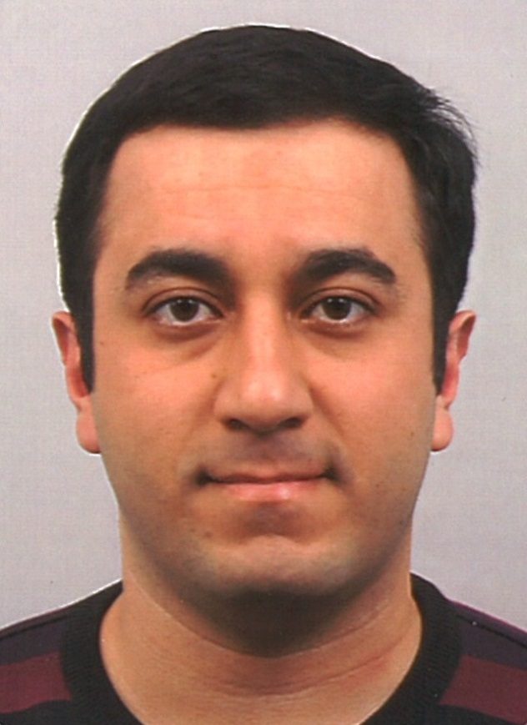
Mohammad Hoseini
Assistant Professor at IMPS
Ph.D. in Economics, Tilburg University
Development Economics, Public Economics
Head of macroeconomics research group at IMPS

Slide 2
On The Supply Of Female Labor In Iran
Mohammad Hoseini
Abolfazl Karimi
Notes:
Its an onging project, it has different parts, I focus on two issue which might be more interesting

Slide 3
Outline
Low female participation in Iran
A recent trend change: structural or transitory?
Flow variables: entry and exit rates from labor market
Why female exit rate is so high in Iran?
M.Hoseini, A.Karimi

Slide 4
Labor force data in Iran
Census of Population and Housing (decennial in 1956-2006, 2011)
Employment and Unemployment Survey (1997-2004)
Labor force survey (2005- ) :
  Quarterly (around 150,000 individuals)
  Rotated panel: each household is sampled in two consecutive seasons and in two consecutive years.
  Every four years the panel is entirely refreshed.
M. Hoseini, A. Karimi

Slide 5

Low female participation in Iran
M. Hoseini, A. Karimi

Slide 6
Recent trends in female labor market
In the last 3 years, female participation rate has increased.
What can explain this?
Is it different than previous rises?
Using LFS raw data, we can look into the detail characteristics as well as entry and exits.
M. Hoseini, A. Karimi
Notes:
A graph of participation rate of women using census, LFS and EUHS> then

Slide 7
Job status of women in 2005 and 2016
Between 2005 and 2016:
Women reallocation from family work to salaried private sector jobs.
16%
12%
M.Hoseini, A.Karimi

Slide 8
Occupation of women in 2005 and 2016
Between 2005 and 2016:
Women reallocation from low-skill jobs to professional and high-skill jobs.
7%
9%
M.Hoseini, A.Karimi

Slide 9
Signs of structural change in female labor market
With the increasing trend women with higher education, we expect female participation growth in future.
M.Hoseini, A.Karimi

Slide 10
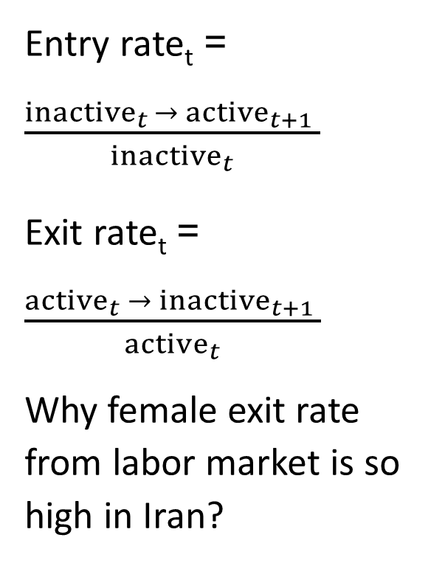
Entry and exit probability by gender
Entry rate_{t} = $\frac{inactive_{t }→ active_{t+1} }{inactive_{t}}$
Exit rate_{t} = $\frac{active_{t} → inactive_{t+1} }{active_{t}}$
Why female exit rate from labor market is so high in Iran?
M.Hoseini, A.Karimi

Slide 11
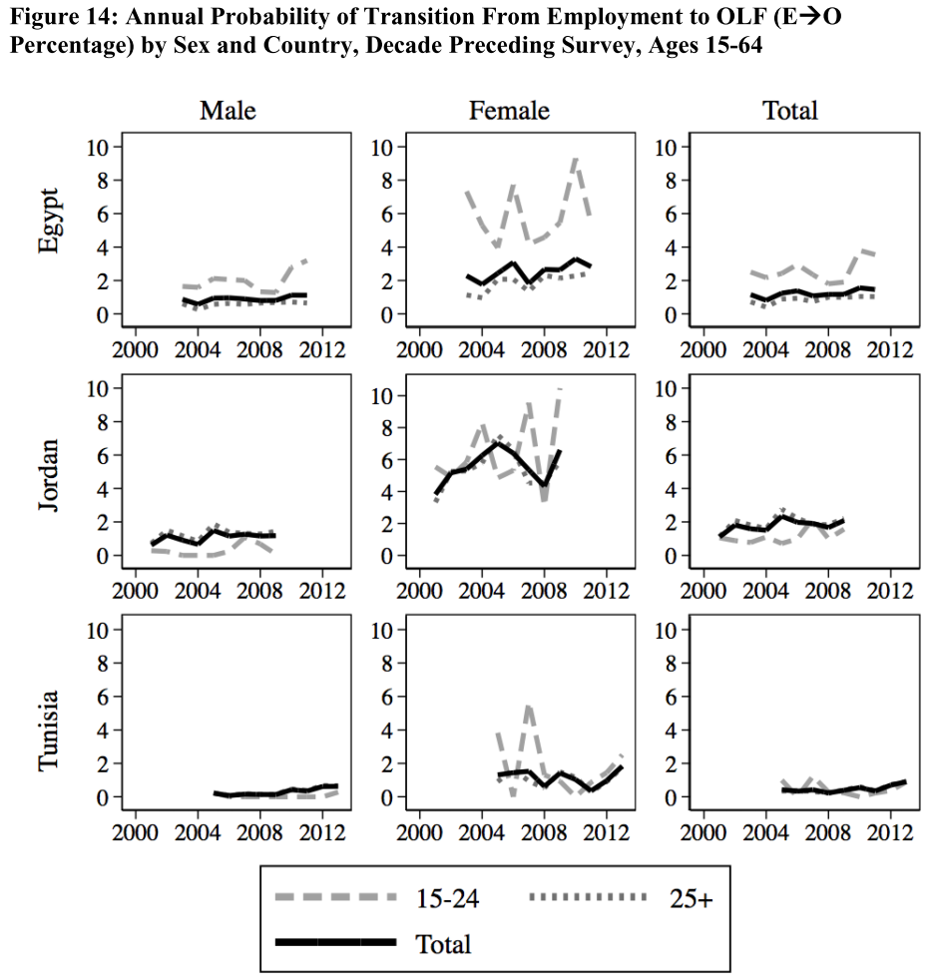
Exit rate comparison with other countries
Germany (Hirsch 2012):
Men 10.4, women 12.3
The U.S. (Royalty 1998):
Men 13, women 16
Iran:
Men 12, women 42
M.Hoseini, A.Karimi

Slide 12
What explains female exit from labor market?
Occupation?
M.Hoseini, A.Karimi
Notes:
Status+unemployed/ occupation+unemployed

Slide 13
What explains female exit from labor market?
M.Hoseini, A.Karimi

Slide 14
What explains female exit from labor market?
Counter intuitive results: Salaried women in the public sector, female manager, female doctors exit from labor market with probability 20%!
We test for many other characteristics:
Size of firm, education of head, industry, having insurance, province, rural/urban, head/spouse/child, age group, experience, first job
The exit rate of women is all categories is above 20%
The gap between men and women in all categories is at least 10%
M.Hoseini, A.Karimi

Slide 15
The reason for exit and the status after
M.Hoseini, A.Karimi

Slide 16
The childbirth of marriage for exiting women
M.Hoseini, A.Karimi
Notes:
Working inside/outside? Full-time/part-time

Slide 17
What we have found so far
Female exit rate from the labor market is huge in Iran
Job characteristics cannot explain the gap between men and women
Women exit mainly for the reason of family or personal responsibilities
Among exiting women, marriage or giving birth to a child is less than 10%
Why female exit rate is so high in Iran?
The other potential reasons:
wage gap
Social norms
M.Hoseini, A.Karimi

Slide 18
Conclusion
In the past ten years, women are from low skill to high skill jobs
With the increase in higher education the increasing trend in female participation is likely to continue
Female exit rate from labor market is high in Iran and job and family characteristics fail to fully explain this fact
More research is needed

