Slide 1

Issa Mansouri
Deputy Minister of Cooperatives, Labor and Social Welfare
Ph.D. in Economic Development Management
Development Policies, Business development and Employment Policies, Structural Transformation

Slide 2
Employment Policies;
Main challenges in Iran
Issa Mansouri

Slide 3
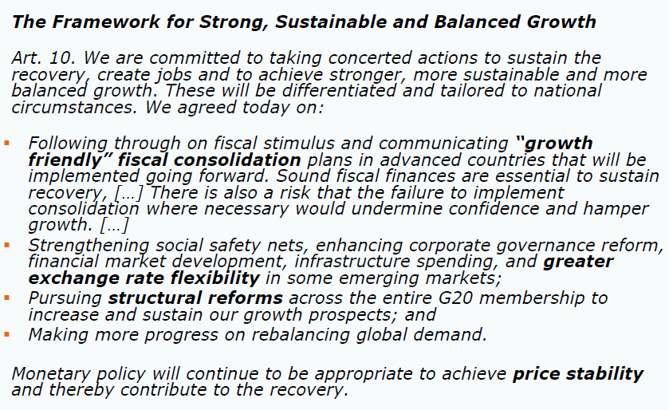
The G20 Toronto Declaration (June, 2010)-
Back to “business as usual”

Slide 4
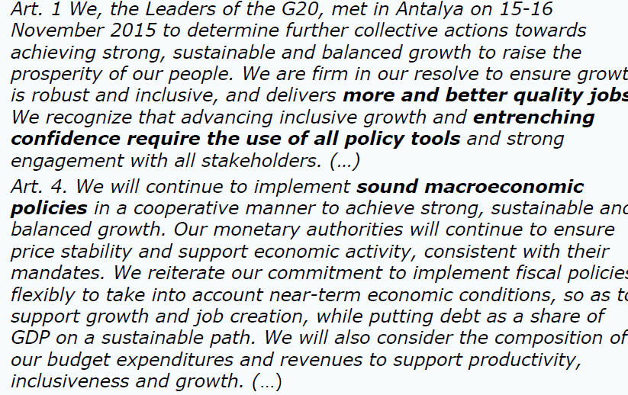
The G20 Leaders statement in Antalya (Nov., 2015) – A new view

Slide 5

Necessity of a new consensus on macro, meso and micro policies

Slide 6

Employment policy; main components
Supply
Skill Dev., Education
Demand
Macro-economic
Industry
Institutions
Laws & Regulations etc.

Slide 7
1. Demand side

Slide 8
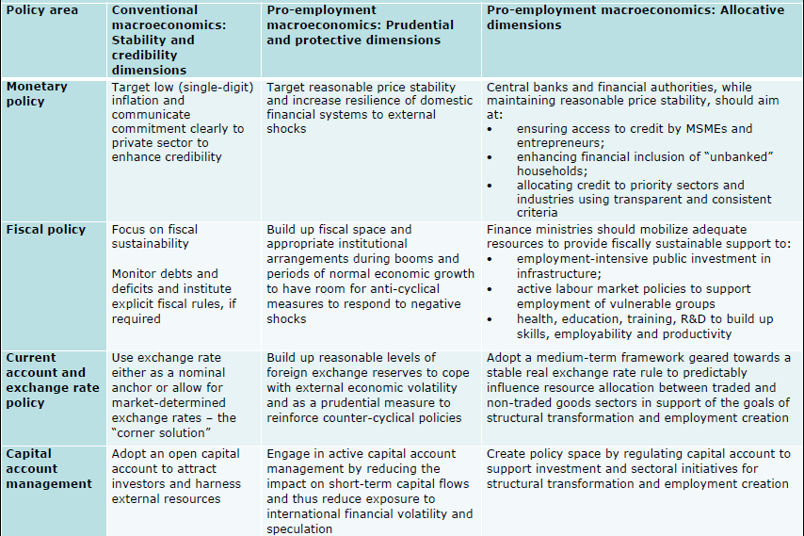
Key elements of a pro-employment macro framework

Slide 9
Sectoral drivers of employment
Consistent with traditional structuralist views, manufacturing is an important driver of productivity growth in many countries but generally a weak driver of employment growth
Services are an increasingly important driver of productivity growth in developing countries while remaining an important driver of employment growth
Multiple paths to favorable macroeconomic performance: China, S. Korea, Thailand driven more by manufacturing productivity growth, Hong Kong, Singapore, Taiwan and India driven more by services productivity growth

Slide 10
Industry or Service drive the growth and employment
The industry (manufacturing) sector is associated with more rapid growth in per capita incomes and employment only if it occurs alongside high export or investment shares, or both. (S. Korea, Thailand etc.)

Slide 11
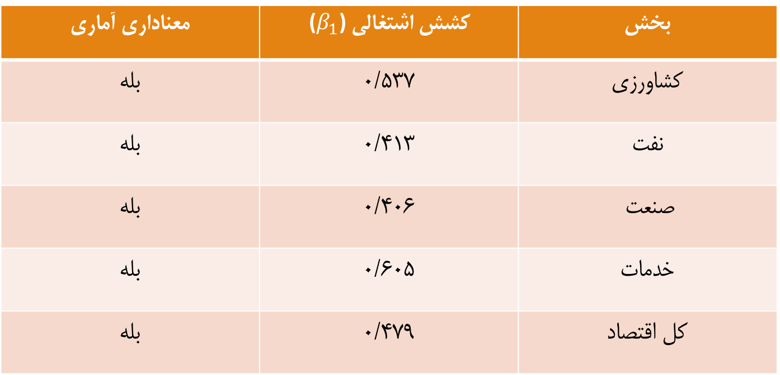
Employment elasticity of sectors in Iran (based on 40 years data)
 | Sector
0.351 | Agriculture
0.406 | Industry
0.605 | Services
0.479 | Aggregated
Elasticity

Slide 12
Industrial development policies in Iran
Global competition level
Policy framework
Selective
policies
Horizontal
policies
Functional policies
Institutional capacities

Slide 13
Douglass North’s idea on development of private sector in developing countries:
Doing Business criteria is the matter of privates sector development to some extent in developing countries,
But more important point is how much private small businesses can grow up to large companies.

Slide 14
Tools of Governance for private sector development in Iran
Interaction type
Tools
Contract with subcontractors
Contract with consultant Government- Private sector
Providing loan
Giving permissions
----------------------------------------------
Developmental interventions
Institution building
Capacity building Private sector-Private sector
Match-making
Specific sectoral
business enabling environment
Existing
to be formed

Slide 15
2. Supply side

Slide 16
Higher education systems
Public/centralized system
Liberal/neo-liberal system
Public-private partnership

Slide 17
Characteristics of Public/centralized system
Massification of programs/courses/contents
Delivering standard programs/courses/contents
Financed by the Government
Centralized in decision making
Less share of research in comparison to training
Less share of practical vs. theoretical

Slide 18
TVT approaches in a big perspective
Gov. plays the role of trainer
Both of Gov. & Private S. plays the role of trainer
Gov. role: Development &
Regulation
Private S.: Execution
High Efficiency Low
Training for changing demand
Private-led business development
Focus on existing businesses in private sector
- Focus on establishment/creating of new businesses
- State-led large scale company establishment
Continuous training
(school-work)
Before employment
training
2010 onward 2005-2010 1965-2005

Slide 19
Proposed policies
Short Run: increase coordination with the demand side
Medium Run: Tracing and anticipation
Long term: Improving the governance structure

Slide 20
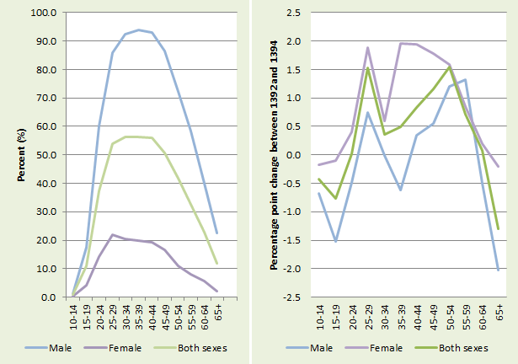
Labour Force Participation Rate in Iran

Slide 21
Reasons for decrease in participation rate
Family Issues
Education, skill training
Total
Female
Male

Slide 22
Institutions:
Labor law
Critical issue:
Employer-employee contract
as a marriage certificate

Slide 23
Thank you

