Slide 1
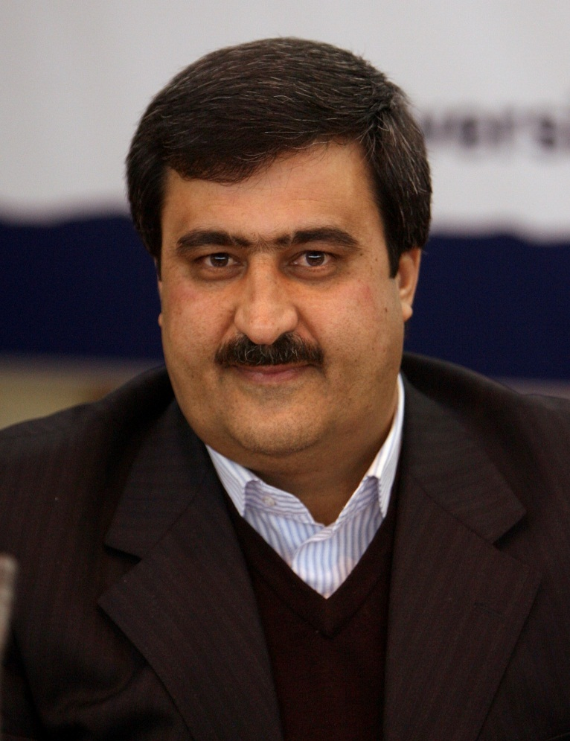
Mohammad Jalal Abbasi-Shavazi
Director of National Population Studies And Comprehensive Management Institute
Ph.D in Demography, Australian National University
Families and Households, Fertility, International Migration
Professor of Demography, University of Tehran
Visiting Fellow, Australian National University
President of Population Association of Iran
Laureate of the 2011 UN Population Award

Slide 2
Age-Structural Changes and Demographic Window in Iran:
Opportunities and Challenges
Mohammad Jalal Abbasi-Shavazi
Rasoul Sadeghi
Meimanat Hosseini Chavoshi
2-3 September 2017

Slide 3
OUTLINE
Introduction: Demographic Dividend
Demographic Transition in Iran
  Age structural change
  Demographic window in Iran
  Age-structural and educational composition
Is the demographic window seized?
Unemployment
Women’s employment
Brain Drain
Conclusions
M. J. Abbasi-Shavazi, R. Sadeghi, M. Hosseini Chavoshi

Slide 4
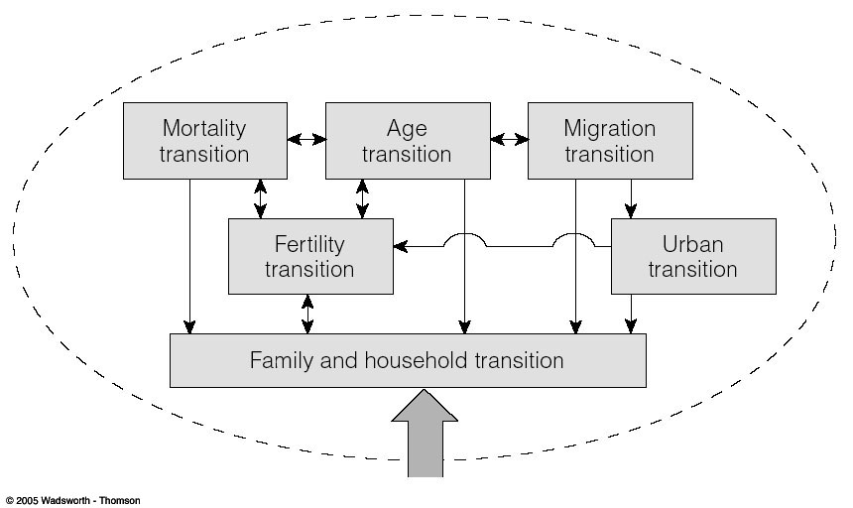
DEMOGRAPHIC TRANSITIONS ARE COMPLEX AND INTERRELATED
Weeks, 2012
Impact on Society
M. J. Abbasi-Shavazi, R. Sadeghi, M. Hosseini Chavoshi

Slide 5
First Demographic Dividend
At an early stage of [demographic] transition, fertility rates fall, leading to fewer young mouths to feed. During this period, the labor force temporarily grows more rapidly than the population dependent on it, freeing up resources for investment in economic development and family welfare.
The “first demographic dividend” is transitory because, eventually, the population of working age ceases to increase.
-- Lee and Mason (2006)
M. J. Abbasi-Shavazi, R. Sadeghi, M. Hosseini Chavoshi

Slide 6
Second Demographic Dividend
A second dividend is also possible. A population concentrated at older working ages and facing an extended period of retirement has a powerful incentive to accumulate assets—unless it is confident that its needs will be provided for by families or governments.
-- Lee and Mason (2006)
M. J. Abbasi-Shavazi, R. Sadeghi, M. Hosseini Chavoshi

Slide 7
Demographic dividend or education dividend?
The beneficial effect of change in age structure after a decrease fertility has become known as demographic dividend. Yet, the possibility of the effect owing to educational change rather than age structure change is under question.
Recent studies by Lutz et all (2013) has shown that “educational attainment expansions are able to account for the sizable productivity effects that other writers had assumed to be caused by age-structure changes”. Thus, improvements in education, rather than fertility declines, are the main driver of subsequent economic growth.
These results call into question the notion of a demographic window opening and closing (Lutz, 2014: 530).
M. J. Abbasi-Shavazi, R. Sadeghi, M. Hosseini Chavoshi
Source: Lutz (2014: 30)

Slide 8
What Do We Know About Demographic Transition in Iran?
M. J. Abbasi-Shavazi, R. Sadeghi, M. Hosseini Chavoshi

Slide 9
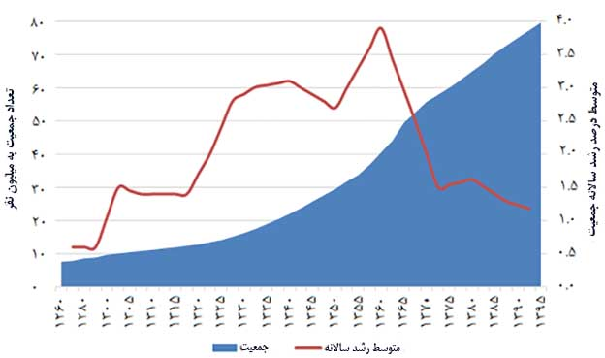
‎Trend of population number and growth rate in Iran, 1880-2011
M. J. Abbasi-Shavazi, R. Sadeghi, M. Hosseini Chavoshi

Slide 10
Total Fertility Trends by rural and urban areas in Iran, 1972-2011
M. J. Abbasi-Shavazi, R. Sadeghi, M. Hosseini Chavoshi
Ref: Abbasi-Shavazi and Hosseini-Chavoshi, 2014

Slide 11
Age-Specific Fertility Trends in Iran, 1972-2011
M. J. Abbasi-Shavazi, R. Sadeghi, M. Hosseini Chavoshi
Source: Abbasi-Shavazi, Hosseini-Chavoshi, Banihashemi, and Khosravi (2013).

Slide 12
Female Singulate mean age at marriage (SMAM) and age specific percentages married, 1976-2006, Iran
Year | SMAM | Married%
 |  | 15-19 | 20-24 | 25-29
1976 | 19.7 | 34.3 | 78.6 | 93.2
1986 | 19.8 | 33.5 | 79.6 | 90.6
1996 | 22.4 | 18.6 | 60.7 | 85.2
2006 | 23.3 | 16.9 | 50.3 | 75.9
2011 | 23.4 | 21.4 | 52.9 | 73.8
M. J. Abbasi-Shavazi, R. Sadeghi, M. Hosseini Chavoshi

Slide 13
Fertility and Mortality Trends
M. J. Abbasi-Shavazi, R. Sadeghi, M. Hosseini Chavoshi

Slide 14
Population and Age Structural Transition in Iran
M. J. Abbasi-Shavazi, R. Sadeghi, M. Hosseini Chavoshi

Slide 15
Iran’s age structure, 1986
M. J. Abbasi-Shavazi, R. Sadeghi, M. Hosseini Chavoshi
M. J. Abbasi-Shavazi, R. Sadeghi, M. Hosseini Chavoshi

Slide 16
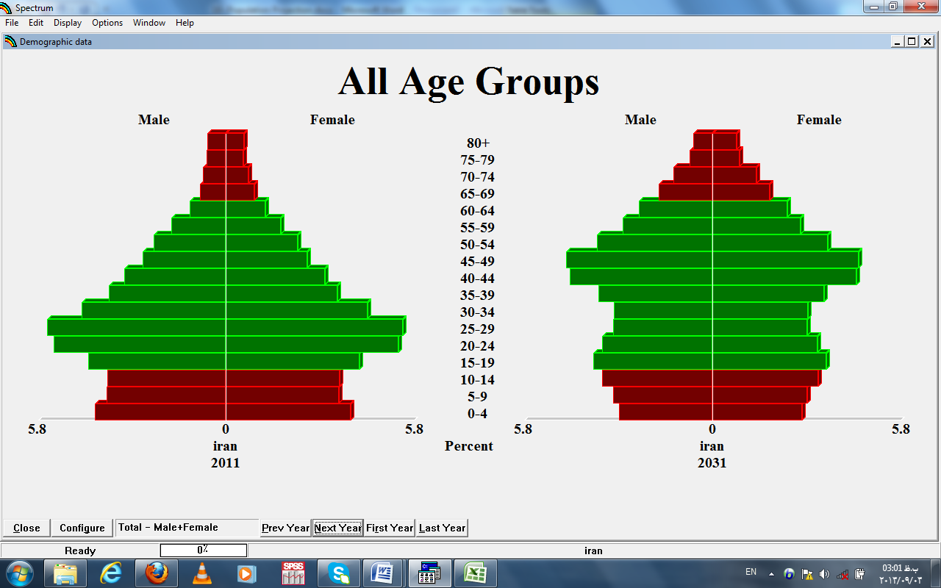
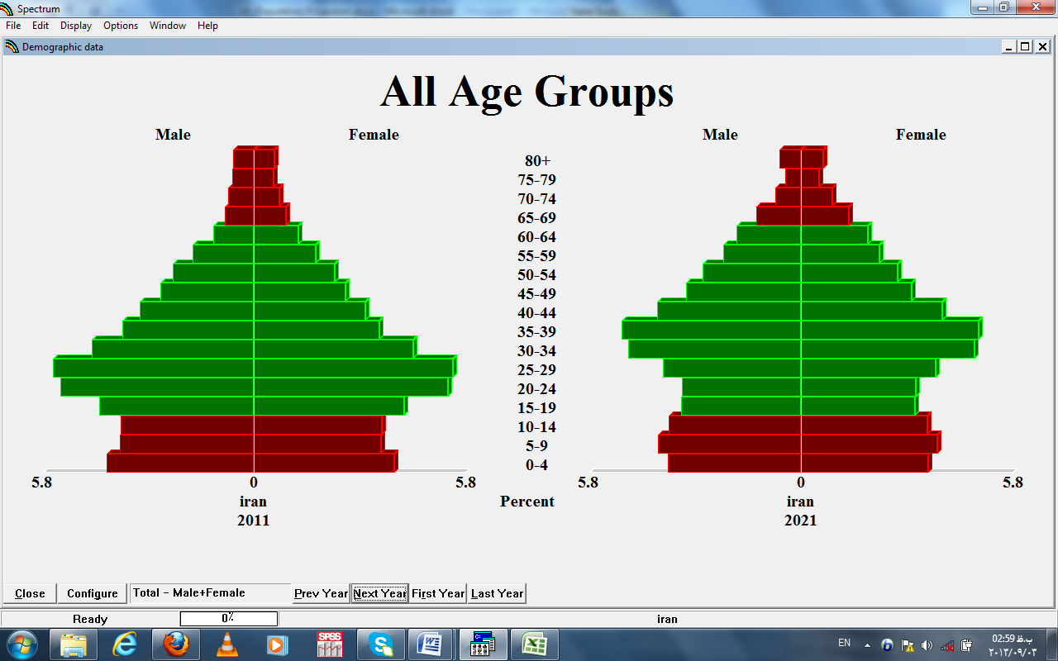
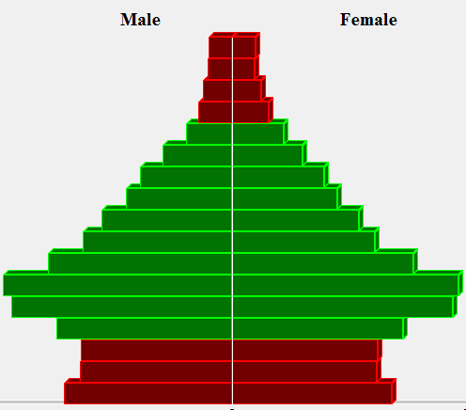
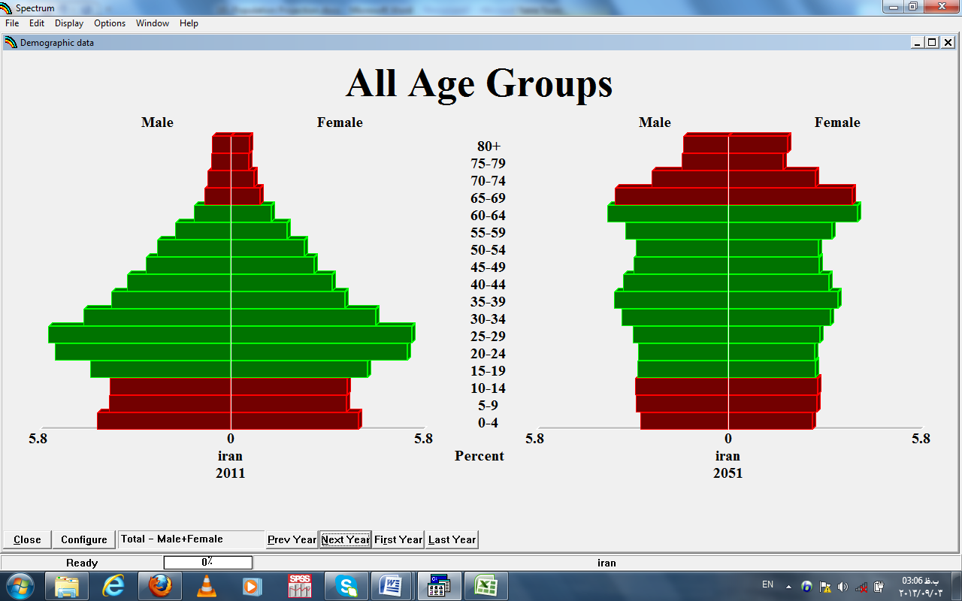
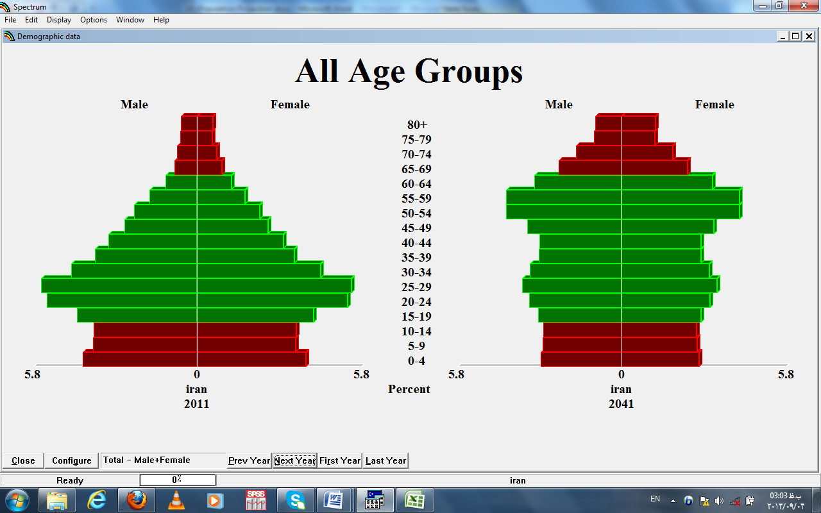
IRAN’S AGE TRANSITIONS, 2011-2051

Slide 17
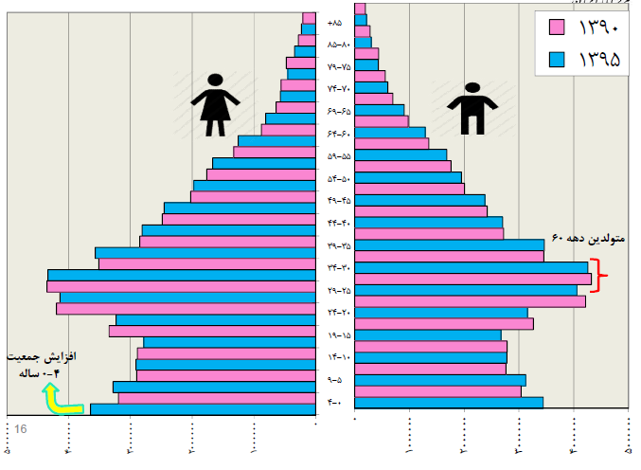
Iran’s age pyramid, 2016
M. J. Abbasi-Shavazi, R. Sadeghi, M. Hosseini Chavoshi

Slide 18
Iran’s age transitions, 2011-2051
Window of Opportunity
M. J. Abbasi-Shavazi, R. Sadeghi, M. Hosseini Chavoshi

Slide 19
Child and Old Dependency Ratios, 1950-2100
M. J. Abbasi-Shavazi, R. Sadeghi, M. Hosseini Chavoshi

Slide 20
Demographic Window of Opportunity, Opening and Closing Time
M. J. Abbasi-Shavazi, R. Sadeghi, M. Hosseini Chavoshi

Slide 21
Per capita Labor Income and total Consumption, Age Profile, Iran, 2012
M. J. Abbasi-Shavazi, R. Sadeghi, M. Hosseini Chavoshi

Slide 22
Working age population
Mean years of schooling
Human Capital
M. J. Abbasi-Shavazi, R. Sadeghi, M. Hosseini Chavoshi

Slide 23
Increased education and human capital dynamics in Iran
M. J. Abbasi-Shavazi, R. Sadeghi, M. Hosseini Chavoshi

Slide 24
Increased mean years of schooling in Iran, 1970-2030
M. J. Abbasi-Shavazi, R. Sadeghi, M. Hosseini Chavoshi

Slide 25
Internet users (per 100 people) Muslim-majority countries 1990-2015
M. J. Abbasi-Shavazi, R. Sadeghi, M. Hosseini Chavoshi

Slide 26
Low Female Labour Force Participation in Iran, 2006-2016
M. J. Abbasi-Shavazi, R. Sadeghi, M. Hosseini Chavoshi

Slide 27
Unemployment among youth in Iran, 2006-2016
M. J. Abbasi-Shavazi, R. Sadeghi, M. Hosseini Chavoshi

Slide 28
Unemployment by Education, 2011
M. J. Abbasi-Shavazi, R. Sadeghi, M. Hosseini Chavoshi

Slide 29
Population and Employment (Shaded) Age Pyramid, Iran, 2011
M. J. Abbasi-Shavazi, R. Sadeghi, M. Hosseini Chavoshi

Slide 30
Human Capital Waste
High Unemployment
And Low FLFP
Low GDP
Human capital waste
Youth migration and Brain Drain
M. J. Abbasi-Shavazi, R. Sadeghi, M. Hosseini Chavoshi

Slide 31
Experiences in reaping DD in other countries: Demographic Miracle to Demographic Waste
Demographic Miracle in South East Asia
  31 % of GDP due to DD (Bloom and Williamson 1998) Impact of demographic window on high economic growth in Japan (Ogawa 2005).
Economic waste
  High unemployment and ow economic growth during demographic winder (Bloom et al. 2001).
Note: experiencing demographic dividend does not automatically lead to economic growth, and it depends upon the institutional and political context, designing and implementing relevant polices to read the dividend.
M. J. Abbasi-Shavazi, R. Sadeghi, M. Hosseini Chavoshi

Slide 32
List of countries and territories by Iranian population
Country | Iranian-born | Residents of Iranian ancestry
United States | 283,225 (2000) | 448,722 (2010 US Census) to around 1-2 million (2014, USA Government and other sources)
Turkey |  | ~500,000 (2010)
Qatar | 27000
UAE |  | 400,000-500,000 (2008)
Canada | 95,420 (2006) | 163,290 (2011)
Germany | 100,000 - 120,000 (2003)
Kuwait | 80,000 (2003)
Malaysia | 100000
Sweden | 53,892 (2000) | 92,428 (2011)
Japan | 12,000 (2000) | 7,000 (2000)
M. J. Abbasi-Shavazi, R. Sadeghi, M. Hosseini Chavoshi

Slide 33
List of countries and territories by Iranian population
Country | Iranian-born | Residents of Iranian ancestry
Russia | 50,000 (2002)
Bahrain | 173,000 (2014)
Israel | 47,800 (2007) | 135,000 (2007)
United Kingdom | 83,000 (2011)
Netherlands | 35,561 (2014)
Australia | 34,455 (2011) | 36,168 (2011)
France | 18,376 (2000)
Denmark |  | 8,977 (1991)
Italy |  | 7,444 (2010)
Austria | 16,203 (1.1.2015) | 17,000-20,000 (2013)
Switzerland |  | 4,044 (2000)
Norway |  | 17,913 (2012)
New Zealand |  | 2,895 (2006)
Spain |  | 12,344 (2011)
Portugal |  | 339 (2011)
M. J. Abbasi-Shavazi, R. Sadeghi, M. Hosseini Chavoshi

Slide 34
Iranian migrants in Australia by year of Arrival and sex
The 2011 Australia Census
M. J. Abbasi-Shavazi, R. Sadeghi, M. Hosseini Chavoshi

Slide 35
Age structure of Iranian migrants in Australia
The 2011 Australia Census
M. J. Abbasi-Shavazi, R. Sadeghi, M. Hosseini Chavoshi

Slide 36
Iranian migrants in Australia by highest level of education
(% among those stated their education level)
The 2011 Australia Census
Age | No tertiary education | Tertiary education: Certificate/ Graduate diploma | Tertiary education: Bachelor, Master, PhD | Total
20-24 | 56.1 | 9.6 | 34.3 | 100.0
25-29 | 22.5 | 7.5 | 70.0 | 100.0
30-34 | 15.0 | 6.0 | 78.9 | 100.0
35-39 | 18.3 | 7.6 | 74.1 | 100.0
40-44 | 26.0 | 12.1 | 61.9 | 100.0
45-49 | 31.1 | 17.2 | 51.7 | 100.0
50-54 | 34.0 | 16.0 | 50.0 | 100.0
55-59 | 32.6 | 11.0 | 56.4 | 100.0
60-64 | 37.3 | 9.1 | 53.5 | 100.0
65+ | 57.6 | 5.4 | 37.1 | 100.0
M. J. Abbasi-Shavazi, R. Sadeghi, M. Hosseini Chavoshi

Slide 37
Iranian migrants 20 years or more in Australia by having tertiary education and the field of qualification (% among those stated their education level)
The 2011 Australia Census
M. J. Abbasi-Shavazi, R. Sadeghi, M. Hosseini Chavoshi

Slide 38
TAKE-HOME MESSAGES
Demography matters for the pace of economic development
There is potentially a significant demographic dividend (DD) in Iran’s future
Need for estimating the potential size and impact of Iran’s demographic dividend
Lack of data, low data quality, and lack of access to data for measuring DD is a challenge
M. J. Abbasi-Shavazi, R. Sadeghi, M. Hosseini Chavoshi

Slide 39
TAKE-HOME MESSAGES
Reaping the DD requires:
  High employment
  Women’s involvement in labour market
  Productivity
  Long term, flexible, coordinated plan and ACTION
M. J. Abbasi-Shavazi, R. Sadeghi, M. Hosseini Chavoshi

